Slide 1

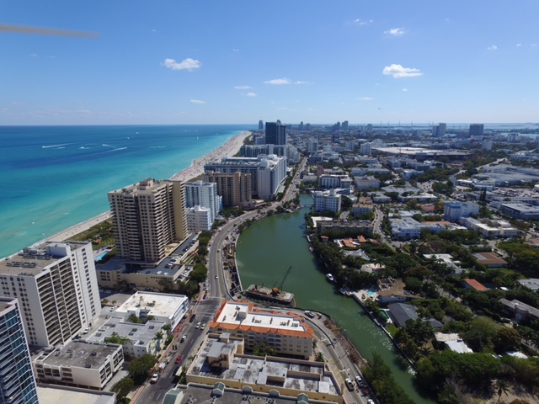

Indian Creek Drive Flooding Mitigation Project Phase 3
Wednesday, November 13, 2019
Notes:
Heather will welcome the group and introduce elected officials.

Slide 2
Presented by:
Maher Maaliki, P.E. Consultant Project Manager Ribbeck Engineering, Inc.
Mauricio Arze, P.E. Senior Project Engineer WSP USA Inc.
Mina Samadi, P.E. City of Miami Beach Senior Capital Projects Coordinator Office of Capital Improvement Projects
Michael Fischer RIC-MAN Construction Florida, Inc. Chief Operating Officer Contractor
Notes:
Heather will introduce team members

Slide 3
Presentation Outline
1
Where We Are Now
2
Why is this Project Needed/Overview
3
Project Phasing
4
What to Expect During Construction
5
Questions/Comments
Notes:
HL will describe format and hand off to Mina

Slide 4
Where We Are Now
1
Notes:
Mina

Slide 5
Where We Are Now
Ongoing Activities
Contractor issued Notice to Proceed (NTP)
Reviewing corridor and existing field conditions
Setting up field trailer and bringing equipment to site
Performing preliminary survey work
Verifying location and elevation of utilities (this may require lane closures if a utility is in a travel lane)
Cleaning areas near pump station at 32 Street
Working with city and agencies to obtain all necessary permits
Preparing construction work plans and drawings
Continue to meet with property representatives to review project impacts and execute License Agreements
Reach out to your property manager or HOA board for more information
Deadline to submit executed agreement: November 30, 2019
Notes:
Mina

Slide 6
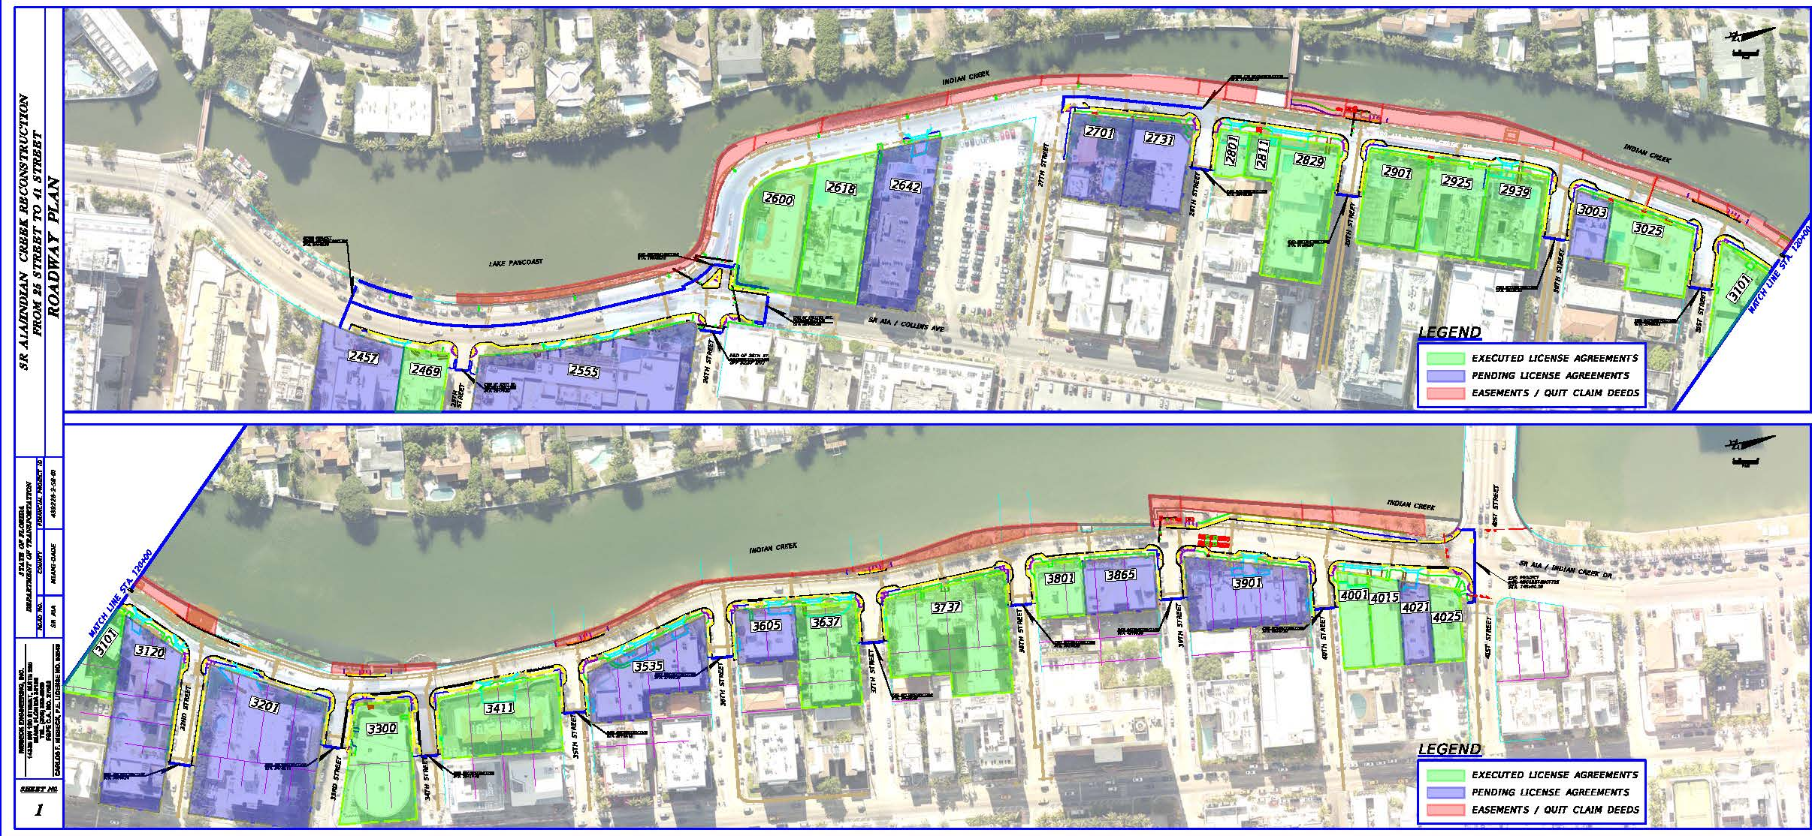
Executed License Agreements
Notes:
Mike
Highlight the numbers of properties and the ones who haven’t submitted.

Slide 7
Project Overview
Improvements
Continuing stormwater drainage improvements on Indian Creek Drive and side streets, including completing the stormwater pump station at 32 Street
Final restoration of the roadway and sidewalk on Collins Avenue between 25 Street and 26 Street
Rebuilding and raising the roadway with ADA-compliant sidewalks on Indian Creek Drive between 26 Street and 41Street
Installing new signage and pavement markings
Installing new street lighting
Installing new traffic signals at 26, 29 and 39 streets
Harmonization: connecting the new roadway elevation to existing properties
Access to properties will be maintained unless coordinated in advance.
As the work progresses, sections of on-street parking will be temporarily unavailable.
Notes:
Mina

Slide 8
Why is this Project Needed/Overview
2
Notes:
Mina

Slide 9
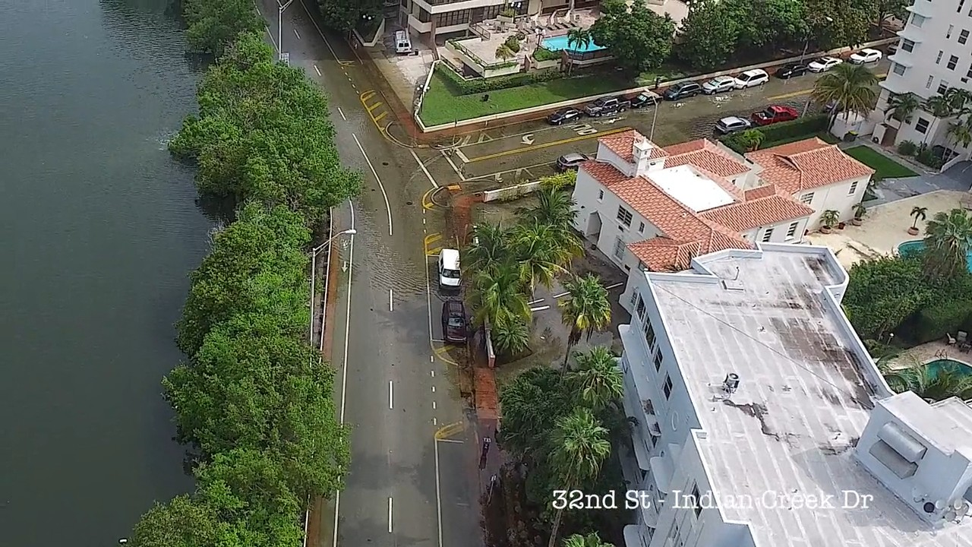
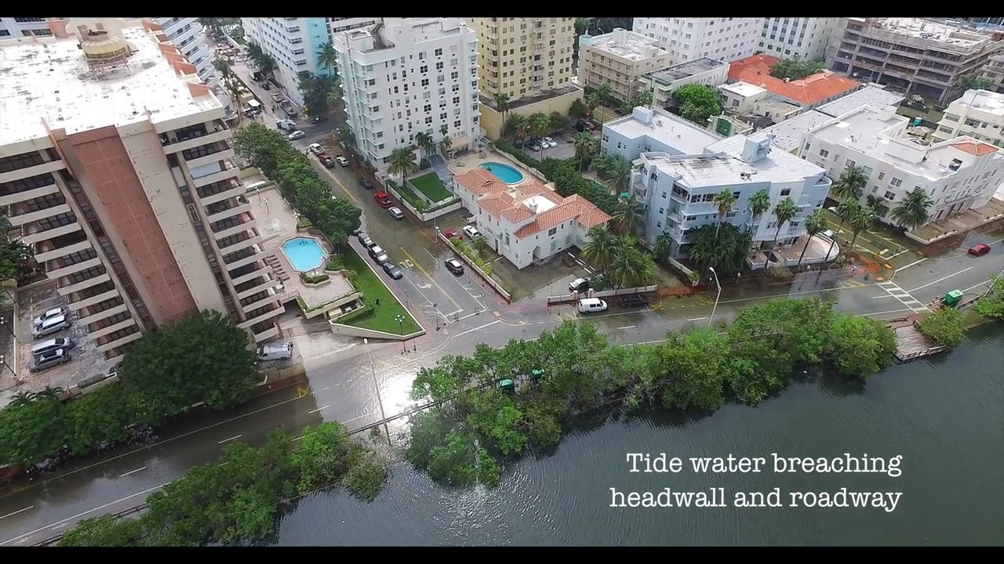
Project Need/Overview
Pre-Construction Conditions: 2015
Indian Creek Drive
at 32 Street
Notes:
Mina
Move under caption

Slide 10
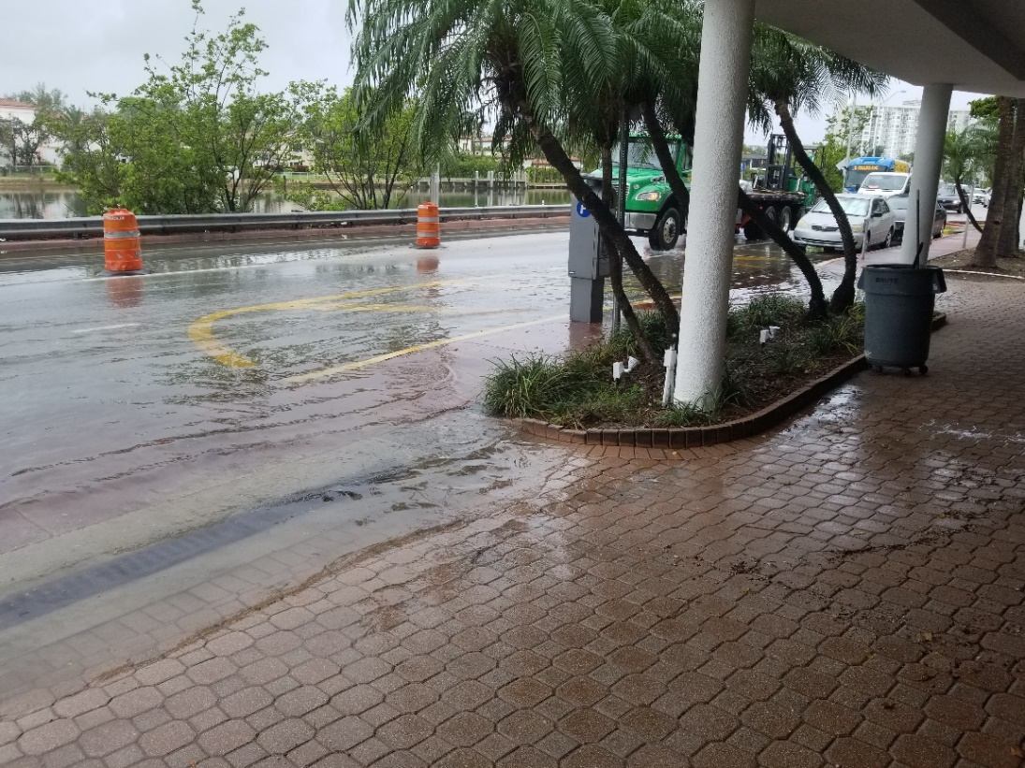
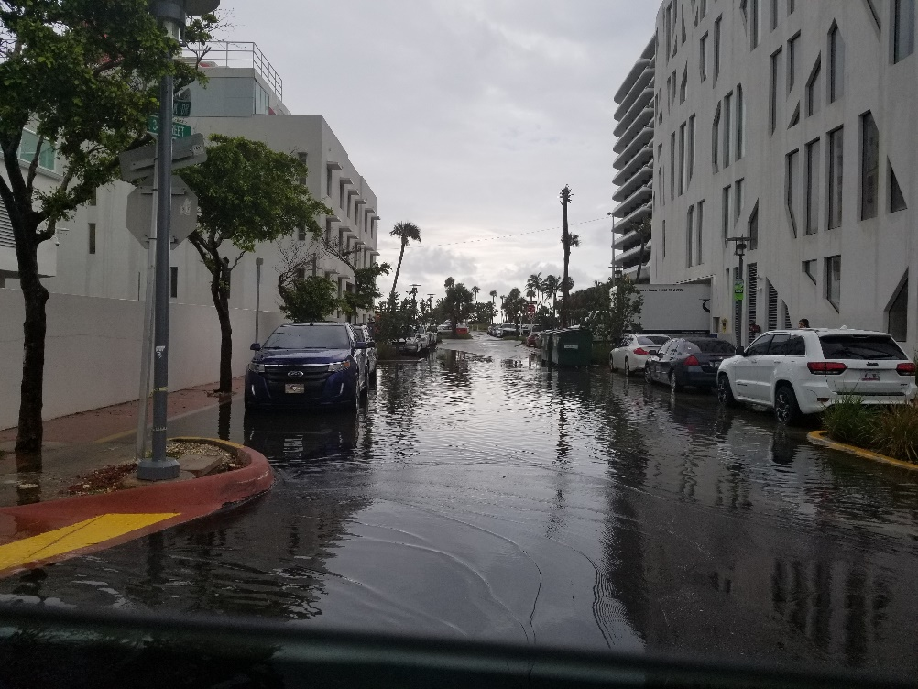
Project Need/Overview
Pre-Construction Conditions: May 2018
Notes:
Mina

Slide 11
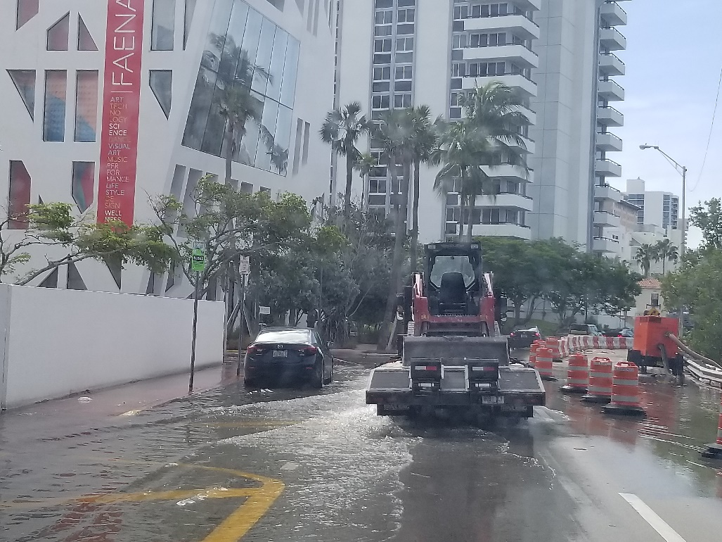
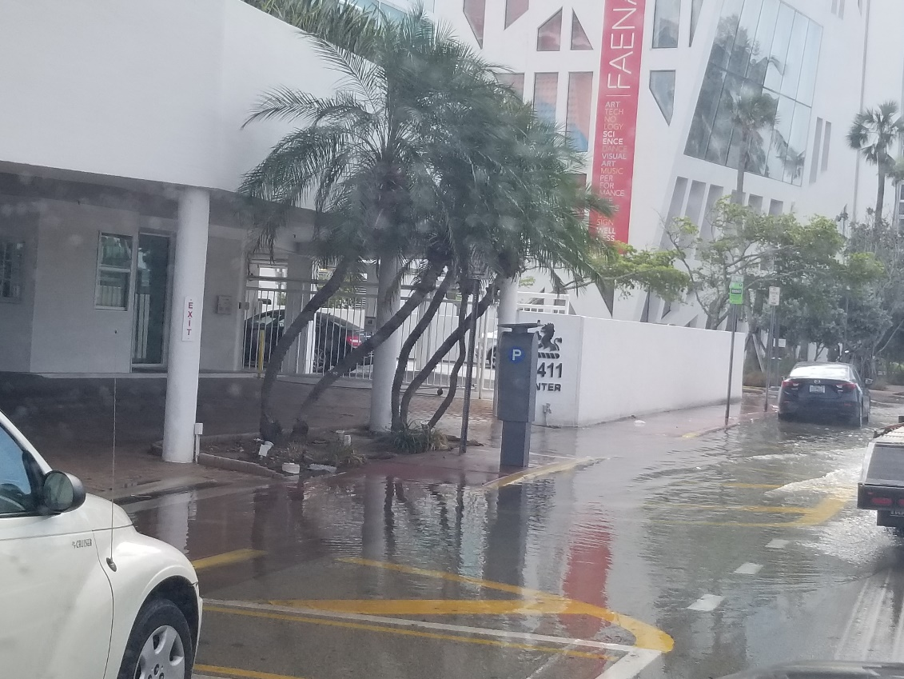
Project Need/Overview
Pre-Construction Conditions: November 2019
Notes:
Mina

Slide 12
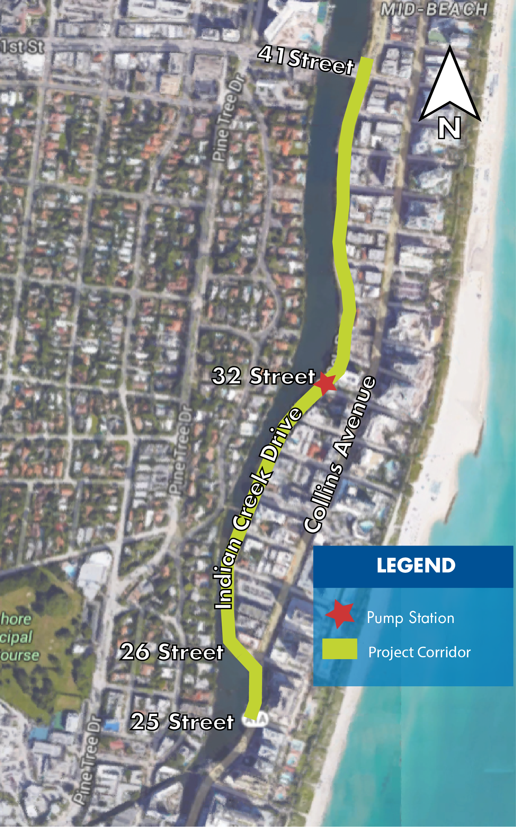
Project Overview
Limits
Indian Creek Drive between 26 Street and 41 Street
Collins Avenue between 25 Street and 26 Street
Project Schedule
Preliminary work started October 11
Full construction will not begin until all permits are obtained
Anticipated project duration once full construction starts: 19 months
Notes:
Mina

Slide 13
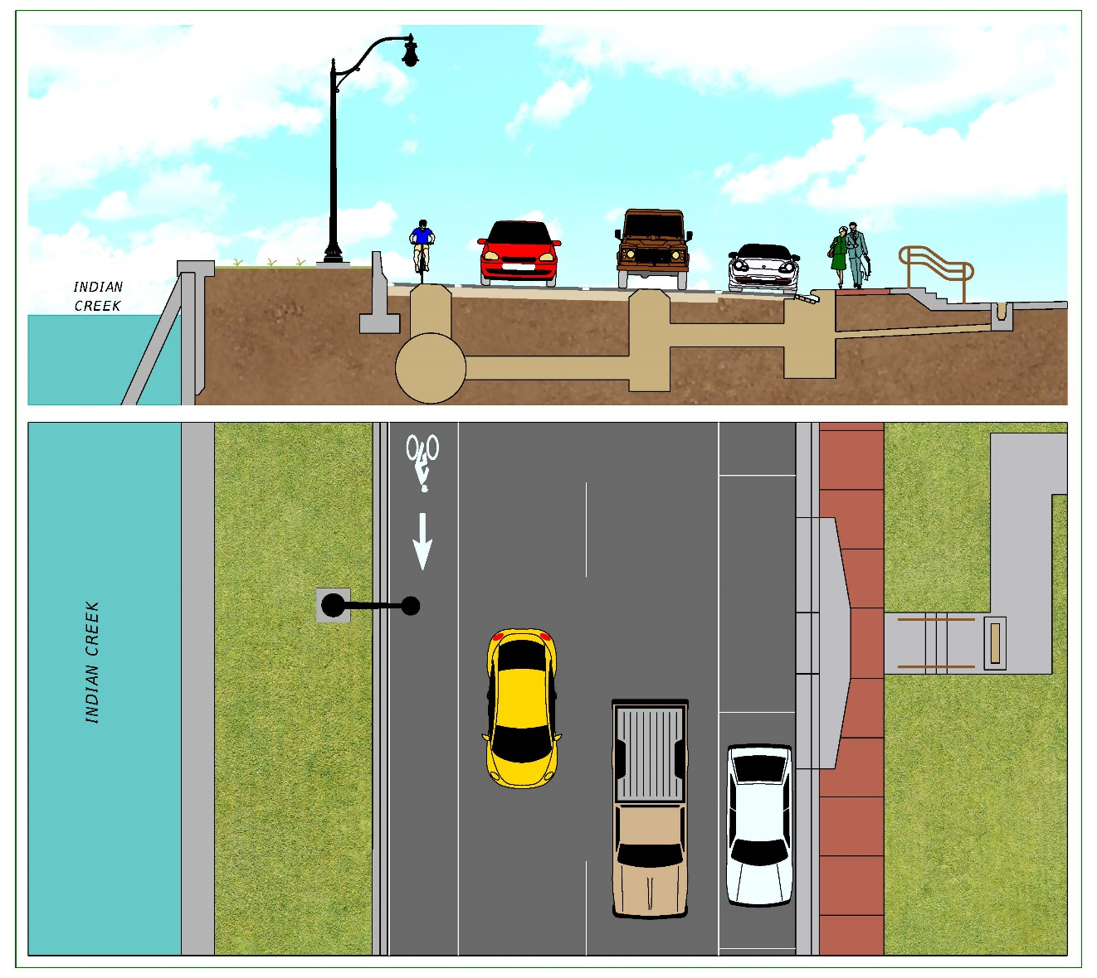
Typical Infrastructure Layout
Notes:
Mina

Slide 14
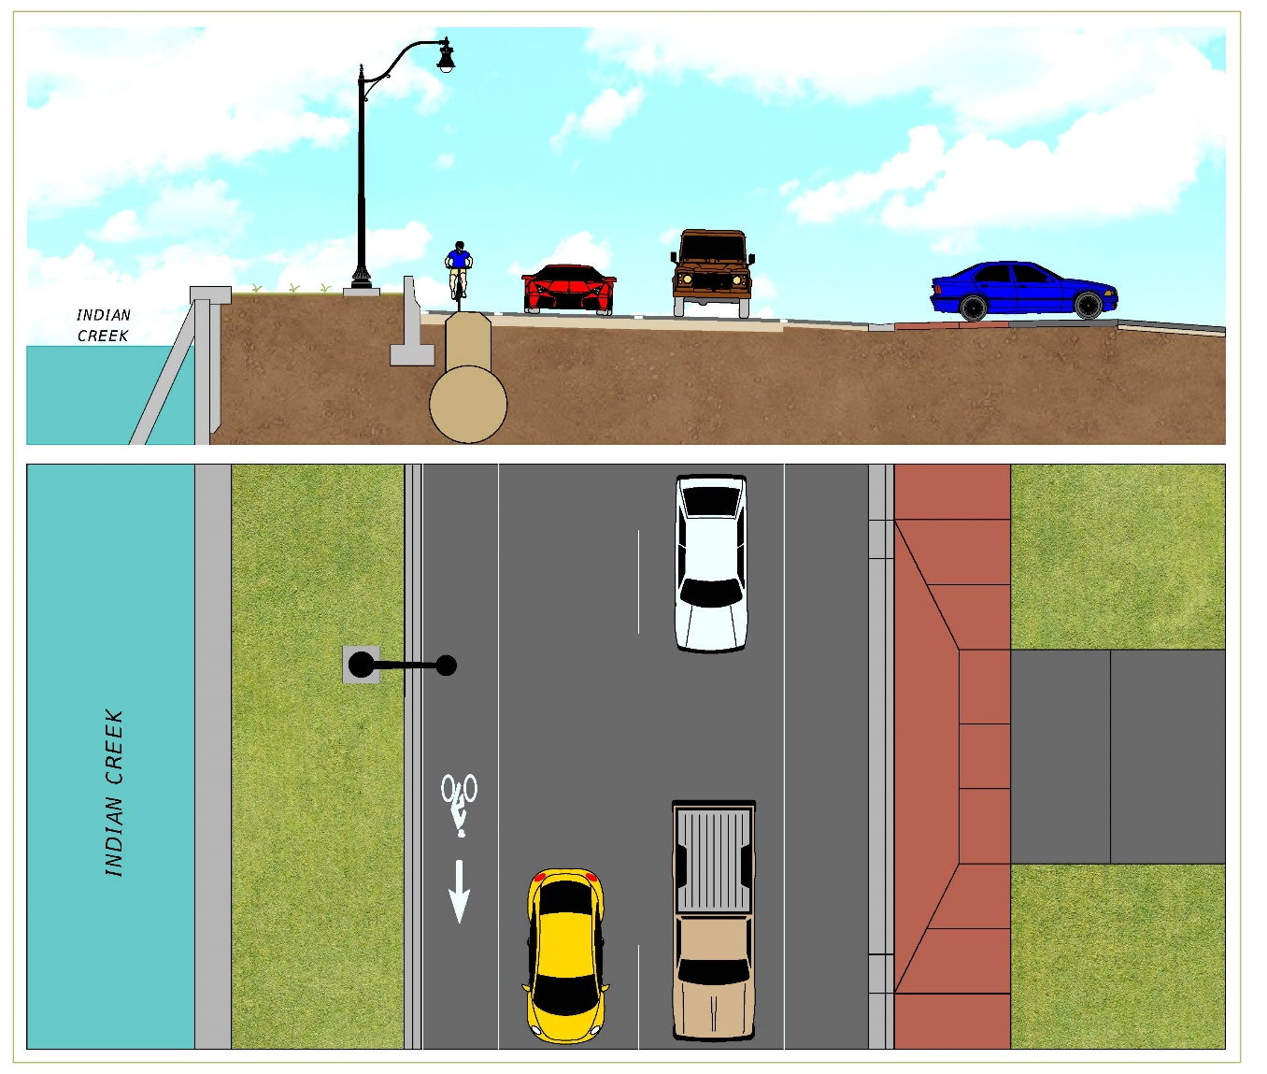
Typical Infrastructure Layout
Notes:
Mina

Slide 15
Project Phasing
3
Notes:
Mina handoff to Mike

Slide 16
Project Phasing
How Does it Work?
Divided into two main phases
Each phase is divided into smaller sections
10 work zones, approximately 500 feet long
Contractor works in one section at a time to complete as much work as possible before moving onto next section
All underground utility work, drainage, sidewalks, road reconstruction, first layer of asphalt, signage, signals, lighting and harmonizations will be complete
Final layer of asphalt and pavement markings will be placed all at once toward the end of the project to ensure uniformity and consistent appearance
Notes:
Mike

Slide 17
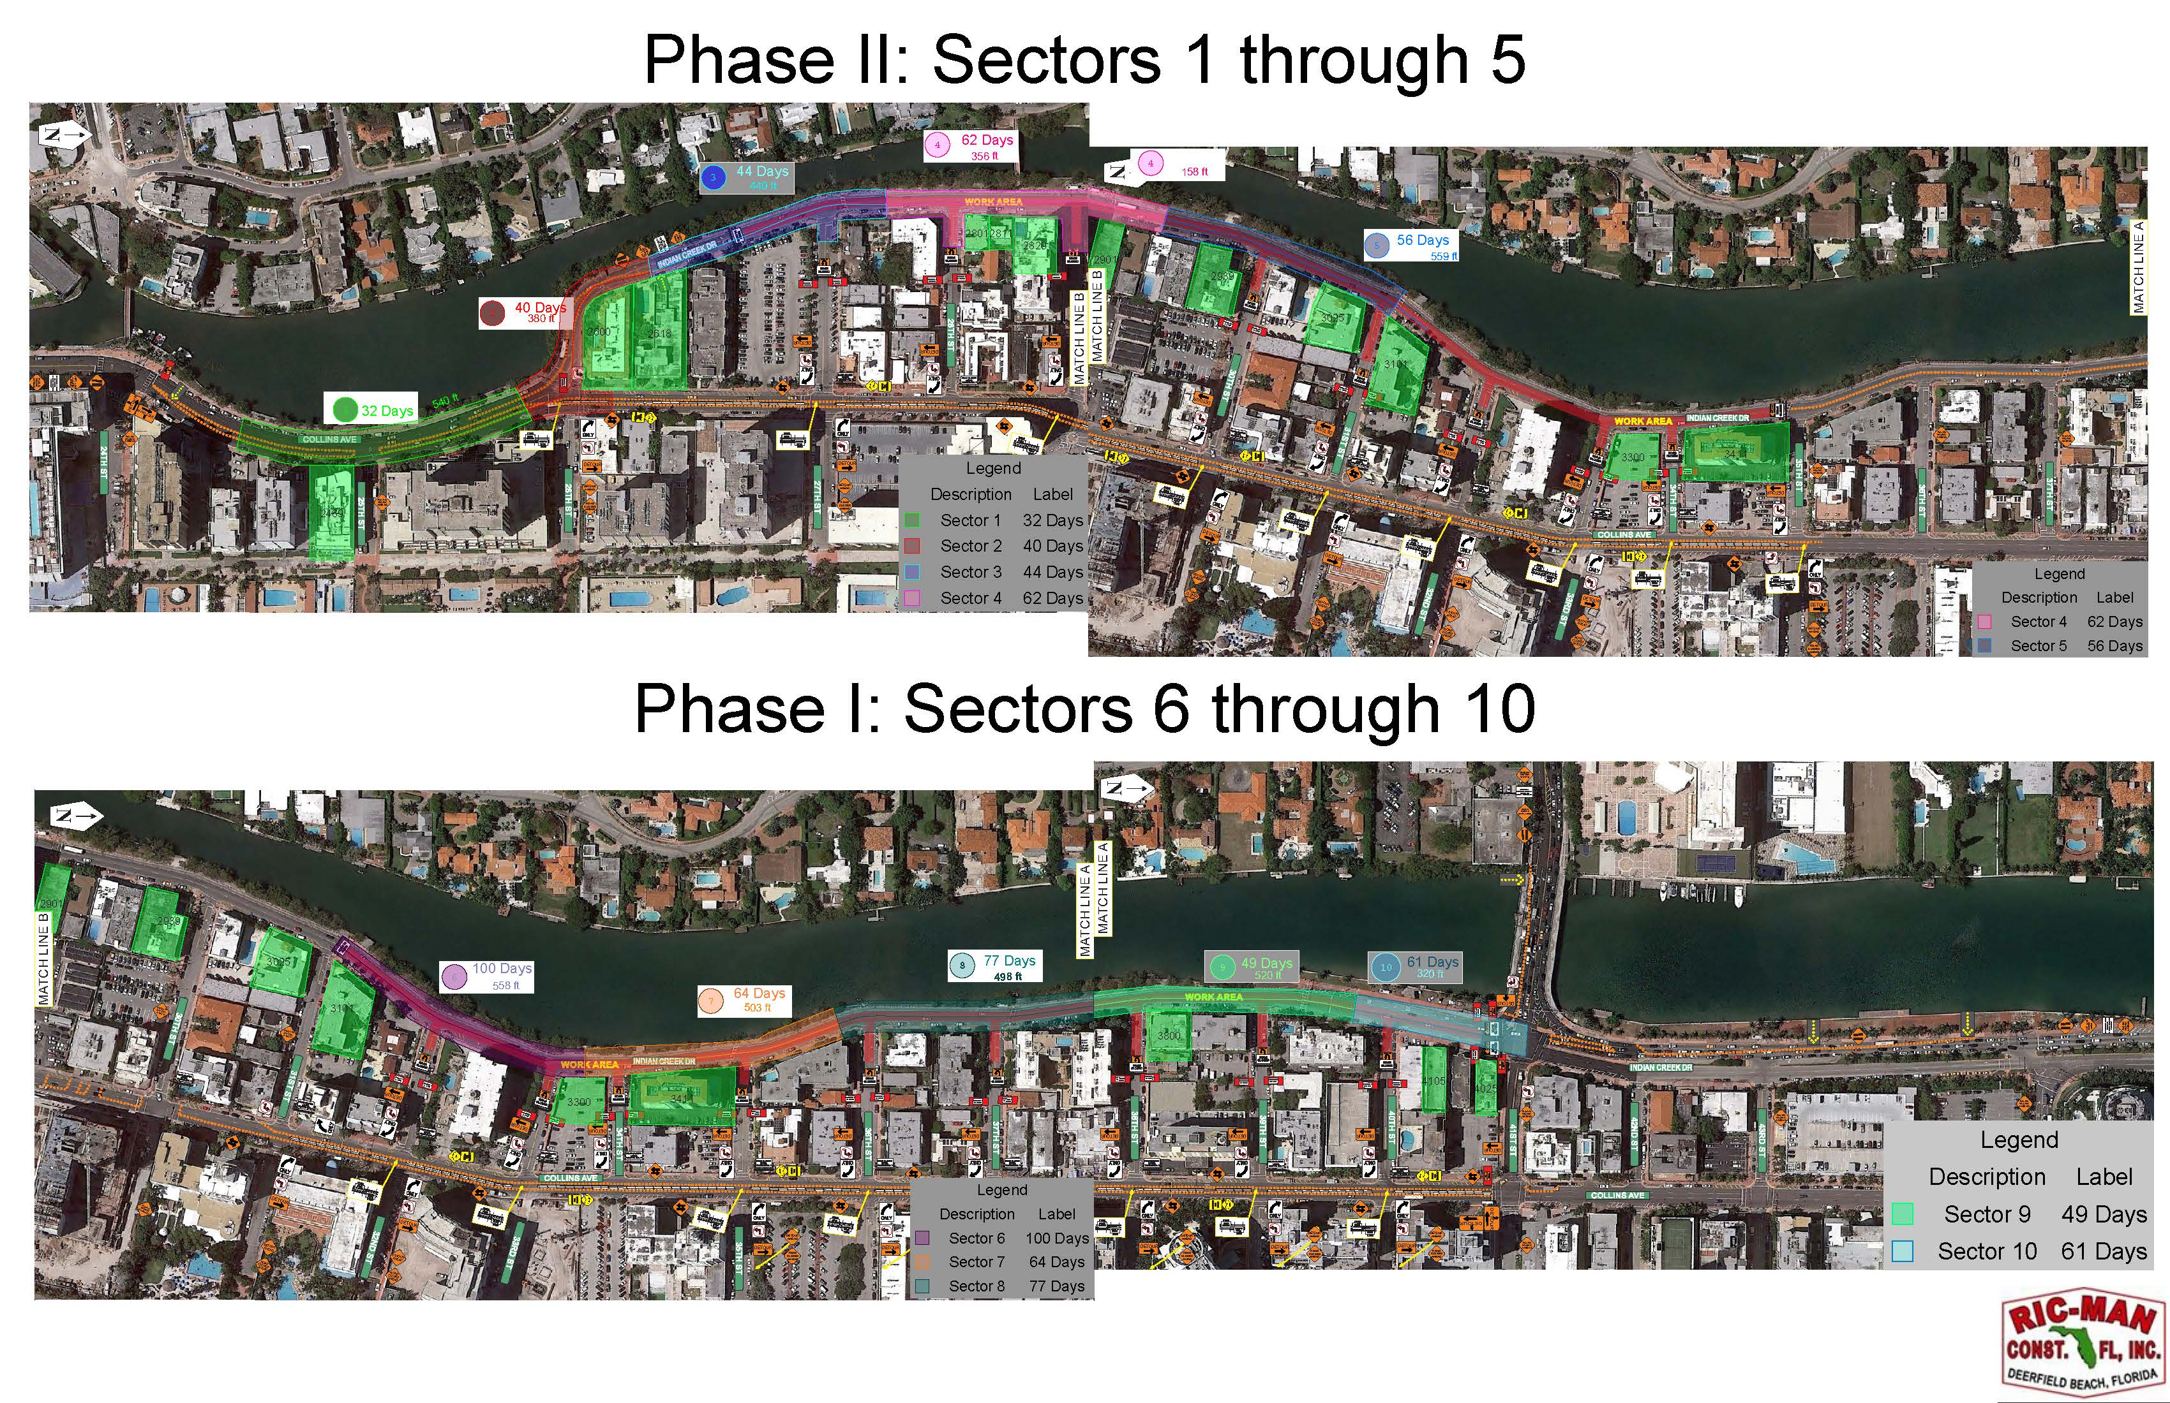
Project Phasing
Notes:
Mike

Slide 18
Project Phasing
Anticipated project timeline
Phase I
Beginning in Section 6 working to Section 10
From 31 Street to 41 Street
Working south to north
Overall expected timeframe in this area: 11.5 months
Phase II
Work in Section 1 to Section 5
From 25 Street to 31 Street
Working south to north
Overall expected timeframe in this area: 7.5 months
Please note this schedule may change due to weather or other unforeseen conditions.
Notes:
Mike

Slide 19
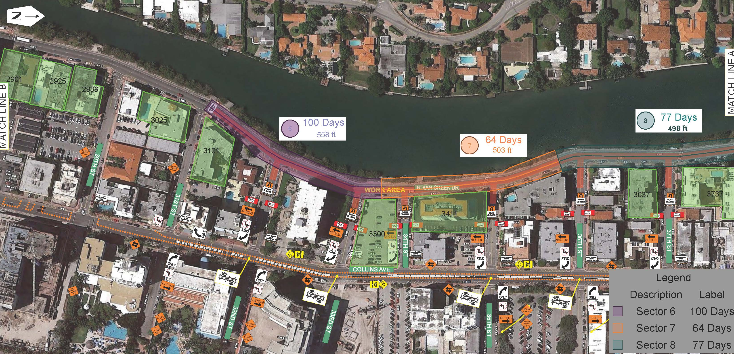
Phase I: Sector’s 6 through 8
Notes:
Mike

Slide 20
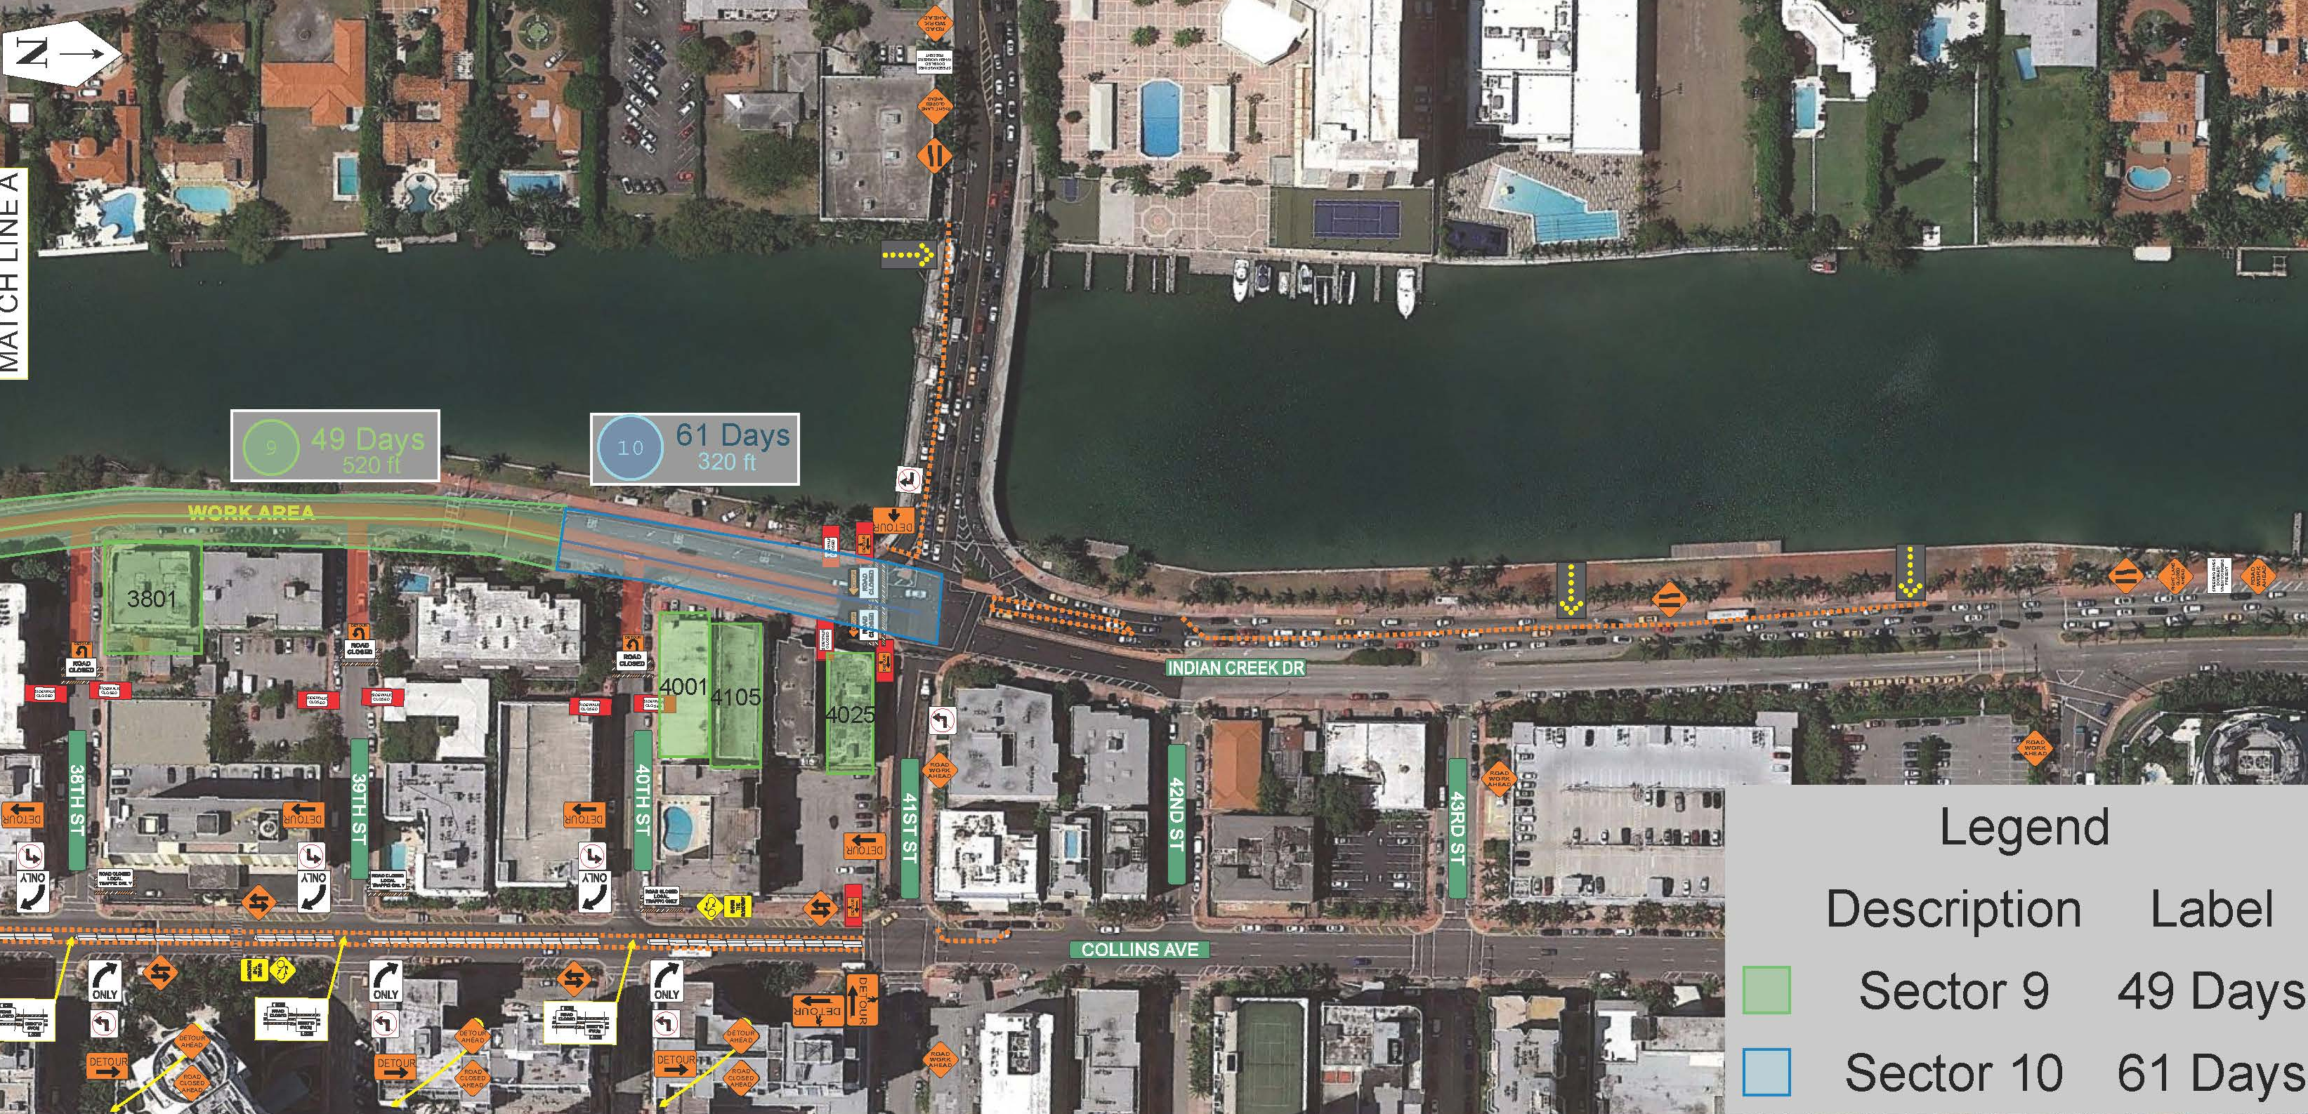
Phase I: Sector’s 9 and 10
Notes:
Mike

Slide 21
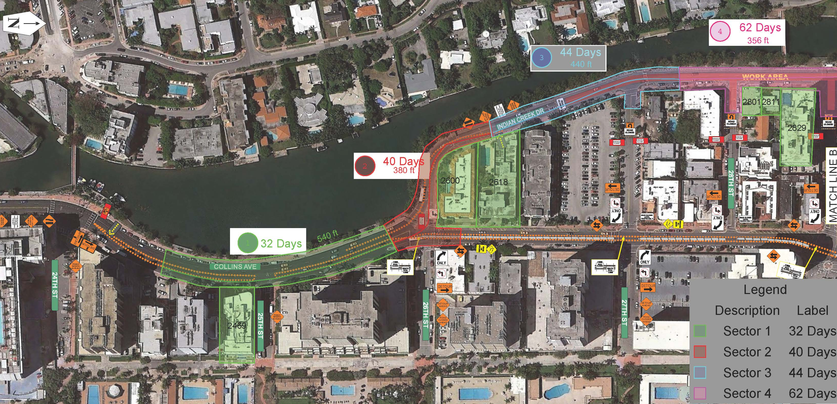
Phase II: Sector’s 1 through 4
Notes:
Mike

Slide 22
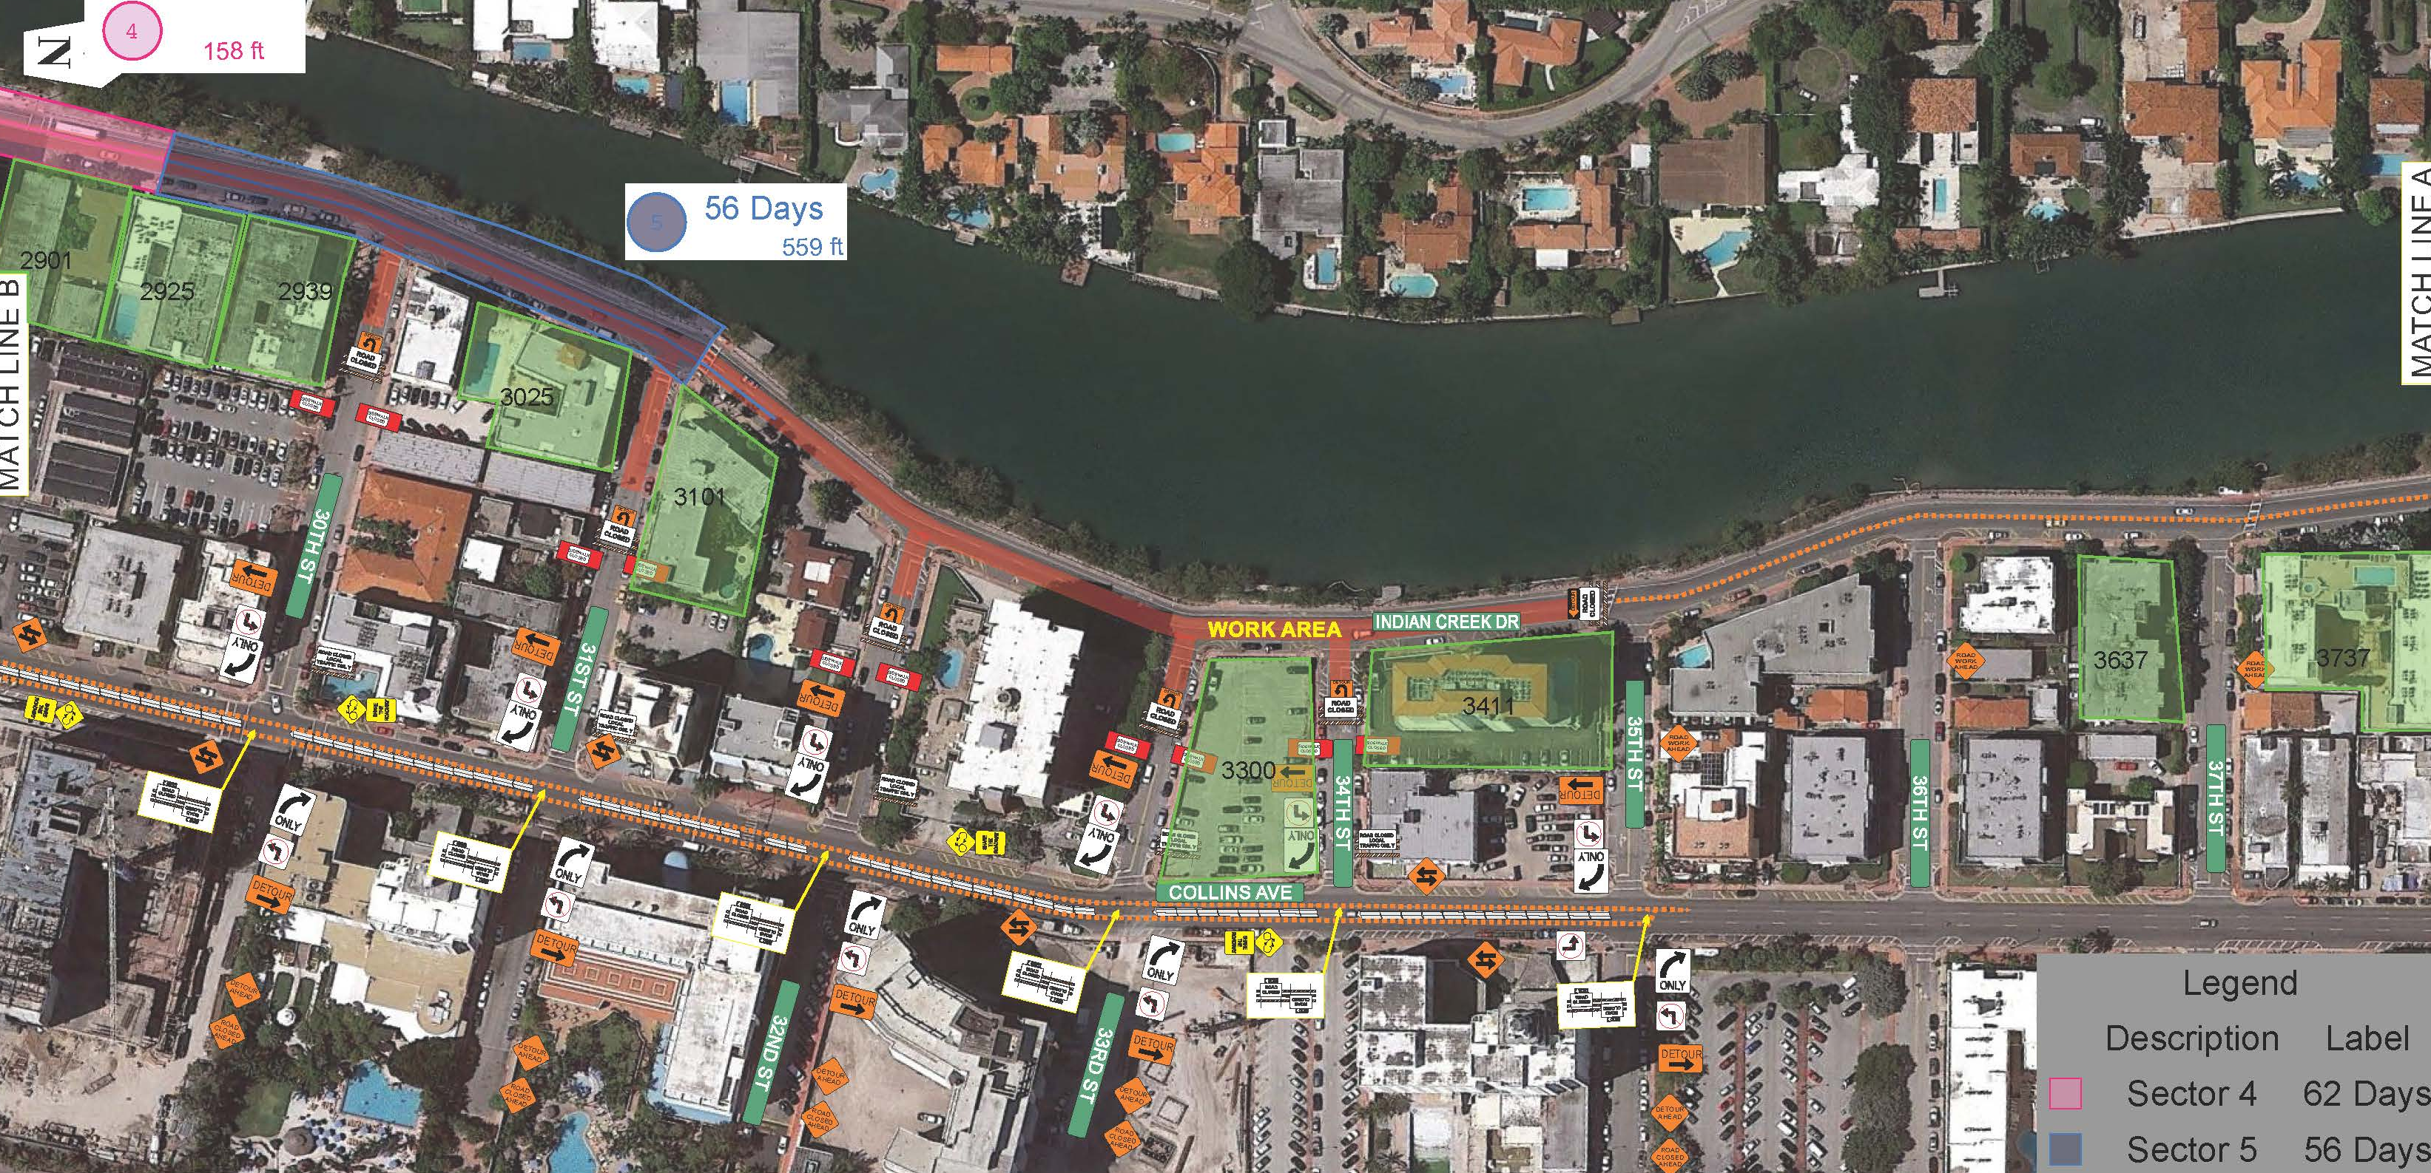
Phase II: Sector’s 4 and 5
Notes:
Mike

Slide 23
Project Phasing
Benefits
Fully dedicates resources to one section at a time
Shortens the overall duration of work in a given area
Average duration in each section is approximately eight weeks
Community will see progress within each section rather than experiencing work in multiple phases
^{Including harmonization}
Minimizes construction traffic impacts along Indian Creek Drive as the entire road will not be an open work zone
Local traffic will be maintained within active sections
General traffic will be detoured around the work
Final Maintenance of Traffic (MOT) pending City and FDOT approval
Notes:
Mike

Slide 24
What to Expect During Construction
4
Notes:
Mike

Slide 25
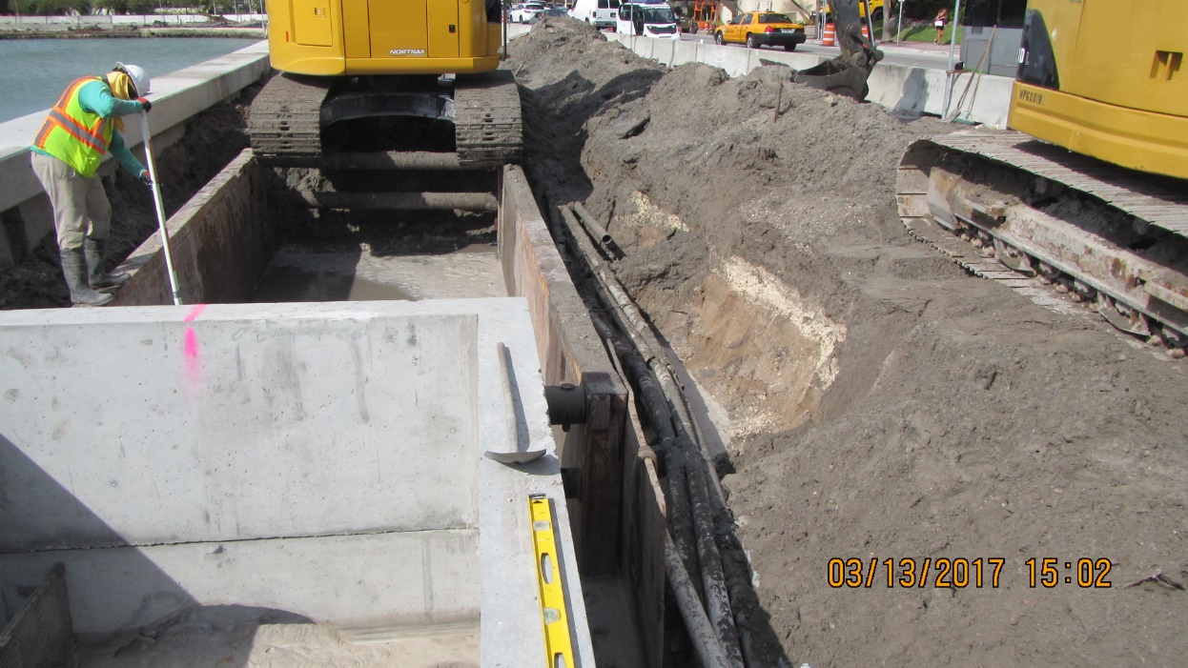
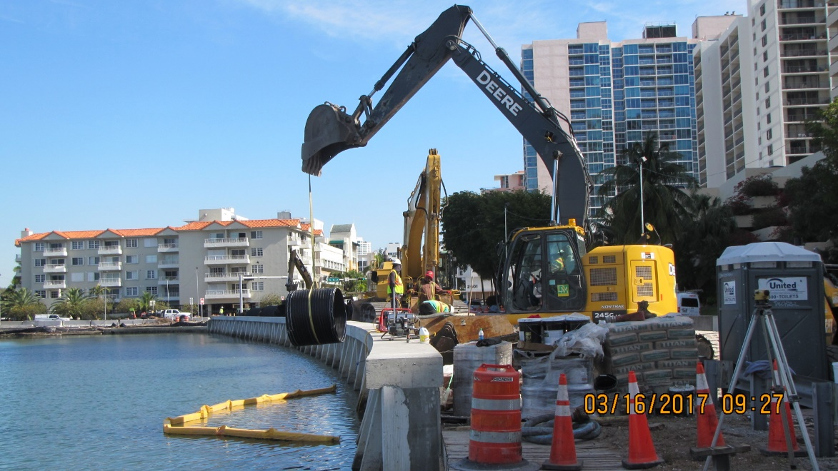
What to Expect…
Notes:
Mike

Slide 26
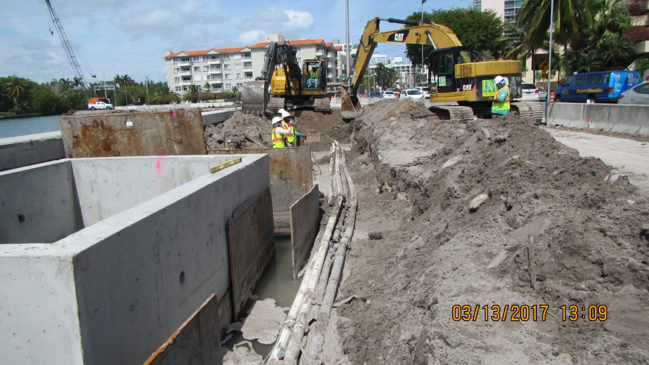
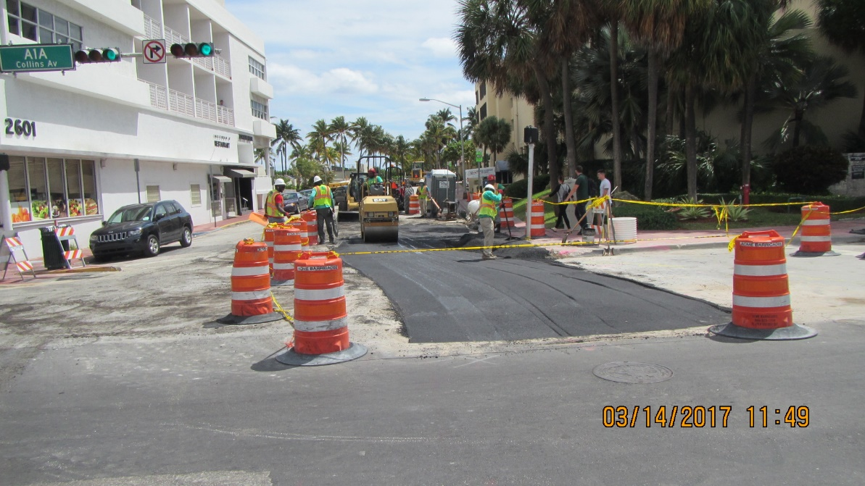
What to Expect…
Notes:
Mike

Slide 27
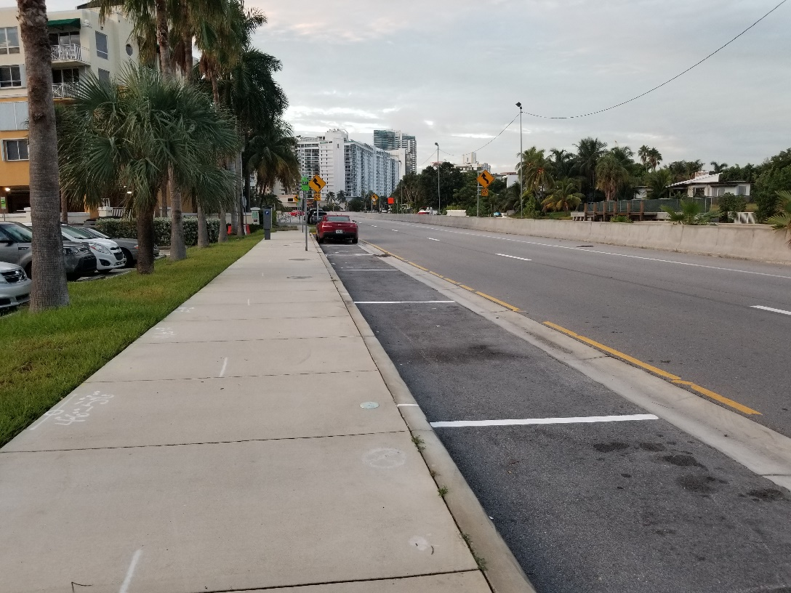
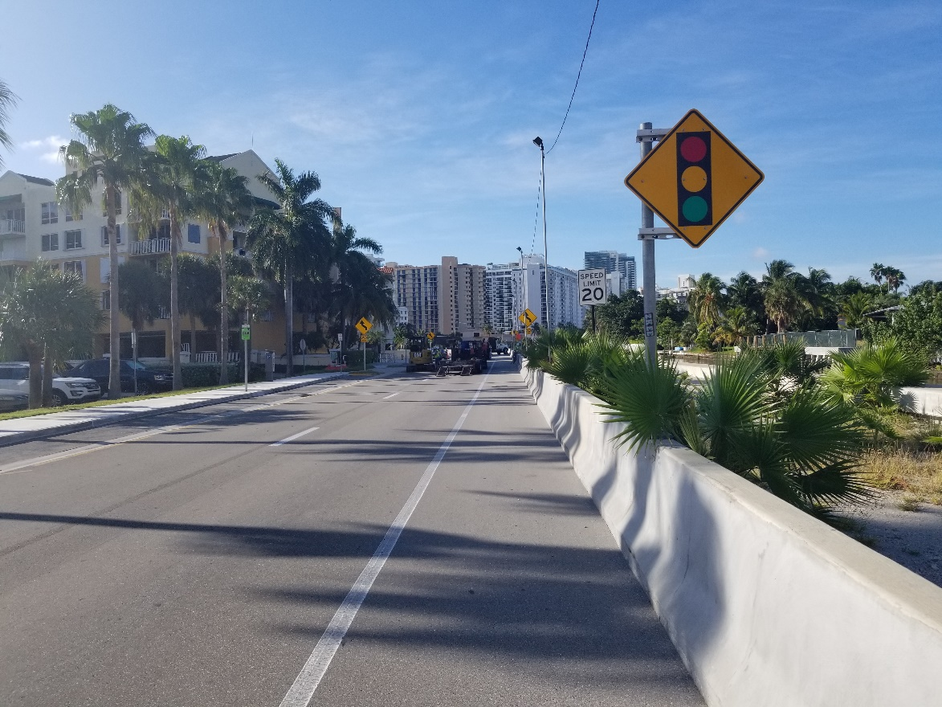
What to Expect…
Notes:
Mike

Slide 28
Questions/Comments
5
Notes:
Lynn will facilitate Q&A

Slide 29
For more information please contact: Heather M. Leslie, Public Information Liaison 305.905.5876 Heather@hmlpublicoutreach.com
Notes:
Heather will thank everyone for attending

