Slide 1
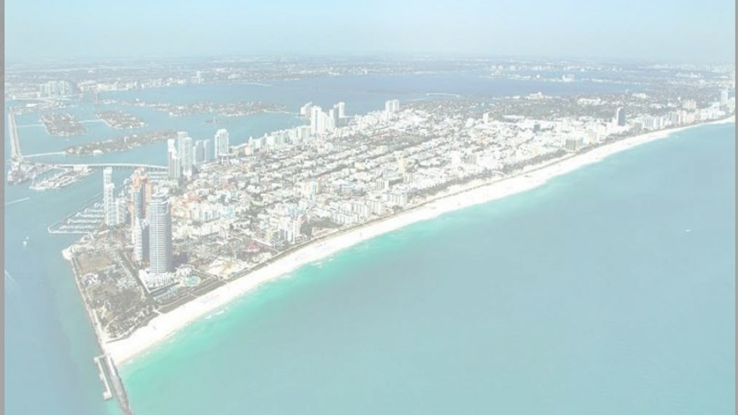

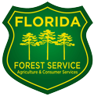



MIAMI BEACH
URBAN FORESTRY MASTER PLAN

Slide 2
PROJECT TEAM
Urban Forestry Master Plan
CITY STAFF MEMBERS
ELIZABETH WHEATON I ENVIRONMENTAL + SUSTAINABILITY DIRECTOR OMAR LEON I URBAN FORESTER
DAVEY RESOURCE GROUP +
CALVIN, GIORDANO & ASSOCIATES
KERRY GRAY/ DRG I URBAN FORESTRY CONSULTANT/PROJECT MANAGER
MICHAEL CONNER/ CGA I LANDSCAPE ARCHITECT
GIANNO FEOLI/ CGA I DIRECTOR OF LANDSCAPE URBANISM + DESIGN
SHIRLEY VAUGHN/ DRG I BUSINESS DEVELOPER
WILL AYERSMAN / DRG I GIS SERVICES COORDINATOR

Slide 3
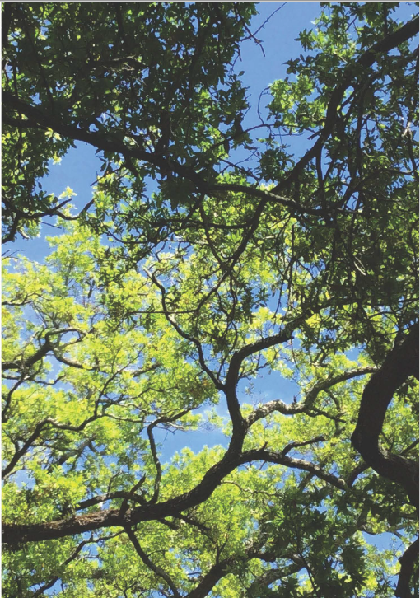
OBJECTIVES & SCOPE
  Analyze the existing conditions of Miami Beach’s urban forest
  Review operational processes within the city to understand how they affect the management of the urban forest
  Establish goals and targets for Miami Beach’s urban forest
  Develop recommendations & actions for implementation
      Day-to-day: Operations and contracting
      Design: Implementation ‘Toolkit’

Slide 4
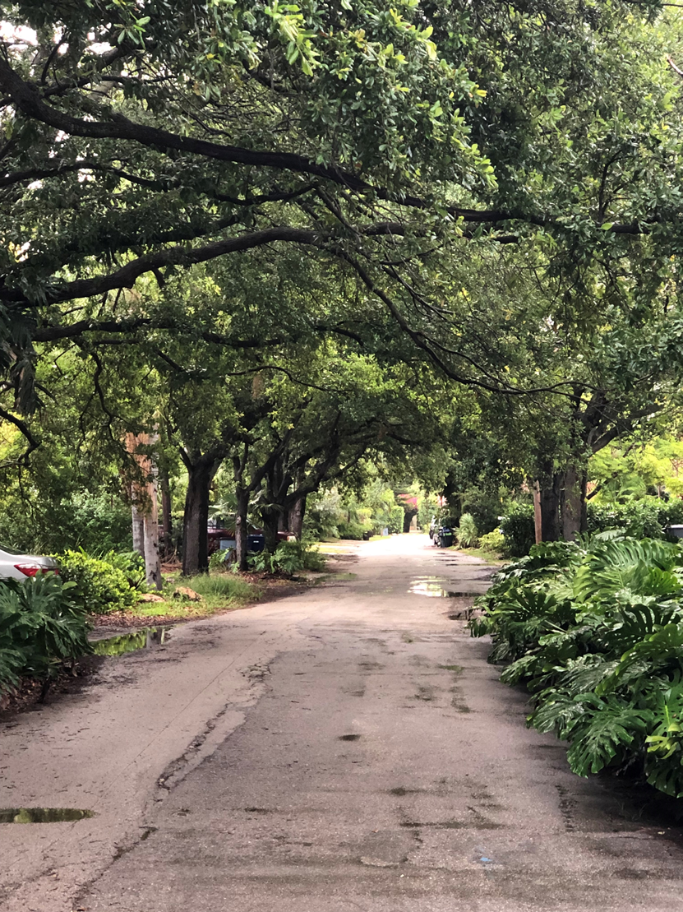
WHY PLAN?
Benefits of The Urban Forest
Reduce and filter stormwater
Improve air quality & sequester carbon
Wildlife habitat
Moderate local climate
Increase property values & reduce energy costs
Community character and aesthetics
Improve human health
Without a Plan and with limited public resources, Miami Beach could lose more trees than it is replacing; preservation is important!

Slide 5
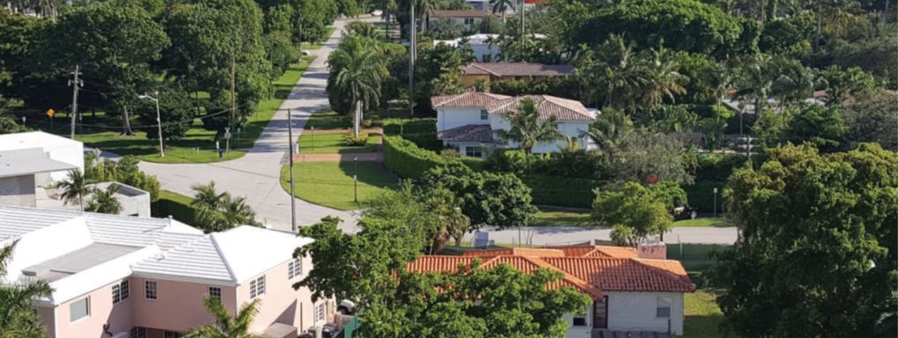
State of the Urban Forest

Slide 6
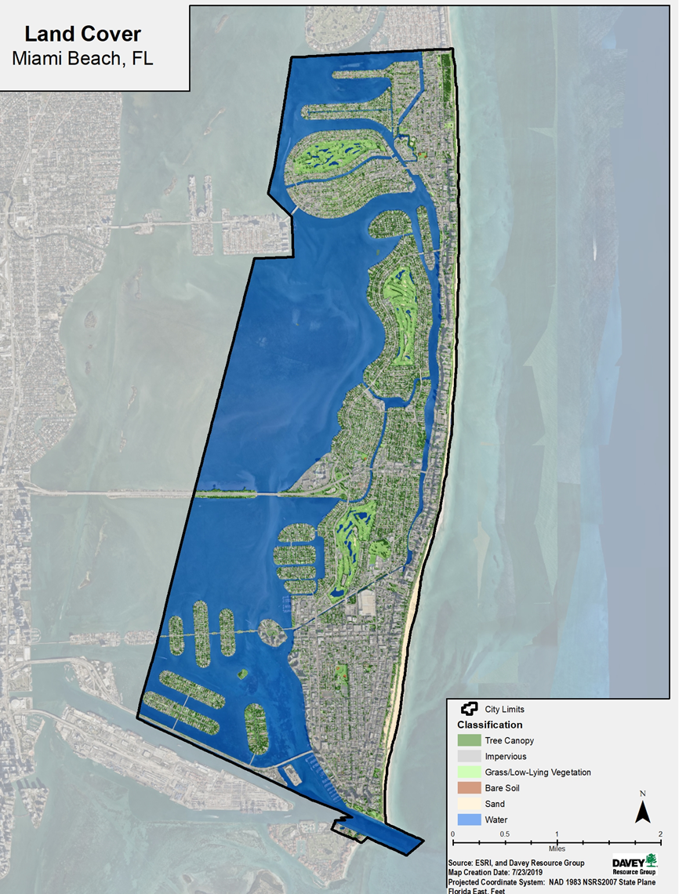

STATE OF THE URBAN FOREST
Land Cover and Tree Canopy
MIAMI BEACH LAND COVER:
Impervious Surfaces: 61%
Tree Canopy Cover: 17%
  78% of tree canopy cover on private residential property

Slide 7
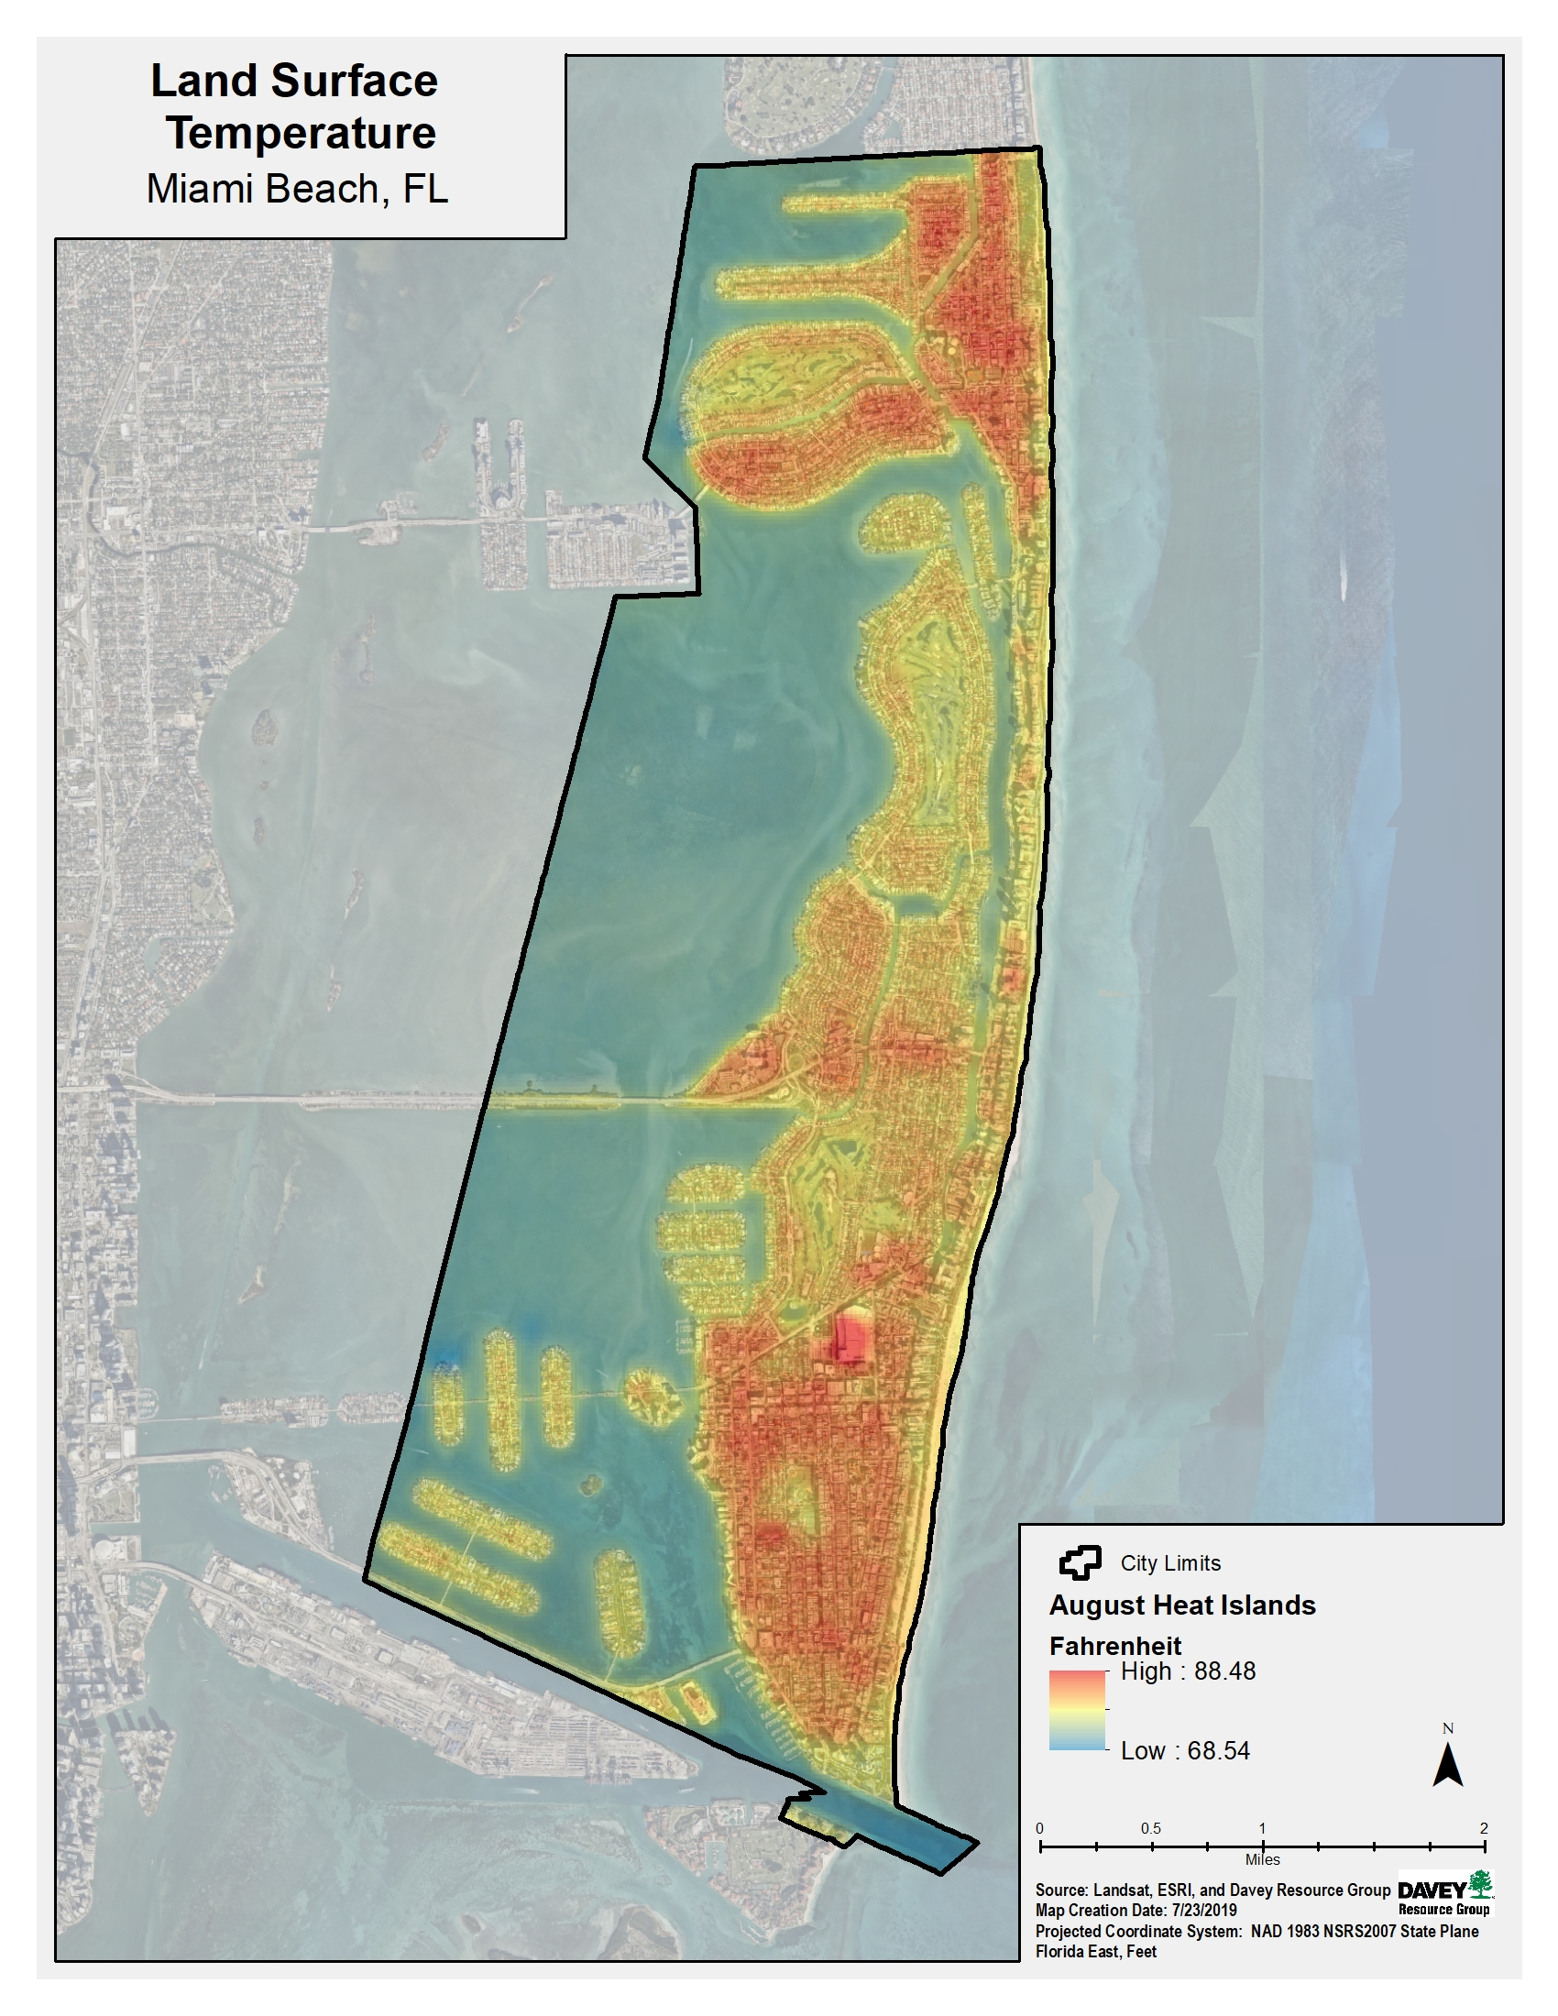
STATE OF THE URBAN FOREST
Land Cover and Urban Tree Canopy
61% of the land in Miami Beach
is covered by impervious surfaces
CHALLENGE: URBAN HEAT ISLAND
Occurs when roads, buildings, and sidewalks (impervious surfaces) trap and retain heat causing the air temperature to be hotter than nearby areas that are less built up. Leading to:
Health Impacts (heat-related illnesses)
Increased energy consumption
Elevated air pollution and greenhouse gases
Trees reduce the urban heat island effect by shading impervious surfaces & reducing the amount of heat absorbed.
.

Slide 8
STATE OF THE URBAN FOREST
Public Tree and Palm Population
CHALLENGE: SPECIES DIVERSITY
Palms have shifted from an accent plant to a major component of Miami Beach’s urban forest
48,600 Palms and Trees growing along Miami Beach streets and parks
Palms: 57% of population
  90 different species
Shade/Flowering Trees: 43% of population
  212 different species
Benefits* | Shade Tree Live Oak (Quercus virginiana) | Palm Cabbage/Sabal Palm (Sabal palmetto)
Carbon Dioxide (CO2) Sequestered (Absorbed) | 510 pounds/year | 2.71 pounds/year
Rainfall Intercepted | 725 gallons/year | 81 gallons/year
Ozone removed from the air | 20 ounces/year | < 2 ounces/year
Energy Savings (A/C) | 60 kWh | 26 kWh
Carbon dioxide stored lifetime to date | 3,214 pounds over lifetime | 26 pounds over lifetime
Annual Value of Benefits | $31.00 | $6.48
*Based on an analysis of a 16” diameter Quercus virginiana and Sabal palmetto utilizing the USDA Forest Service’s i-Tree MyTree benefits tool – www.itreetools.org.
  Palms substantially underperform in all environmental benefits when compared to trees

Slide 9
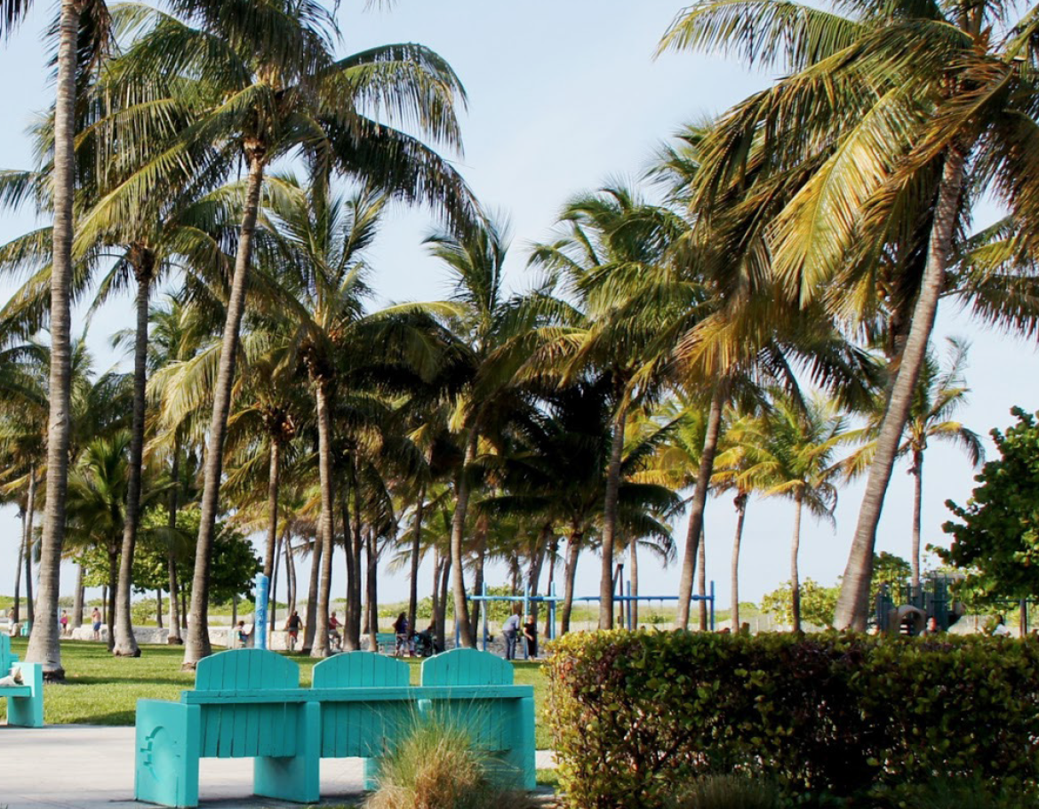
STATE OF THE URBAN FOREST
Unique Challenges the Urban Forestry Master Plan Addresses
Species diversity
  Encouraging shade trees and shifting palms back to an accent plant
Tree species selection
  Selecting species resilient to sea level rise, flooding & increasing salinity, limited growing space, and increasing temperatures
Street tree maintenance and preservation
  Maximize the benefits Miami Beach’s trees provide
Limited space for trees in the public right-of-way (ROW)
57% of the public tree population
is made up of palms

Slide 10
Tree Canopy
Current Tree Canopy Cover: 17%
Possible Tree Canopy Cover: 26%
(if all possible planting areas were planted)
Possible Planting Area = an area with grass or
bare soil where a tree could potentially be planted.
26% canopy cover is not a realistic target
~50% of possible planting areas are suitable for tree planting.
Areas may be unsuitable for trees due to a variety of factors, including:
  Lack of Space
  Utilities: underground or overhead
  Inappropriate location
  Poor soil or drainage
  No access to water
22% canopy cover target is a 5% increase from today and takes into consideration that only about 50% of sites will be suitable for tree planting.
To achieve 22% canopy cover by 2040 will require planting ~1,300 trees per year (or 25,900 total trees) on private and public property.

Slide 11
Design Toolkit

Slide 12
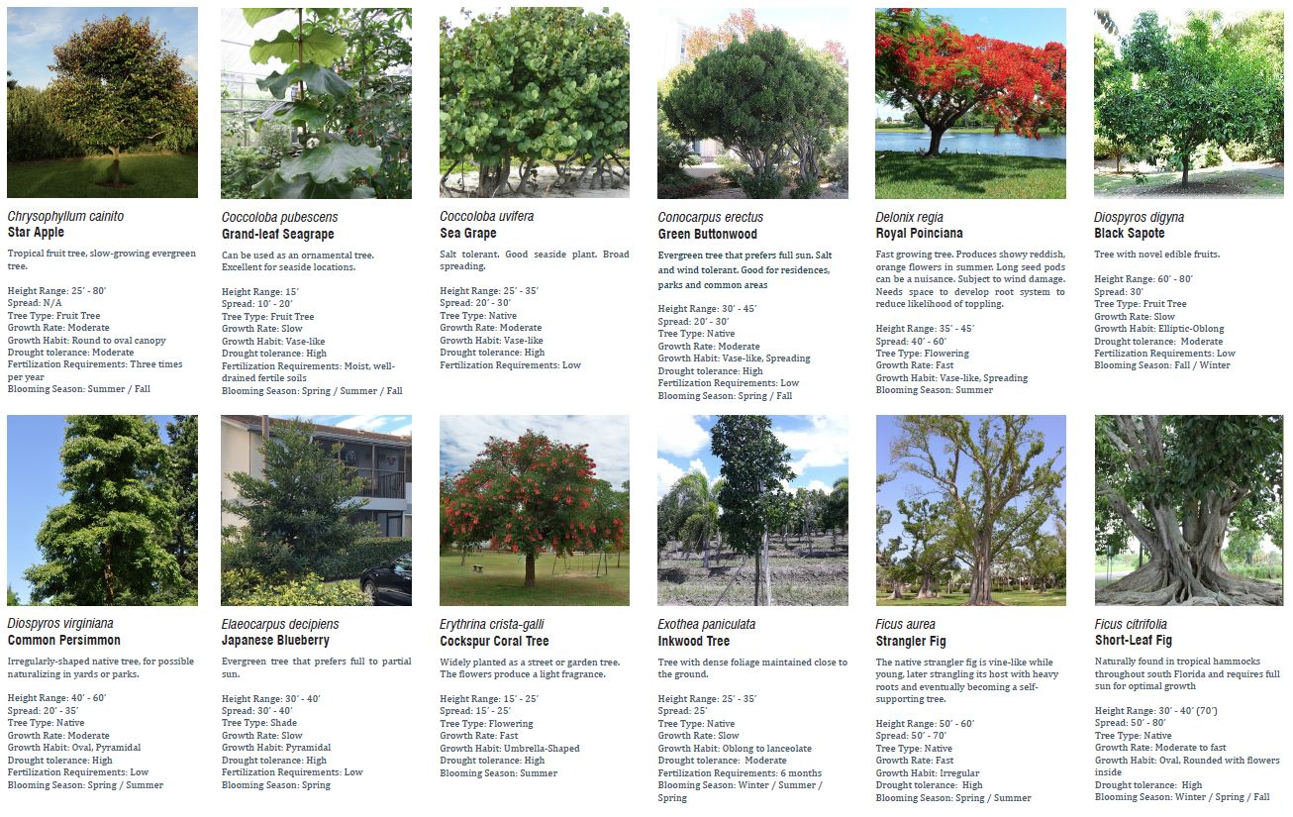
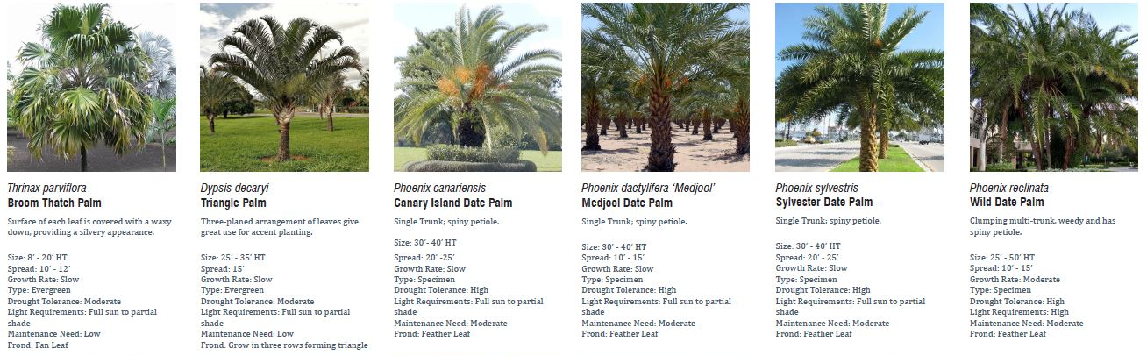
IMPLEMENTATION
SHAPING THE VEGETATION PALETTE IN MIAMI BEACH
Species Diversity
  Palms – moving back to an accent plant
Tree Species Selection
  Re-prioritize species to those that are more resilient to sea level rise, flooding & increasing salinity, limited growing space, and increasing temperatures
Highlights the characteristics of various species
  Can also be used by homeowners to make better species selection when planting trees on their private properties.

Slide 13
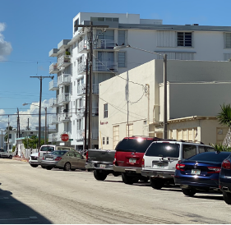
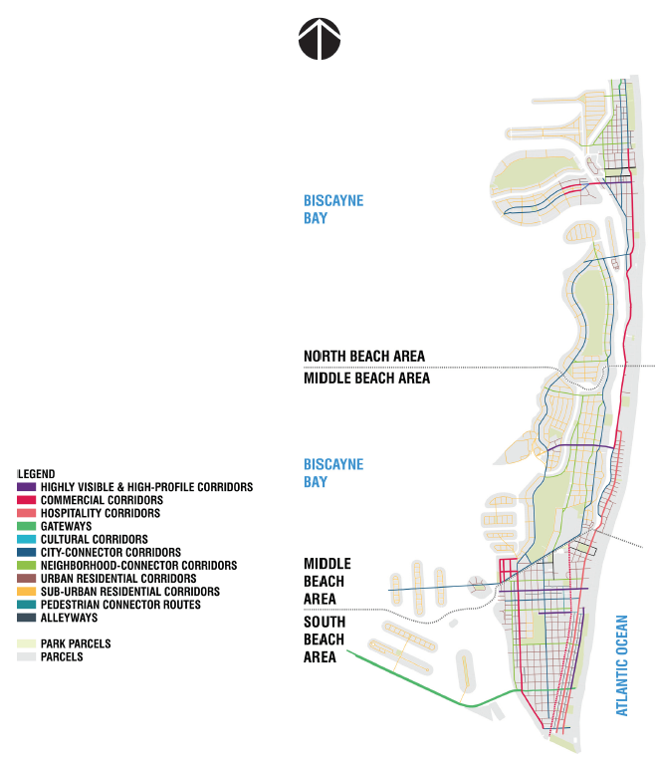
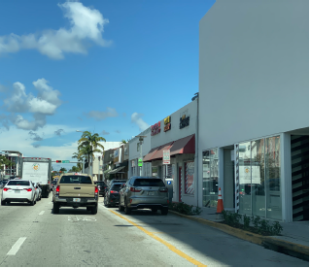
IMPLEMENTATION
PLANNING AND PRIORITIZING STREETS BY CHARACTER & USE
Planning for a city-wide approach
  Establishing a classification strategy for all streets within the City.
Street-by-Character
  Understanding that streets are not only about traffic movement, but also about experience; working in concert with abutting land uses.
Street tree species prioritization plan
  Identifying key species for specific street-types to build uniformity and wayfinding

Slide 14
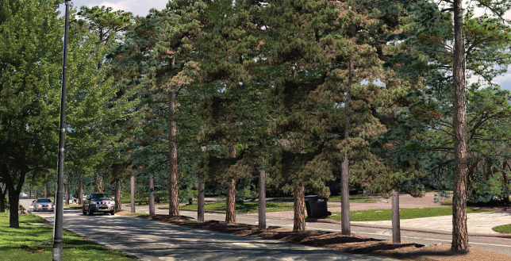
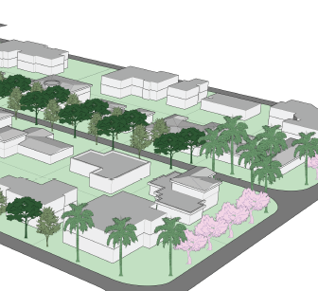
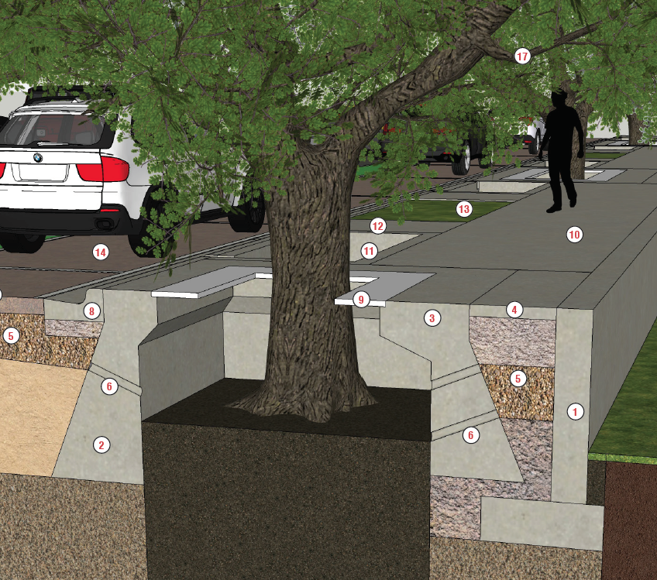
IMPLEMENTATION
CASE-STUDIES ON UNIQUE CONDITIONS IN MIAMI BEACH
Pine Tree Drive
  How can we adapt to natural aging of canopy and changes in the climate without losing our history?
La Gorce Island
  How can we adapt neighborhoods in low-lying areas to meet the challenges of increased salinity in groundwater and still maintain an identity?
Meridian Avenue
  How can we keep the environmental benefits of large, established canopies when approaching the rising of streets?

Slide 15
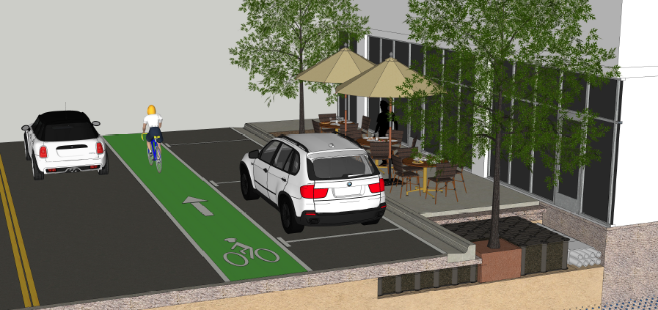
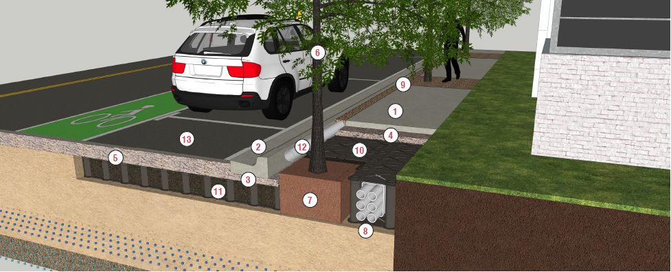
IMPLEMENTATION
Bridging Efforts Across Urban Forestry, Public Works, CIP & Planning
Establishing Tactics for Street Tree Planting
  Key to maintain and promote trees in Miami Beach’s urban condition is to use appropriate green infrastructure.
    Increases short-term implementation costs but provides a better return on investment (ROI) over the long-term.
  Establishes goals in order to budget appropriately for future projects
  Supports design coordination across city departments for review and implementation
    Minimizes conflicts during plan review and construction processes

Slide 16
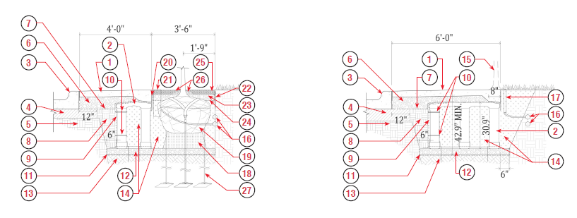
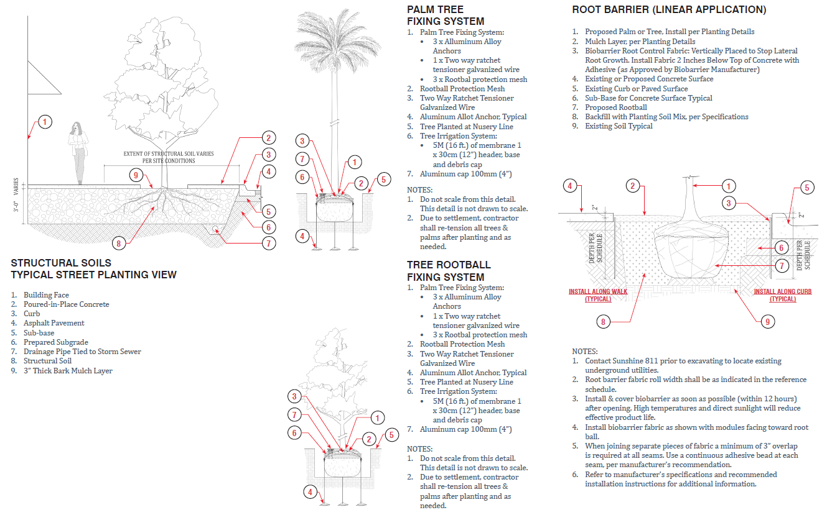
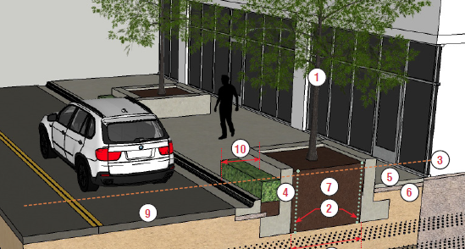
IMPLEMENTATION
Bridging Efforts Across Urban Forestry, Public Works, CIP & Planning
Standardizes components of implementation
  Provides standard construction details to be incorporated into the City’s PW manual and standard details
Establishes minimum metrics for soil volumes
  Helps ensure new trees thrive and reach their ideal mature size.
Provides strategies for a phased approach to street tree planting in light of sea level rise
  How to plan for trees today so that they are not negatively impacted by planned adaptation improvement projects in the future?

Slide 17
MIAMI BEACH
URBAN FORESTRY MASTER PLAN
Thank you for your time
Omarleon@miamibeachfl.gov
Mbrisingabove.com/trees

