Slide 1
City of Miami Beach
PreK Scholarship
Provider Invoicing Session
Dr. Leslie Rosenfeld
Chief Learning Officer
Organizational Development & Performance Initiatives

Slide 2
What Will You Learn Today?
How To Log into your Dashboard
How to Create/Submit Invoice(s)
How to Register as a 2023-24 Provider and each year thereafter
How to Approve in Docusign
How to View Prior Invoices/Statuses

Slide 3
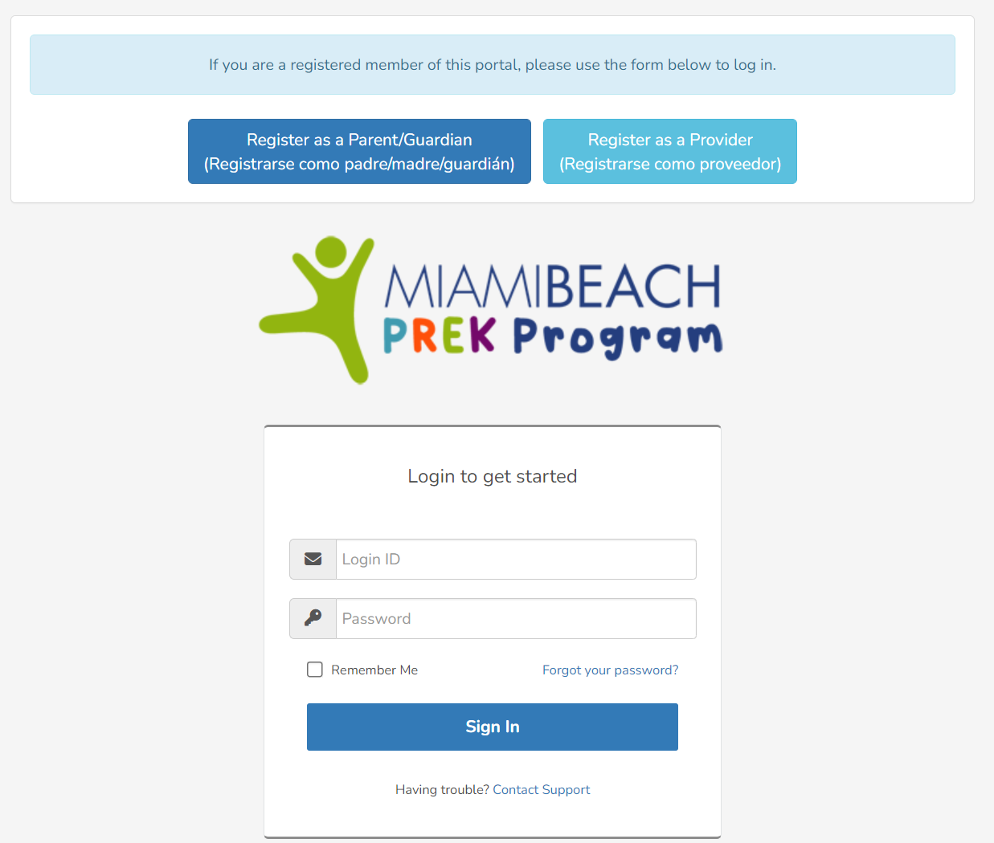
https://miamibeachfl.webauthor.com/
Log Into Your Dashboard
Go to Website https://miamibeachfl.webauthor.com/
Enter Your User I.D
Enter your Password
Click Sign In

Slide 4
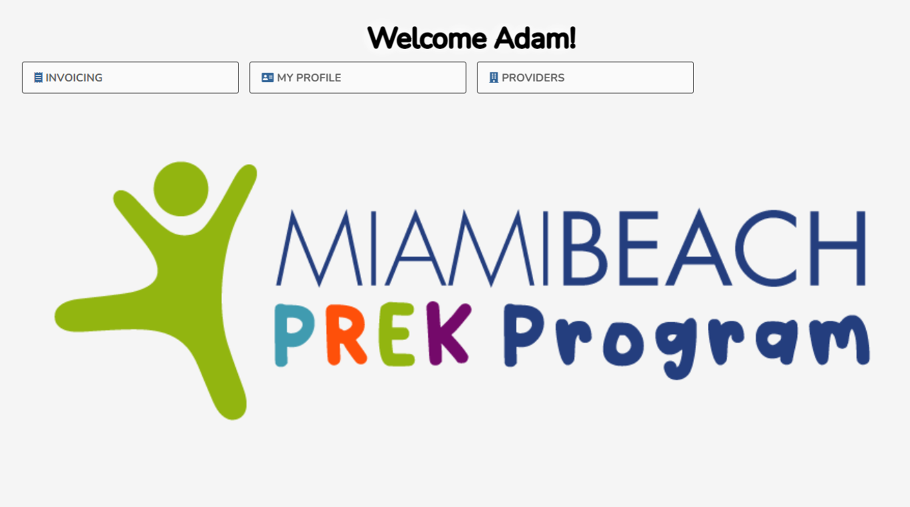
Provider Dashboard

Slide 5
Provider Dashboard
Submit invoices here
and
Review invoices here
Submit 2023-24 application here

Slide 6
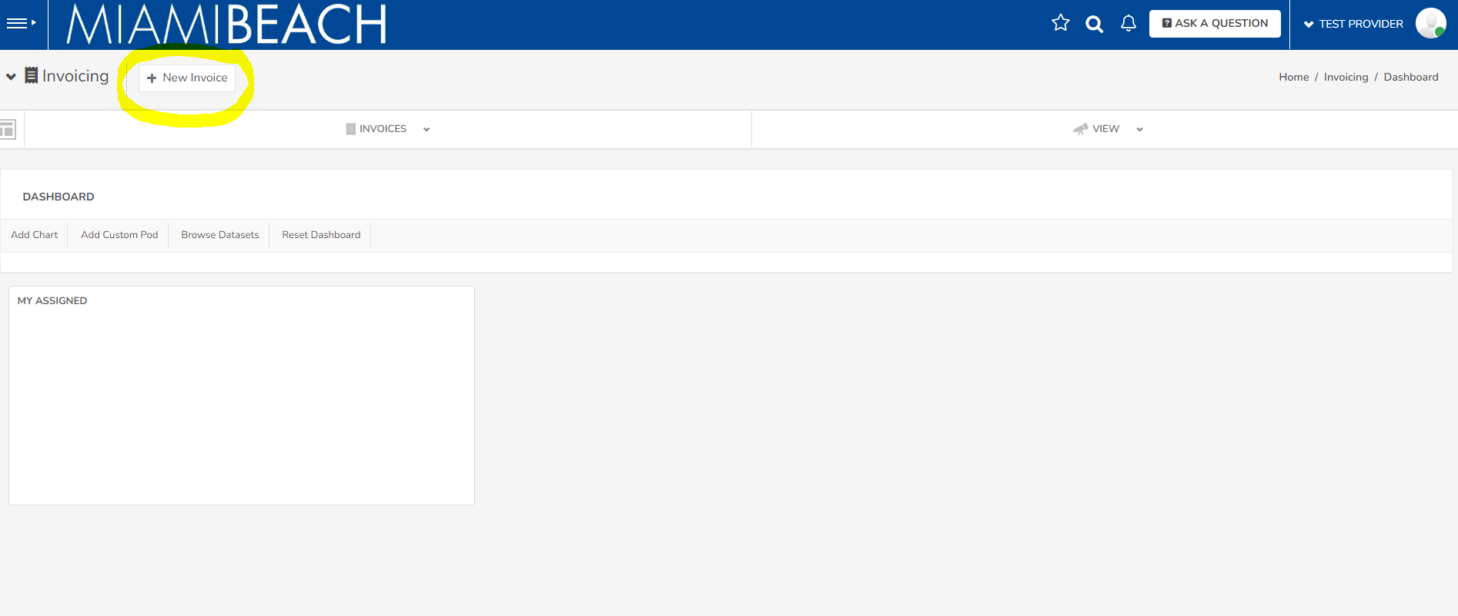
How to Create an Invoice (Step 1: New Invoice)

Slide 7
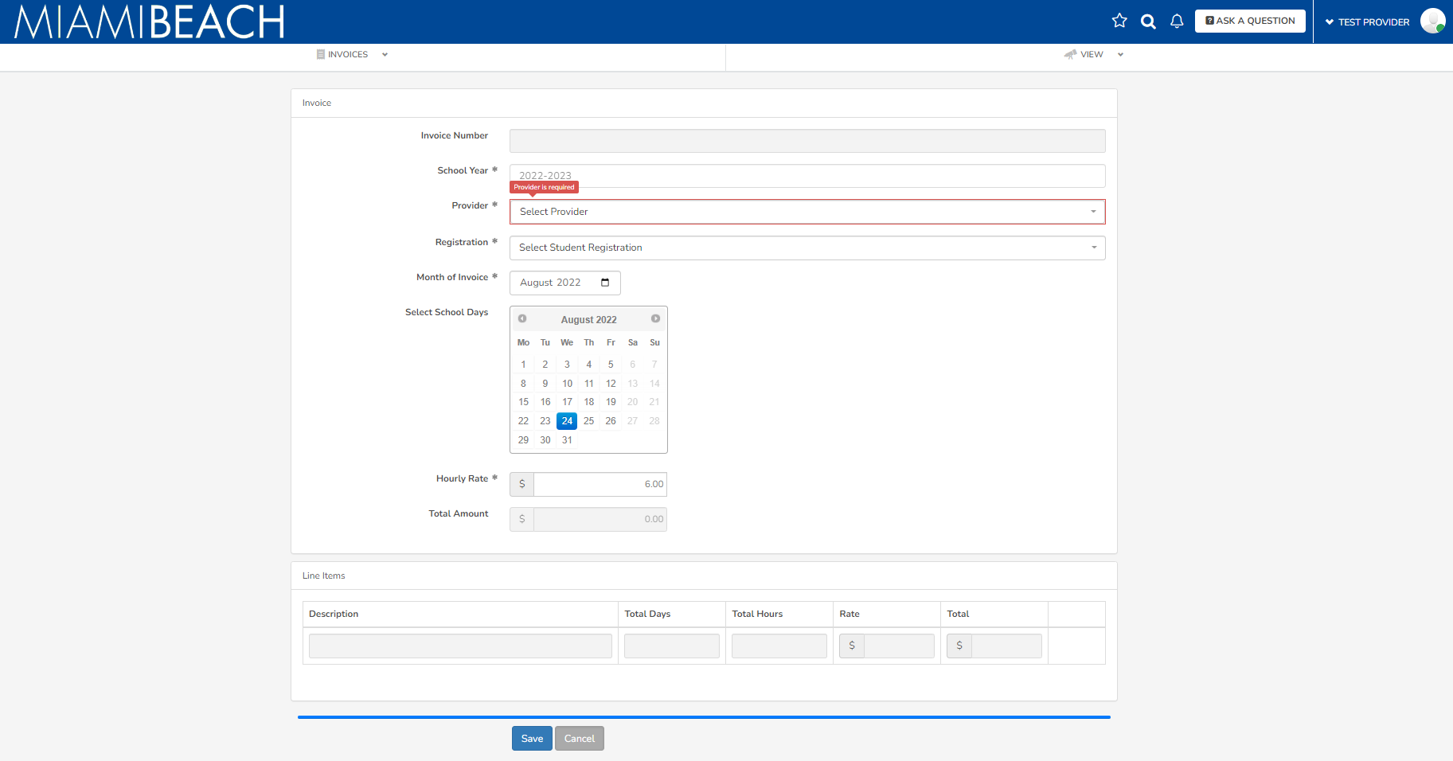
How to Create an Invoice (Step 2: Create monthly invoice per child)

Slide 8
How to Create an Invoice (Step 2: Create invoice per child)
Select provider
Select child
Select month
Select school days
Adjust hourly rate lower if applicable
Review and submit

Slide 9
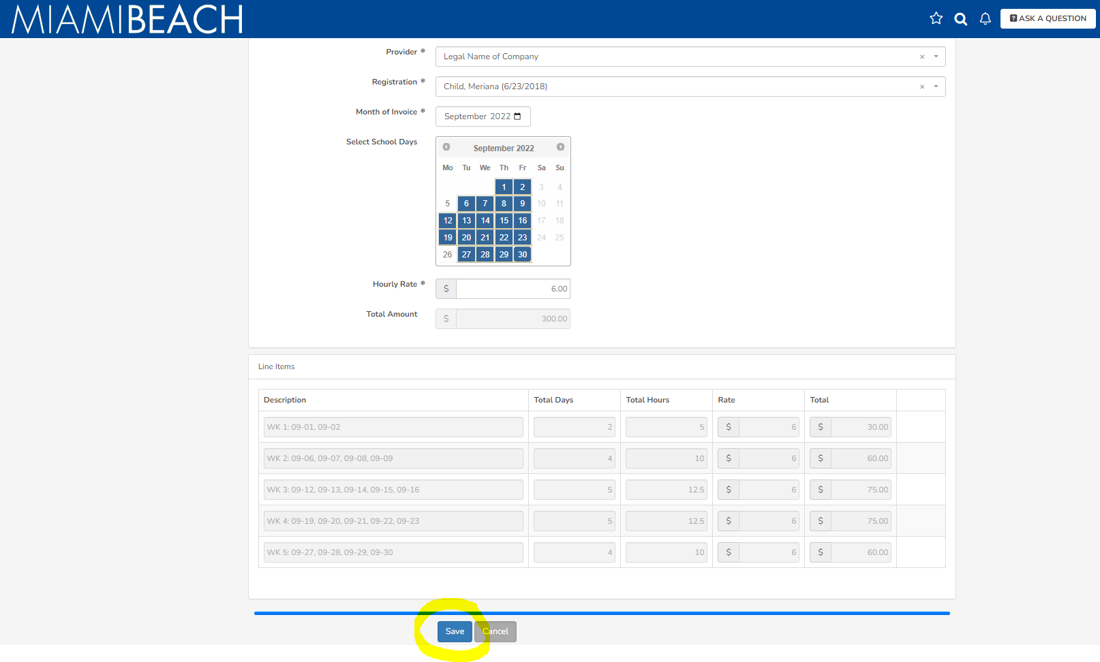
How to Create an Invoice (Step 3: Review Invoice Amount and SAVE)

Slide 10
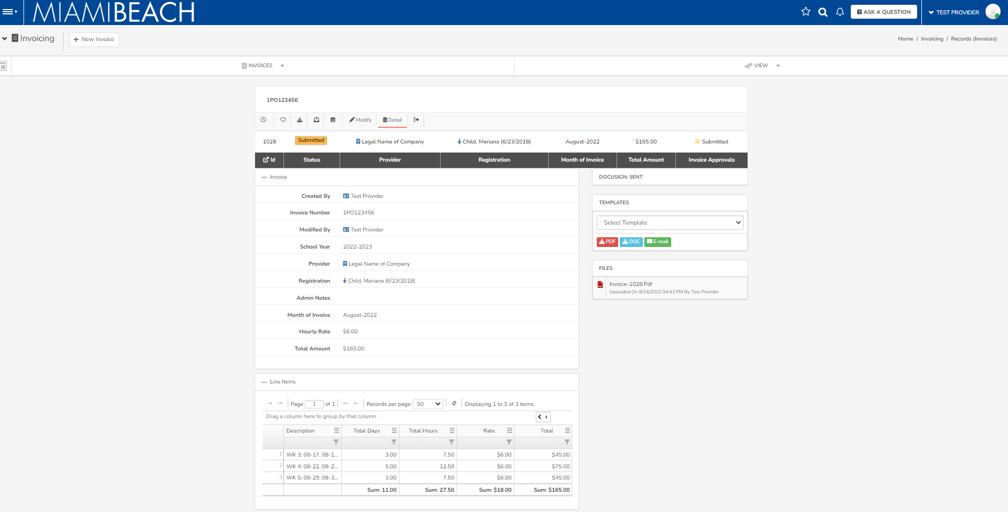
How to Create an Invoice
Invoice automatically sent in Docusign!

Slide 11
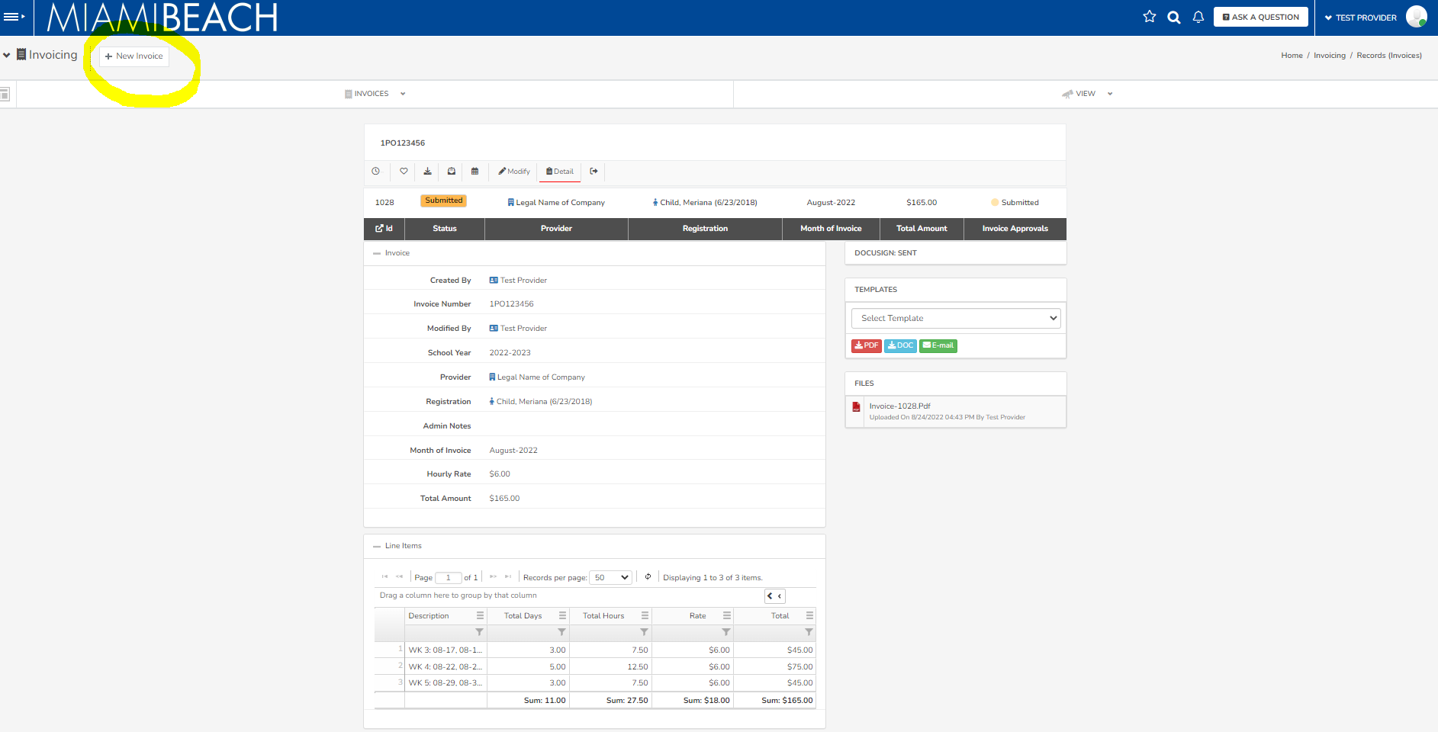
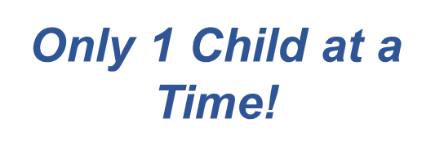
How to Create Additional Invoices
Click here to create another invoice!

Slide 12
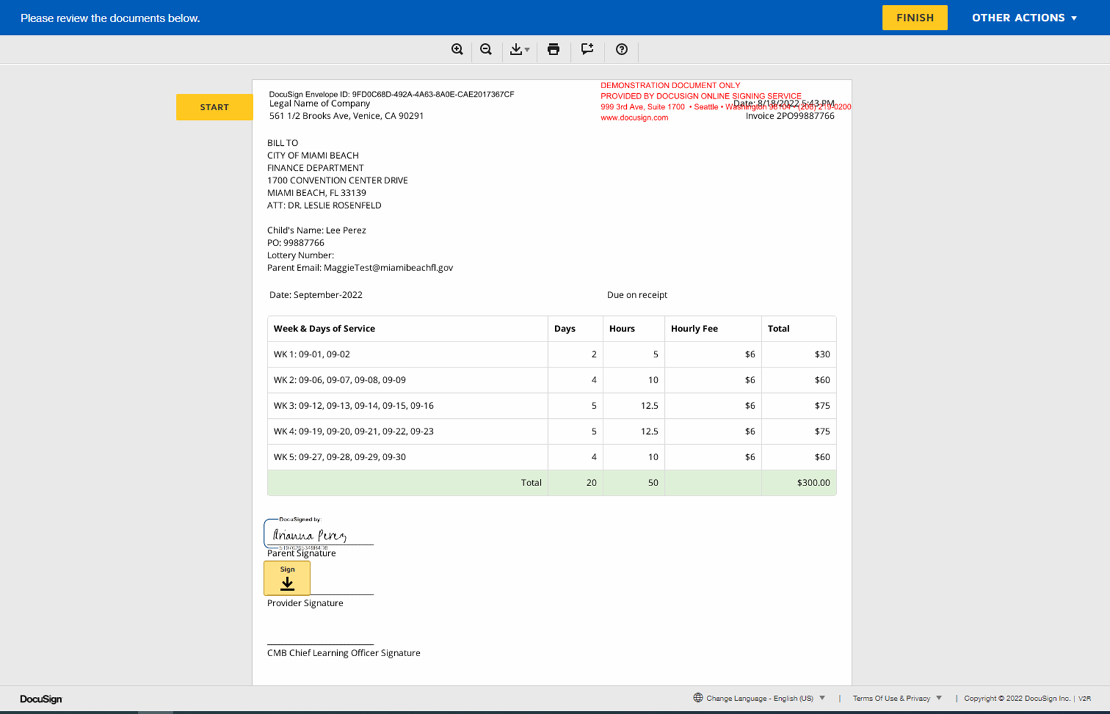
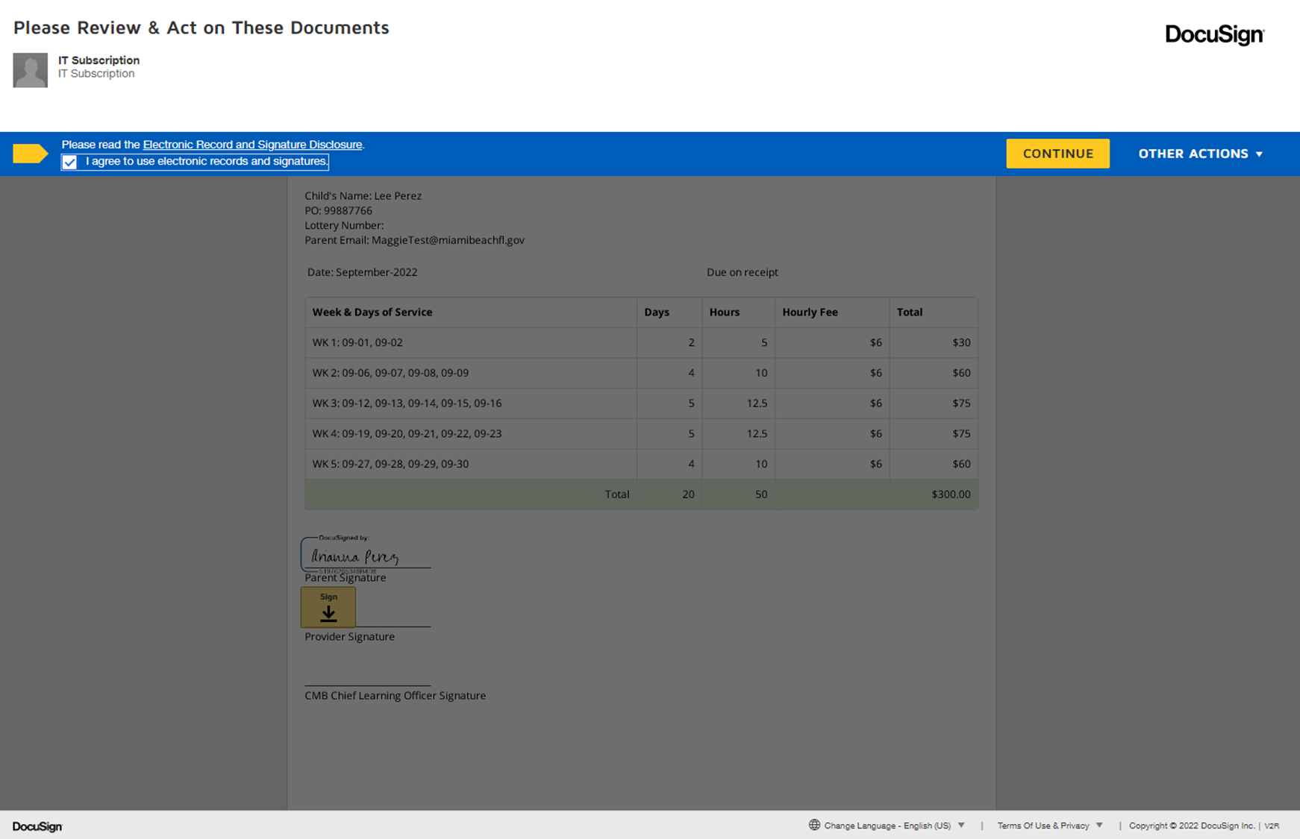
Approval in Docusign (Signing Invoice in 5 clicks)
Docusign will come from education@miamibeachfl.gov
Click: 1
Click: 2
Click: 3

Slide 13
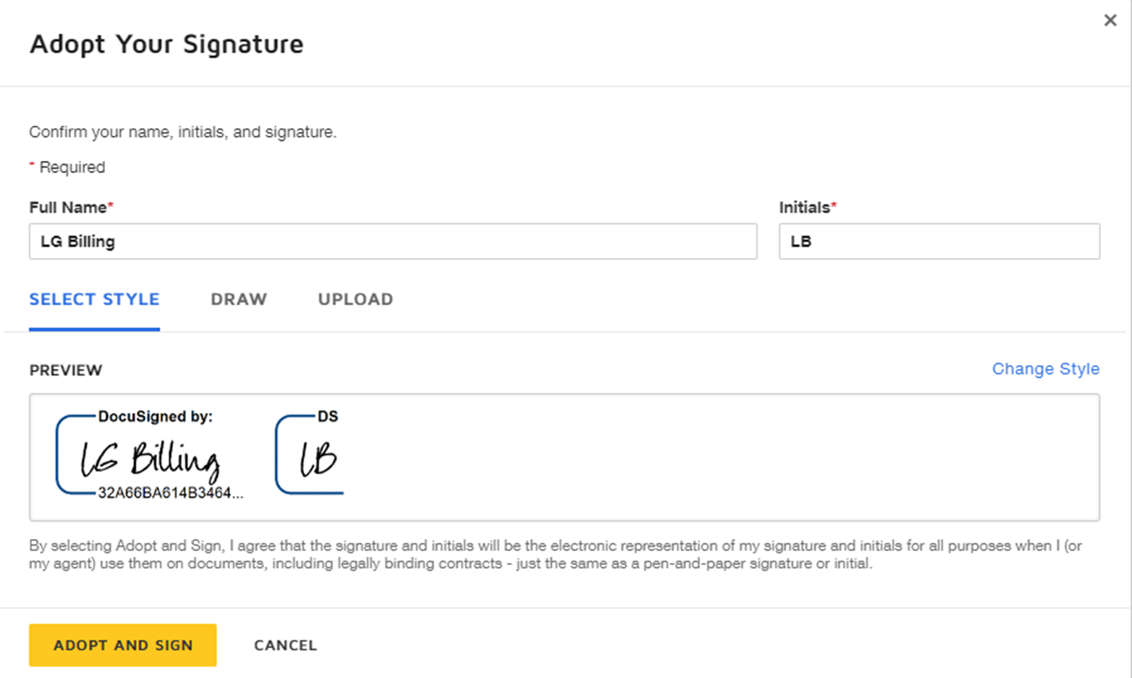
Docusign (Signing Invoice in 5 clicks)
Click: 4
Step: 3

Slide 14
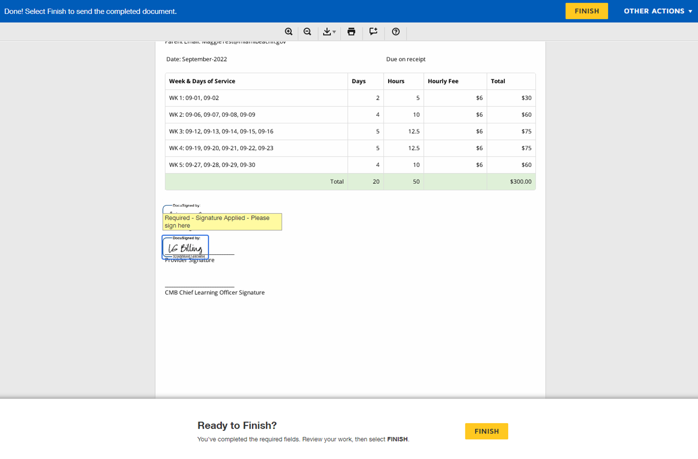
Docusign (Signing Invoice in 5 clicks)
You Did It!
You’ve Finished Signing the Invoice!
Click: 5

Slide 15
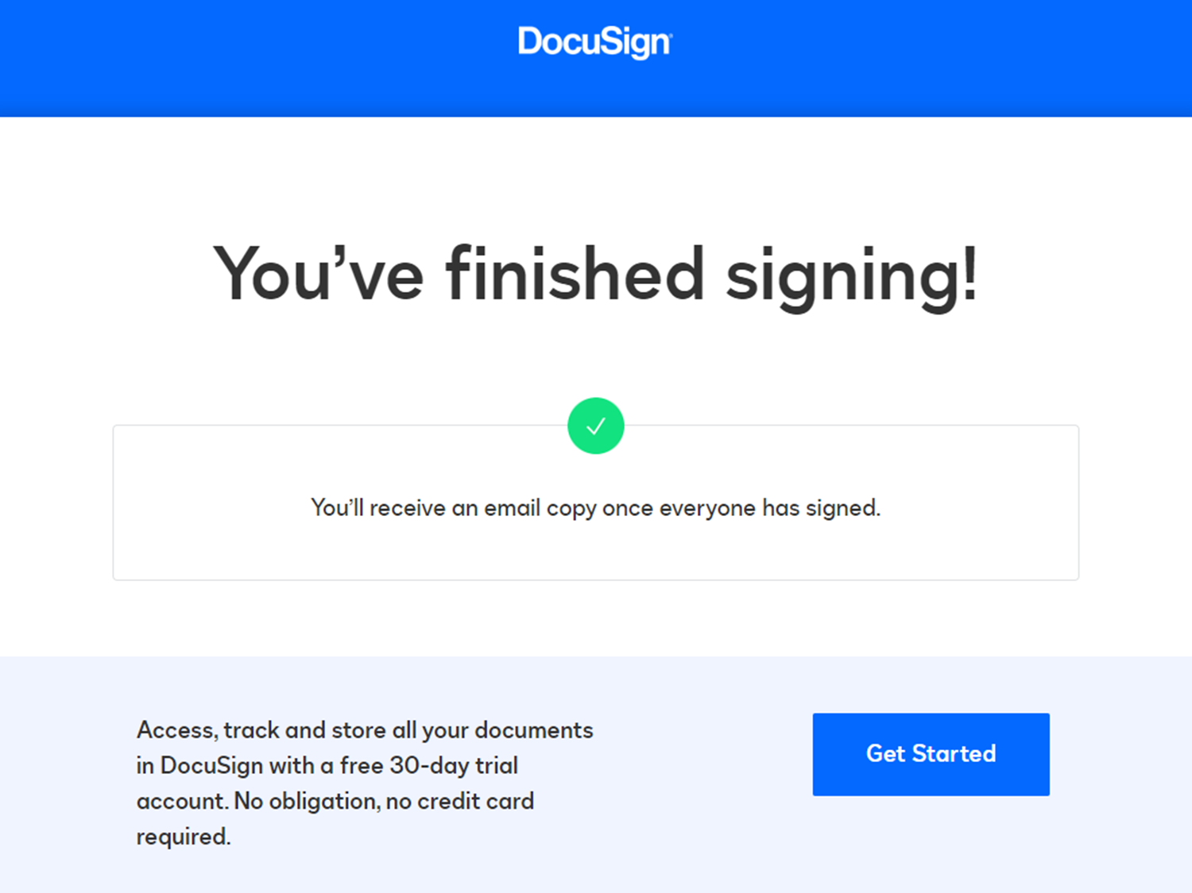
Docusign Complete for Provider

Slide 16
Provider Dashboard
Submit invoices here
and
Review invoices here
Submit 2023-24 application here

Slide 17
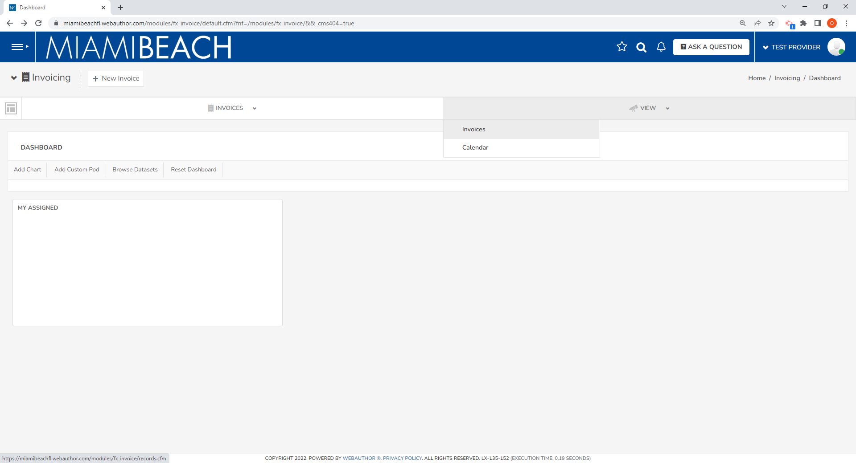
How to Review Invoices
1. Select View
2. Select Invoices

Slide 18
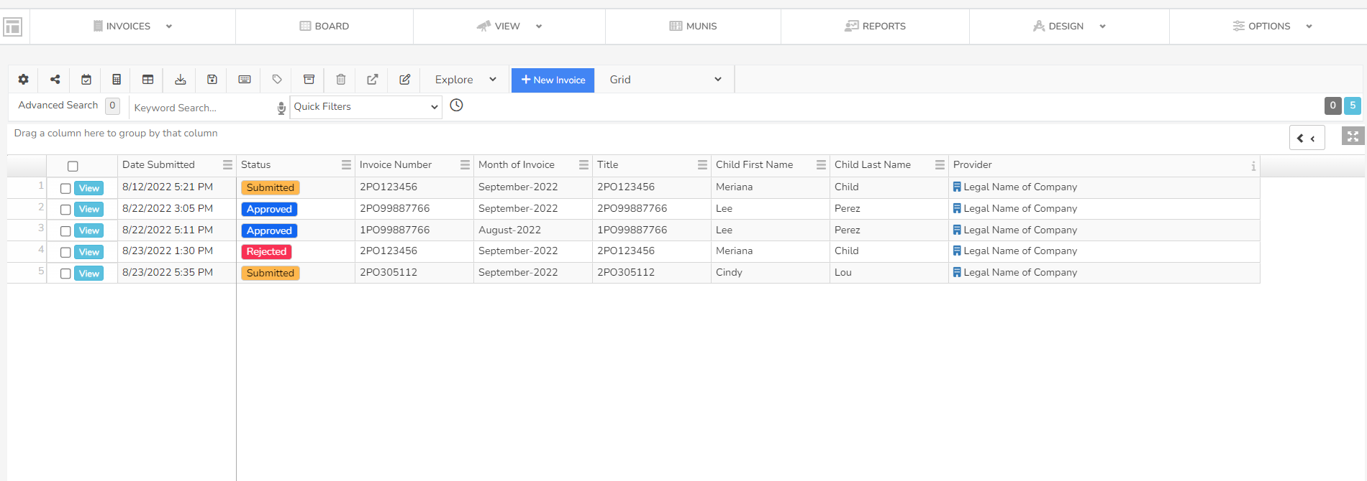
How to Review Invoices
Status:
Approved: The invoice was signed by all parties
Submitted: The invoice is pending signatures in Docusign
Rejected: A NEW invoice must be submitted

Slide 19
Invoice Declined
If an invoice is declined in docusign, you will receive a notification by email.
You must create a NEW invoice for that child for that particular month.

Slide 20
Provider Dashboard
Submit invoices here
and
Review invoices here
Submit 2023-24 application here

Slide 21
Provider Application 2023-24

Slide 22
Let’s Recap
Logging into your dashboard
Creating/submitting invoice(s)
Approving in docusign
Viewing status of prior invoices
Registering as a 2023-24 Provider and each year
Next Steps:
The City will reach out by email to schedule 1:1 invoicing
Provider will email copy of contract with each family reflecting the City’s PreK Scholarship
Contact: education@miamibeachfl.gov

Slide 23
Q & A
Organizational Development & Education

Slide 24
www.miamibeachfl.gov/prek

