Slide 1
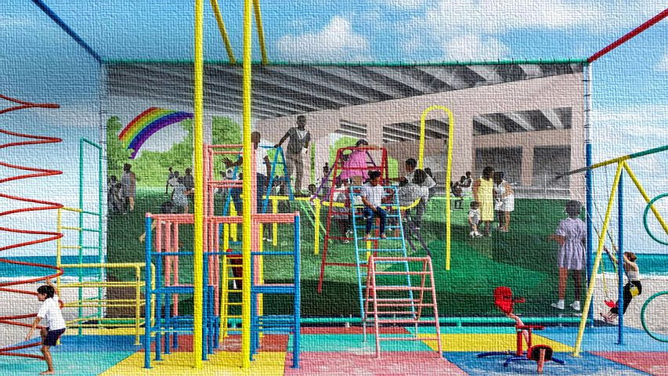
Prekindergarten Scholarship Program
City of Miami Beach
2022-23
Dr. Leslie Rosenfeld
Chief Learning Officer
Organizational Development & Education

Slide 2
Purpose of Informational Session
1. City of Miami Beach Pre-Kindergarten Program Overview
2. Invoicing Process (2022-23)
3. Discuss next steps

Slide 3
Overview of Prekindergarten Scholarship Program
Funds for the Prekindergarten Program are to expand hourly access to prekindergarten for four-year old students by increasing the availability of high-quality prekindergarten placements for Miami Beach children
Builds on the foundation established by the State of Florida investment in prekindergarten across the state
State funded program currently provides for three (3) hours of VPK services for 180 school days

Slide 4
Overview of Prekindergarten Scholarship Program
Current State funded VPK participants requesting additional 2.5 hours (full-day) pay between $4.80 and $6.00 per hour in public Miami-Dade schools
 | Number of Hours | Hourly Cost | 180 School Days
Florida VPK | 3 | $4.58 | $2,473.20
Public fee-supported pre-K | 2.5 | $6.00 | $2,700.00
Public fee-supported pre-K (free or reduced lunch) | 2.5 | $4.80 | $2,160.00

Slide 5
City of Miami Beach Funding
City of Miami Beach proposed funds may fund the expansion of current half-day State funded licensed voluntary pre-kindergarten programs to full-day options for eligible families
Funding may be used to reduce family contribution for hours not currently funded under the State funded VPK and non-State funded pre-kindergarten programs

Slide 6
Continuity of Care Model
Children receiving full-day prekindergarten should remain in the same location throughout the day
The child in the program should keep the same caregiver/teacher throughout the day to help foster a secure attachment with their caregiver/teacher

Slide 7
Miami Beach Family informational sessions scheduled
Application for Families available for 2023-24
Family and provider agreements due to CMB including CMB agreement with Provider, CMB agreement with Family, and agreement between family and provider
Sept. 2022
Nov.2022
Aug. 2022
Jan. 2023
Pre-kindergarten Providers informational sessions scheduled regarding invoicing in 2022-23
Application for providers available for 2023-24
Lottery for Families
Notification to Families and public posting
Notification to provider of MB family selection

Slide 8
www.miamibeachfl.gov/prekprovider

Slide 9
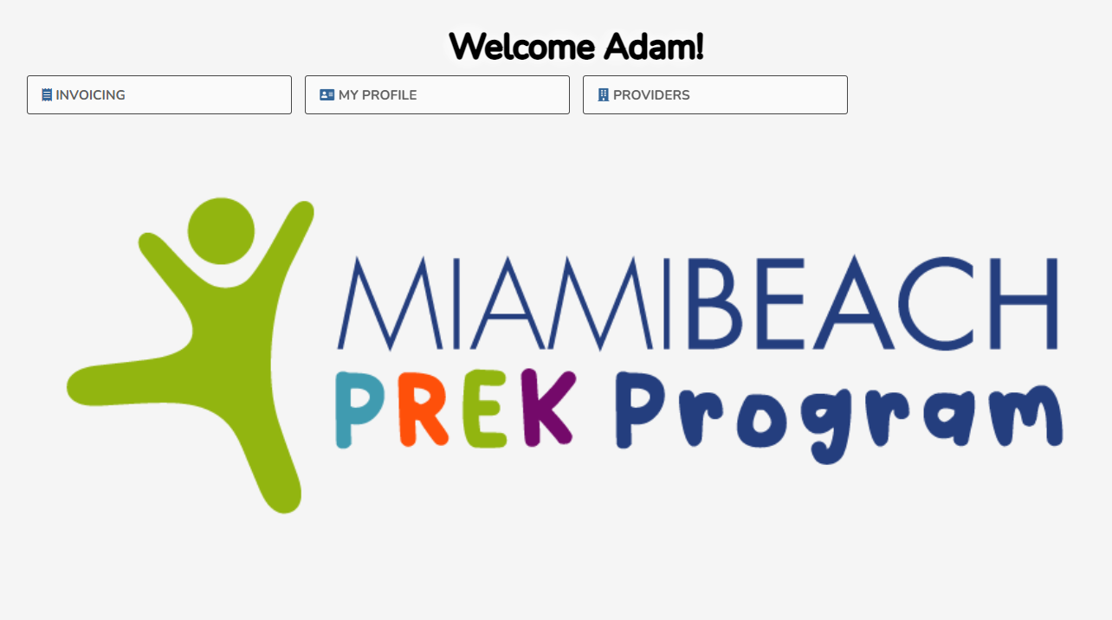

Slide 10
Q & A
Organizational Development Performance Initiative

