Slide 1

Pre-kindergarten Scholarship Program
City of Miami Beach
Info Session
(School Year 2026-2027)
Dr. Leslie Rosenfeld
Chief Education Officer
Education and Performance Initiatives
Maggie Brown Pre-K Administrator
Education and Performance Initiatives

Slide 2
Purpose of Informational Session
1. City of Miami Beach Pre-Kindergarten Scholarship Program Overview
2. Family Application and Lottery Process
3. Discuss next steps

Slide 3



Overview of Prekindergarten Scholarship Program
City funded program will provide a stipend of up to $TBD per school year, to cover up to an additional 450 instructional hours (up to 2.5 hours per day for 180 days)
Can be applied toward educational programming occurring during regular school hours, not after-school hours
Funding will cover 192 Miami Beach resident children, chosen through a lottery of eligible applicants

Slide 4
Miami Beach Child Eligibility for 2026-2027
Families who live in the City of Miami Beach and who have a child(ren) who is 4 years old on or before Sept. 1, 2026
Children born between February 2, 2021 and September 1, 2022 are eligible to participate
Child must be enrolling in PreK for the 2026-2027 academic school year

Slide 5


How to View Your Status:
Visit the PreK Website
Log into your Parent/Guardian Portal
Click “Application PreK”
Ensure the top right button “SY: 2026-2027” is for the correct school year:
Click “View” next to the childs name

Slide 6

www.miamibeachfl.gov/prek

Slide 7
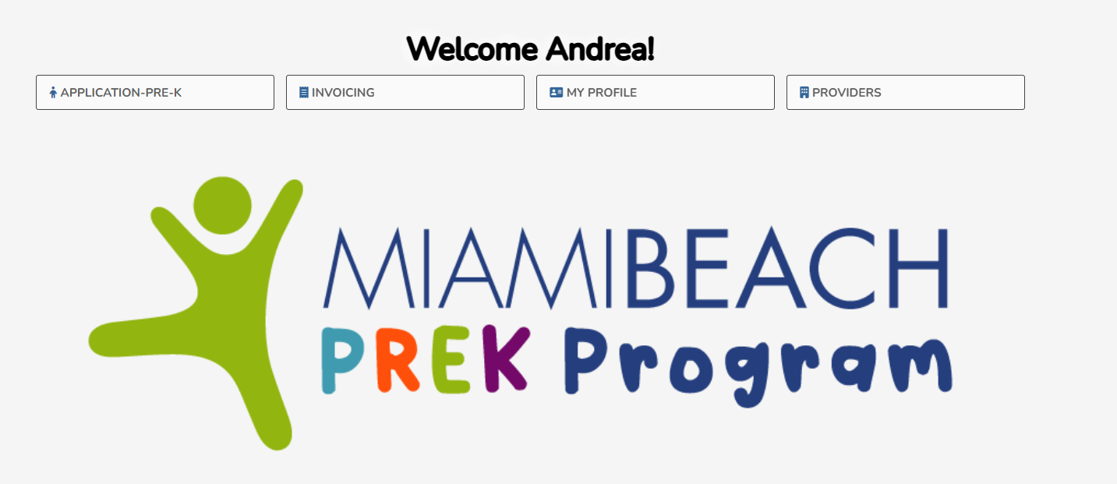

Slide 8
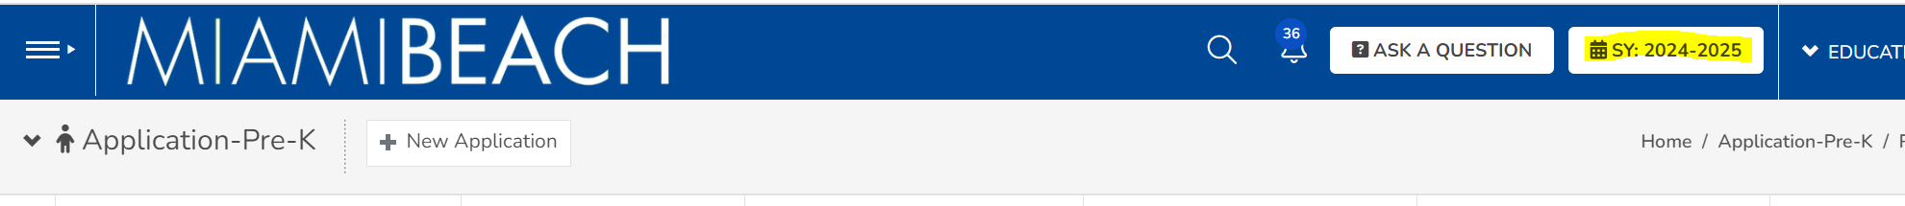
Select SY: 2026 – 2027

Slide 9
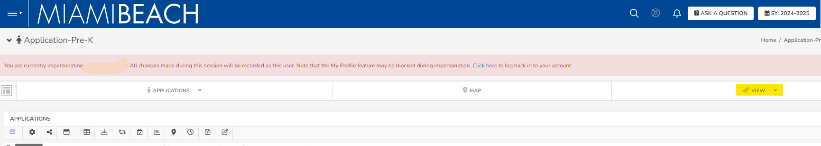
Click “View”
Select “Applications”

Slide 10
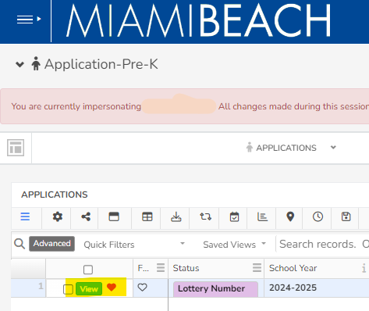
Click “View” to see additional details or make changes to your child’s application

Slide 11
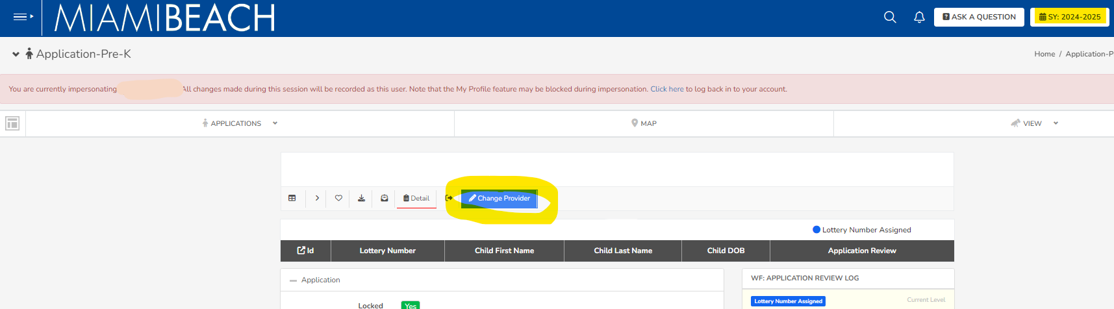
How to Change a PreK Provider:
Go to the child's application
Click “View” button
Click “Change Provider” on the menu bar and select new provider * Make sure you are on the correct school year (“SY: 2026-2027”)

Slide 12
Application Status:
Lottery Number Assign : Provider is notified to select if the child is enrolled or not enrolled for PreK in 2026-2027
Child Waitlisted:: : Child has been waitlisted and will be moved off the waitlist once a scholarship is available
Not Enrolled By Provider: : : Provider notifies the City that the child is not enrolled by the provider for PreK 2026-2027. Another school must be selected
Confirmatory Letter in Proces : A confirmatory letter has been sent through DocusSign to the Chief Education Officer, Family, and Provider to be completed
Won Lottery : The lottery has been won. No further action is required until the start of the school year

Slide 13
Provider Payment
Providers will be paid at their regular rate or $6.66 per hour, whichever is less, for up to 2.5 hours per day for 180 days, not to exceed $TBD per applicable school year per participant child
Any discounts based on income or other Provider offerings will decrease the amount due from the City
If the amount exceeds the City allowed $6.66/hr, the parent/guardian is responsible for any additional funds owed

Slide 14
Next Steps
Ensure your child is enrolled in PreK for the 2026-2027 academic school year with the PreK Provider listed on your application
Contact your PreK Provider to ensure they click “Enrolled” in their PreK Portal
Sign the Confirmatory Letter via DocuSign
Sign a tuition agreement with your PreK Provider once the Confirmatory Letter has been executed stating the reduction of the City of Miami Beach PreK Scholarship

Slide 15
www.miamibeachfl.gov/prek
Email us: education@miamibeachfl.gov

Slide 16
Q & A
Education and Performance Initiative

