Slide 1

Pre-kindergarten Scholarship Program
City of Miami Beach
Post Lottery – Provider Info Session
(School Year 2026-2027)
Dr. Leslie Rosenfeld
Chief Education Officer
Education and Performance Initiatives
Maggie Brown Pre-K Administrator
Education and Performance Initiatives

Slide 2

What Will You Learn Today?
Status of 2026-2027 Scholarship Funds and Provider Agreements
How to View Status of Invoices (2025-2026 school year)
How to Confirm Enrollment in the Provider Dashboard (2026-2027)

Slide 3

www.miamibeachfl.gov/prek

Slide 4
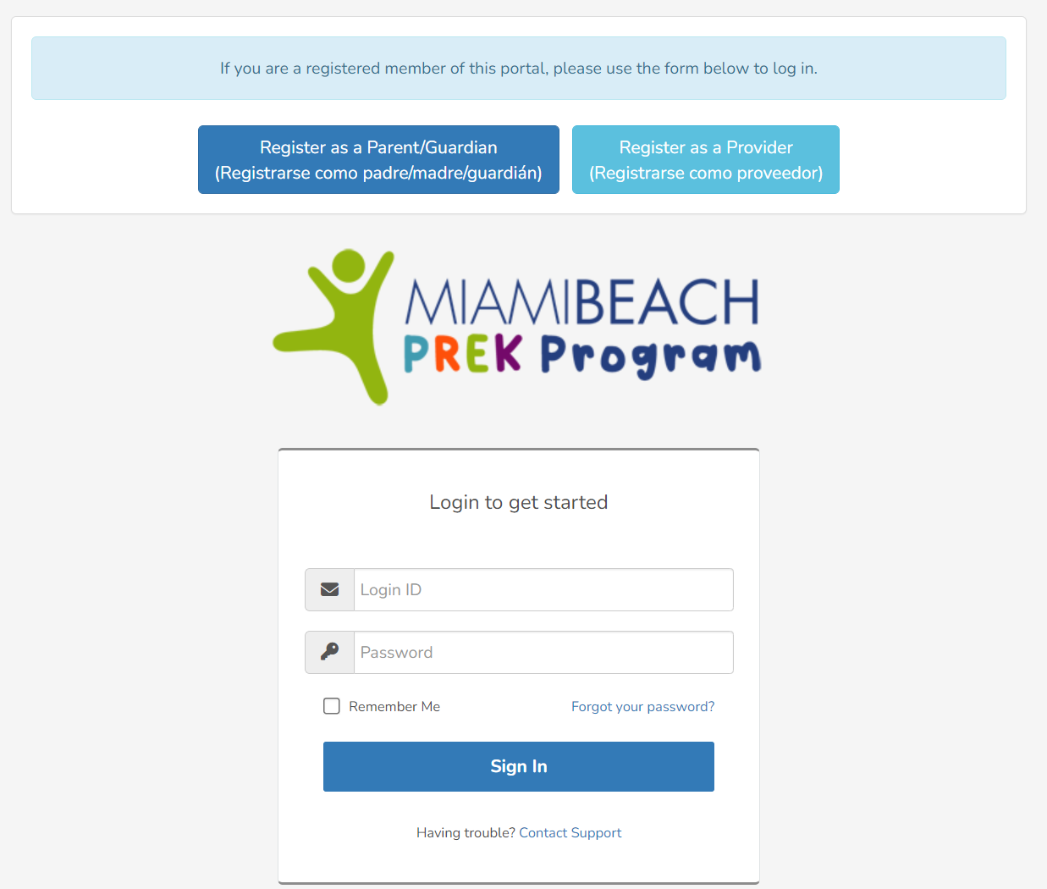
Log Into Your Dashboard
Go to Website https://www.miamibeachfl.gov/prek/
Click “Provider Account”
Enter your User ID
Enter your Password
Click Sign In

Slide 5
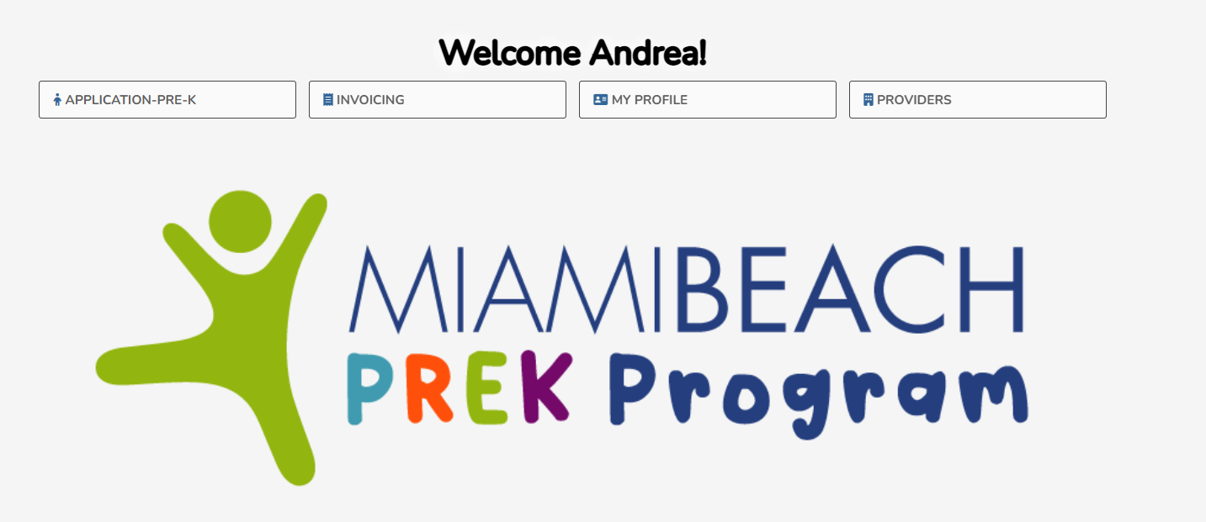
Provider Dashboard

Slide 6
Provider Dashboard
See lottery winners here
Submit and see status of invoices here

Slide 7
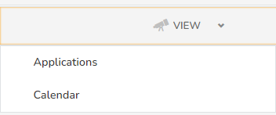
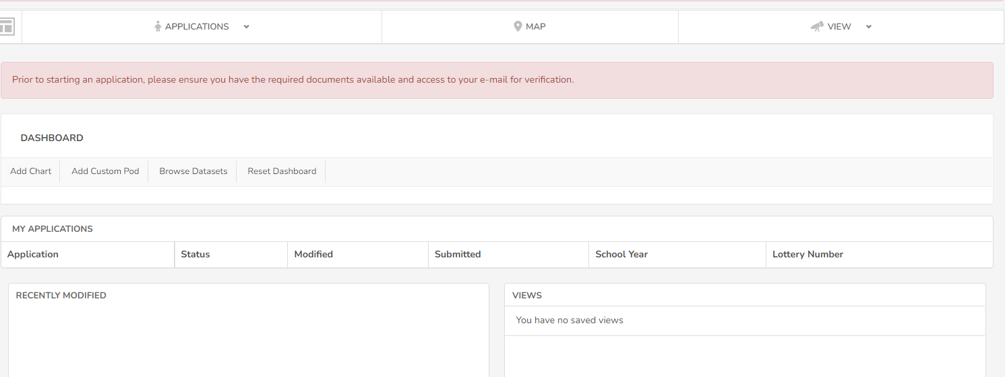
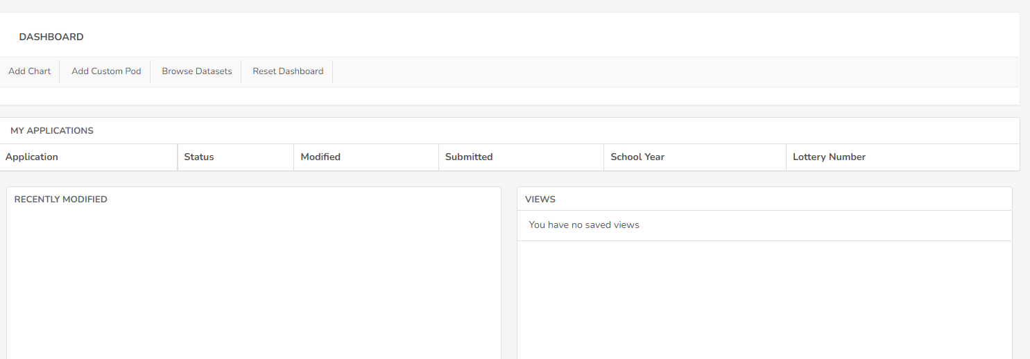
Click “View”
Click “Applications

Slide 8

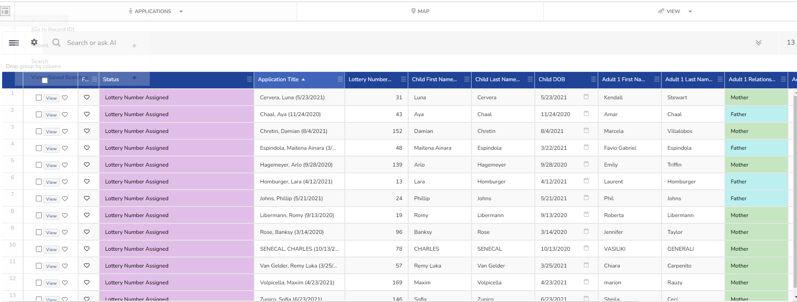
To return to dashboard

Slide 9
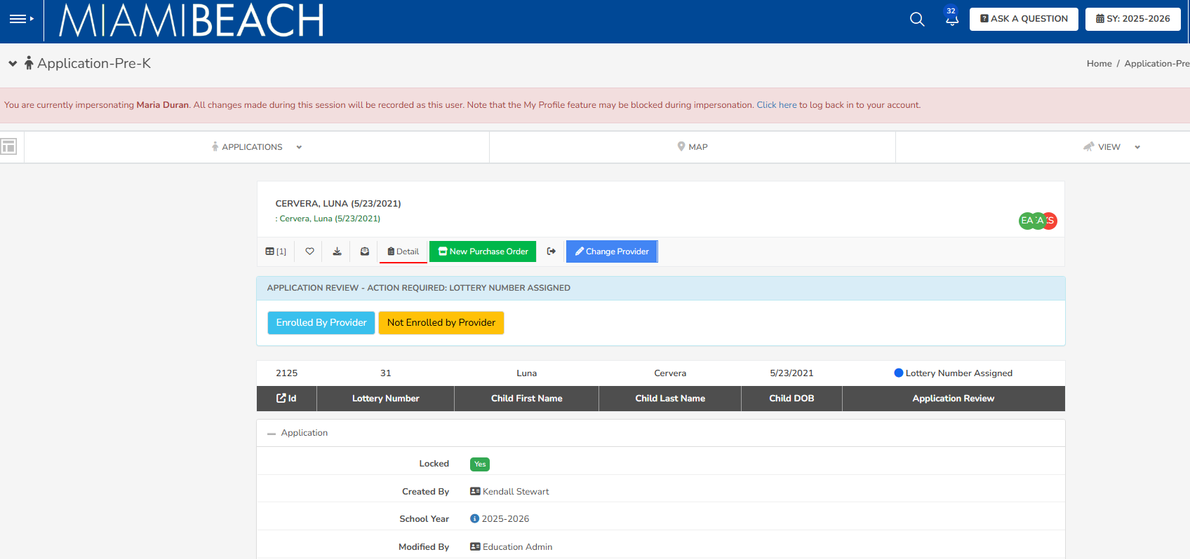
Select One: Prior to clicking the button please ensure:
1) Child is enrolled in PreK for the proper school year
2) Is a Miami Beach resident

Slide 10
Provider Dashboard
Action needed!
See lottery winners here
Submit and see status of invoices here

Slide 11
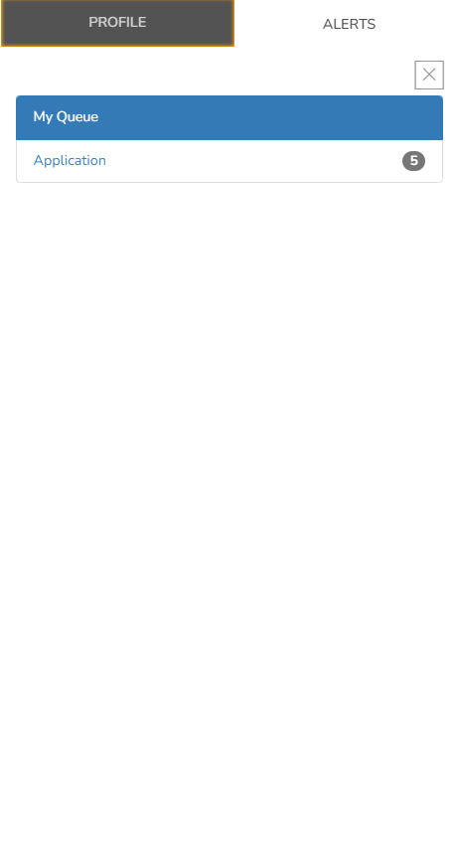

STEP 1
STEP 2

Slide 12
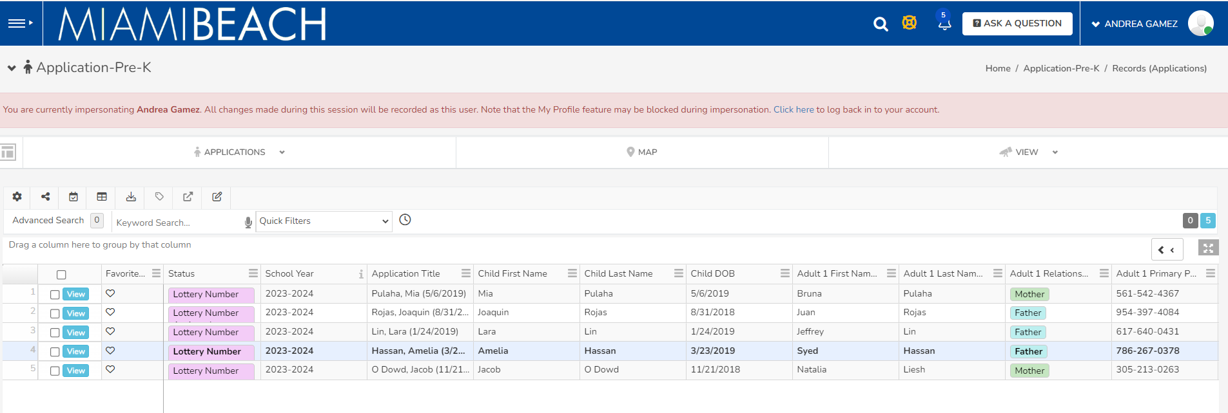
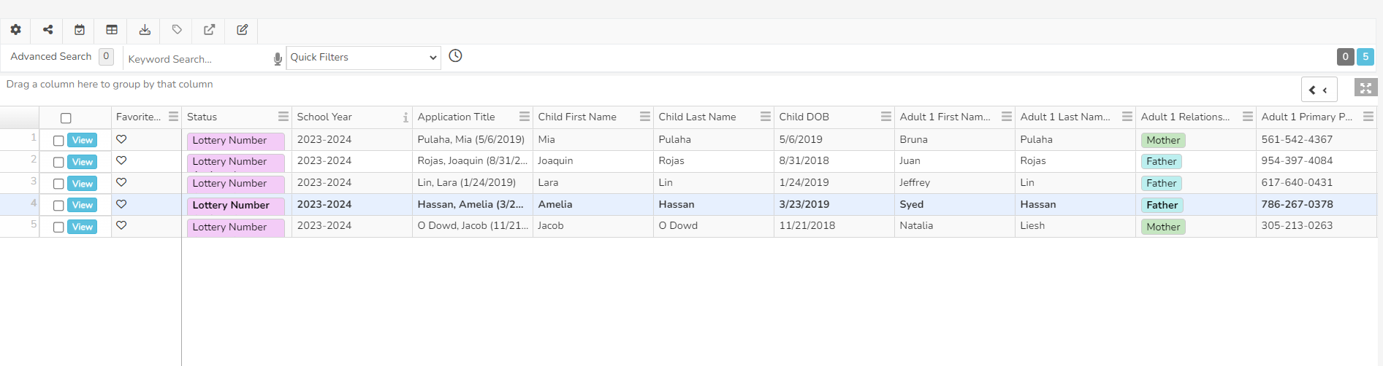
STEP 3

Slide 13
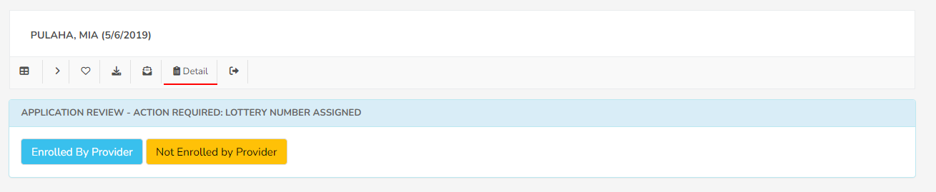
Child’s Name and Birthday
STEP 4

Slide 14
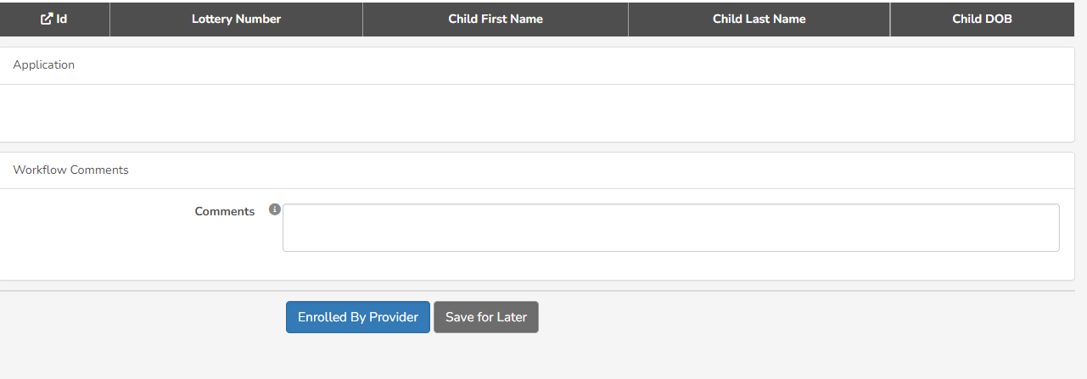
If you clicked “Enrolled By Provider” confirm your selection here.
No comment required.
STEP 5

Slide 15
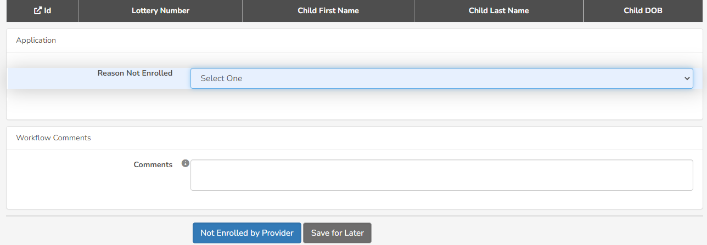
If you clicked “Not Enrolled By Provider” then
select one of the Reasons for Not Enrolled
Confirm your selection
OR STEP 5

Slide 16
Next Steps
Sign confirmatory letters for students who are accepted for 2026-2027
Sign a tuition agreement with your PreK Provider once the Confirmatory Letter has been executed stating the reduction of the City of Miami Beach PreK Scholarship
City will begin to open Purchase Orders

Slide 17
www.miamibeachfl.gov/prek
Email us: education@miamibeachfl.gov

Slide 18
Q & A
Education and Performance Initiative

