Slide 1

Building a Better Miami Beach
An Overview of RFA Requirements for CDBG and HOME Applicants
February 12, 2026
Notes:
“Good morning, everyone. Thank you for joining us today for ‘Building a Better Miami Beach: An Overview of RFA Requirements for CDBG and HOME Applicants.’ My name is Cristina Cabrera and I’m happy to walk you through today’s workshop.
we’ll be covering key requirements and guidelines for the RFA process.

Slide 2
Your Housing Team
Claudia Abreu, Office Associate V
claudiaabreu@miamibeachfl.gov
Paola Arboleda, Administrative Services Manager paolaarboleda@miamibeachfl.gov
Laura Cortes, Office Associate V
lauracortes@miamibeachfl.gov
Marcela Rubio, Assistant Director
marcelarubio@miamibeachfl.gov
Alba Tarre, Department Director
Albatarre@miamibeachfl.gov
The Take Away: The Housing Team is available to offer support and guidance.
Notes:
Presenting today for our team, we have myself, ________, I am the ____________; Claudia Abreu, our Office Associate; and Paola Arboleda, our Administrative Support Manager. On our team, but not on the meeting we have, Marcela Rubio, our Assistant Director; Alba Tarre, Department Director;. Remember, our Housing Team is always available to offer support and guidance. Let’s get started.”

Slide 3
Introduction
The City of Miami Beach is an entitlement grantee of federal funds. It receives an annual allocation of funding for the HOME Investment Partnership Program (HOME) and Community Development Block Grant (CDBG) programs from the United States Department of Housing and Urban Development (HUD). The City is entitled to these funds because its population, housing and/or demographic characteristics meet the formula requirements needed to obtain funding.
Notes:
“Let’s begin with an introduction. The City of Miami Beach is an entitlement grantee of federal funds. Every year, we receive an allocation of funding through the HOME Investment Partnership Program and the Community Development Block Grant, or CDBG, program from the United States Department of Housing and Urban Development. Our city qualifies for these funds because our population, housing, and demographic characteristics meet the specific formula requirements set by HUD.”

Slide 4
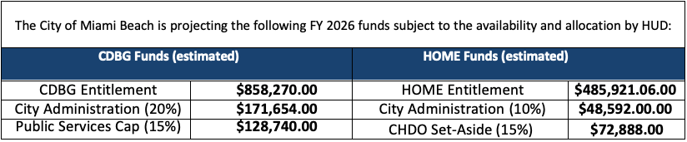
Estimated Amount of Funding Available
APPLICATION DISCLAIMER
This solicitation is subject to the award of funds from the United States Department of Housing and Urban Development (HUD).
Notes:
“As you review the funding information, please note that the amount of available funding is subject to the award of funds by HUD. This solicitation is provided on that basis, so the final funding decisions are dependent on HUD’s allocation. Congress just passed the budget last week, so we will know the final award amounts for the City of Miami Beach by early April”

Slide 5
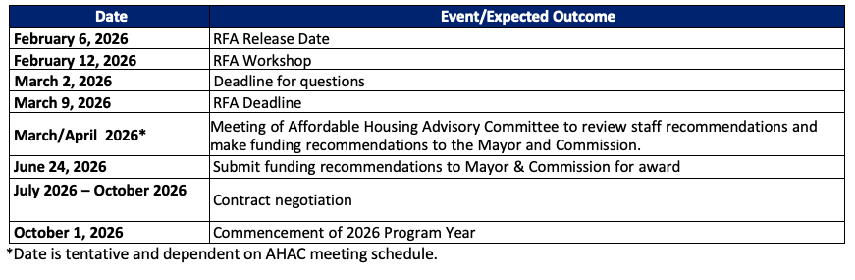
Timeline
Notes:
Next, let’s talk about the timeline. Here we have the key dates for the RFP.
I would like to highlight the deadline for questions is March 2nd and the RFA deadline is March 9th.
Date: March 2nd marks the deadline for applicants to submit any questions or inquiries they may have regarding the RFA. All questions must be submitted by this date to allow sufficient time for responses to be provided before the application deadline.
March 9th is the final deadline for applicants to submit their proposals in response to the RFA. All applications must be completed and submitted by this date to be considered for funding.
In March or April, the Affordable Housing Advisory Committee will convene to review the proposals received in response to the RFA. The committee will consider staff recommendations, and make funding recommendations to the Mayor and Commission.
On June 24th the recommendations will be formally submitted to the Mayor and Commission for approval.
Date: July – October
During this period, negotiations will take place to finalize the terms of the funding agreements or contracts. This may include discussions regarding project budgets, timelines, reporting requirements, and other terms and conditions.
Date: October 1, This marks the official start of the program year for the funded projects or initiatives, Although funds from HUD are typically received in November/December.

Slide 6
Eligible Activities/ Priority Needs
The City’s current Consolidated Plan was adopted June 28, 2023. This Five-Year Plan encompasses housing and non-housing community development activities, resources and projects to be undertaken to address the identified community needs for the fiscal years of 2023 through 2027. During the development of the Consolidated Plan, several priority needs were identified. Guidelines for addressing these priority needs over the 2023-2027 timeframe are summarized below:
Housing Affordability
Housing Affordability - Acquisition & Rental Rehabilitation
Housing Affordability – Tenant-Based Rental Assistance
Housing Affordability – New Construction
Housing Affordability – Homebuyer Ownership Assistance
Increase the Capacity of Public Services
Youth Services
Homelessness Services
Senior Services
Disability Programs
General Services Programs
Public Facility & Infrastructure Improvements
Neighborhood Revitalization
Neighborhood Resilience
Economic Development
Job Training and Business Support
Notes:
The City’s current Consolidated Plan was adopted on June 28, 2023, and covers community development activities for fiscal years 2023 through 2027. In this plan, several priority needs have been identified. These include various aspects of housing affordability – such as acquisition and rental rehabilitation, tenant-based rental assistance, new construction, and homebuyer ownership assistance – as well as increasing the capacity of public services. Additional priorities include youth services, homelessness services, senior services, disability programs, public facility and infrastructure improvements, neighborhood revitalization, neighborhood resilience, and economic development through job training and business support.

Slide 7
CDBG National Objectives
All CDBG activities must result in one of the following:
Benefit low/moderate- income (LMI) persons
Prevent or eliminate slums and blight
Meet an urgent need
For this RFP, the City is seeking applications that will benefit low/moderate income persons.
Notes:
All CDBG activities must achieve one of the following: benefit low- and moderate-income persons, prevent or eliminate slums and blight, or meet an urgent need. For this RFA, the City is particularly seeking applications that will benefit low- and moderate-income individuals.

Slide 8
CDBG LMA Area Benefit
Defining the Service Area:
The project must serve all residents within a defined geographic area, such as a neighborhood or census tract.
The area must be primarily residential.
Meeting the LMI Threshold:
At least 51% of the residents in the service area must be low- and moderate-income.
This is determined using data from the American Community Survey (ACS)
Eligible Activities:
Some public services that benefit all residents in the area.
Food Banks
Crime Awareness
Documenting Compliance:
Must maintain records proving the area meets the LMI requirement.
Documentation can include census data, surveys (if HUD data is insufficient), maps, and project descriptions.
Notes:
The area benefit subcategory requires that at least 51% of the residents in a service area have low to moderate incomes, and that the services are targeted to individuals living in the qualifying area. the project must serve all residents within a defined geographic area – such as a neighborhood or census tract – and that area must be primarily residential. At least 51 percent of the residents in that area must be low- and moderate-income, as determined using HUD data from the American Community Survey. Eligible public service that can use this national objective are services that benefit all residents in the area, such as food banks and crime awareness or prevention activities.. You must also document compliance with these requirements using census data, surveys, maps, and project descriptions.”

Slide 9
CDBG LMC Limited Clientele
Activities that benefit specific populations (e.g., services for seniors; homeless shelter)
Options for meeting limited clientele:
51% of participants are documented as LMC
Presumed clientele:
Activity must primarily serve: elderly, severely disabled adults, homeless persons, illiterate adults, migrant farm workers, abused children, persons with AIDS or battered spouses.
Notes:
The other way to meet the national objective criteria of benefit to low and moderate income persons is through the limited clientele or “presumed benefit” subcategory. In these cases, the activities assist people who have demonstrated that they meet the low or moderate income threshold or are presumed by HUD to have low or moderate incomes.
Under limited clientele, services are targeted to low and moderate income persons or people who are presumed to be low or moderate income regardless of where they live.
Some examples of CDBG funded public services that could qualify under limited clientele include after school programs for youth and job training programs.
When qualifying beneficiaries of these programs, grantees must document the income of the persons assisted by the service and demonstrate that at least 51% of the clientele are persons whose household income does not exceed the LMI income limit.
Sub-Recipients must maintain accurate and complete records for each person receiving direct assistance.
HUD presumes certain groups of people have low and moderate incomes. They are: persons who are elderly, severely disabled, victims of domestic abuse, abused children, illiterate adults, people who are homeless, migrant farm workers, and persons living with AIDS.

Slide 10
CDBG LMI Income Documentation
Several options for documentation:
Full 3rd party documentation, e.g., an employer
Evidence under another program at least as restrictive as CDBG (e.g., public housing, SNAP)
Evidence that assisted person is homeless
Referral from state, county or local employment agency or other entity that agrees to determine income and maintain documentation for grantee
Collect self-certifications on family size and income so that it is evident that at least 51 percent of the clientele are persons whose family income does not exceed the low- and moderate-income limit.
Notes:
“Documentation is key. You must maintain full records to prove that at least 51 percent of the clientele fall below the low- and moderate-income threshold. Collect all necessary information on family size and income to clearly demonstrate compliance.”

Slide 11
CDBG Eligible Public Service Activities
Includes services related to:
Employment
Job training
Crime prevention/public safety
Childcare
Health
Health services
Substance abuse services
Food banks
Notes:
"The CDBG program provides funding for a wide range of public services that improve the quality of life for residents in our community. These funds are meant to assist programs that address critical needs, such as housing stability, economic self-sufficiency, and access to vital services.
Employment Services
Job training programs that help individuals gain skills and secure employment opportunities.
Crime Prevention and Public Safety
Community policing programs, youth intervention initiatives, and activities that enhance neighborhood safety.
Childcare Services
Support for affordable childcare programs that enable parents to work or attend job training.
Health Services
Medical and dental services for low-income individuals.
Substance abuse services, including prevention, treatment, and recovery programs.
Food Banks

Slide 12
CDBG Eligible Public Service
Activities (cont’d)
Also includes services related to:
Housing
Housing counseling
Fair Housing counseling
Energy conservation
Services for homeless persons
Education
Senior Services
Youth Services
Services for Persons with Disabilities
Notes:
Housing-Related Services
Housing counseling to help individuals navigate homeownership or rental options.
Fair Housing counseling to ensure equal access to housing opportunities.
Energy conservation programs that help low-income households reduce utility costs.
Services for homeless individuals, such as outreach programs, shelter assistance, and case management.
Educational Services
Programs that provide tutoring, GED preparation, financial literacy, and other educational opportunities for underserved communities.
Senior Services
Programs that offer meal services, transportation, and social engagement for elderly residents.
Youth Services
Recreation services for teenagers and teen counseling programs
Services for Persons with Disabilities

Slide 13
CDBG Allowable Public Service Costs
Labor, supplies and materials
Operation and maintenance costs of facility where service occurs
Payments must be directly related to the provision of eligible services
Notes:
“When budgeting for public services, allowable costs include labor, supplies and materials, as well as the operation and maintenance costs of the facilities where these services are provided. It is important that all payments are directly related to the provision of these eligible services.”

Slide 14
CDBG Public Service Restrictions
The service must be:
A new service OR
A quantifiable increase in the level of an existing service that has been provided by the grantee or another entity on its behalf with local government funding (or funding from the state to the local government) in the preceding 12 months
Note: This does not mean that a currently funded service organization needs to do more each year
Notes:
"While the CDBG program provides broad support for public services, there are important restrictions to keep in mind. To be eligible for funding, a public service must either:"
✅ Be a new service, or ✅ Represent a quantifiable increase in the level of an existing service that was funded by the local government or state in the preceding 12 months.
"This does not mean that currently funded organizations must expand their services every year. However, CDBG funds cannot simply replace prior local government funding without increasing the service level."

Slide 15
CDBG Ineligible Public Service Activities
❌ Income payments
Except emergency grant payments
Not to exceed three consecutive months
Payments made directly to provider
Examples include utility payments to prevent cutoff of service, and rent/mortgage payments to prevent eviction.
❌ No ongoing operations as a stand-alone public service
For example: operating rental housing
Different than paying to offer a service within the housing development, such as counseling
❌ Political activities ineligible
Notes:
"Certain activities are not eligible for CDBG public service funding. These include:"
❌ Income payments, except in cases of emergency assistance.
Emergency grant payments are limited to three consecutive months and must be paid directly to the service provider.
❌ Ongoing operations of a stand-alone public service.
For example, operating a rental housing facility is not eligible. However, paying for services within a housing development, such as counseling, is allowed.
❌ Political activities, including lobbying and voter registration efforts.

Slide 16
CDBG Public Services &
Religious Entities
Funds may not be used for religious activities
No religious events or requirements to pray before public service is provided
However, eligible public services may be provided through a religious entity if formal agreement in place stipulating:
No discrimination (employment or participants)
No religious instruction or counseling
Notes:
"Another key consideration is how public services can be provided through religious entities. While CDBG funds generally may not be used for religious activities, religious organizations can receive funding if they meet specific requirements."
✔ Religious instruction or worship cannot be a condition of receiving the service. ✔ No discrimination in hiring practices or participant selection. ✔ A formal agreement must be in place to ensure compliance with CDBG regulations.
"This means that while faith-based organizations can participate in the program, CDBG funds cannot be used to support religious events, services, or requirements such as prayer before receiving assistance."

Slide 17
CDBG Economic Development
Eligible Activities
1. Business Assistance
Grants or loans to small businesses and microenterprises.
Working capital, inventory, equipment, or property improvements.
Technical assistance and training for small businesses.
2. Infrastructure for Economic Growth
Public improvements (e.g., roads, utilities) needed to support new or expanding businesses.
Site preparation and rehabilitation for business development.
3. Job Creation & Retention
Projects that create or retain permanent jobs, at least 51% of which must be for LMI individuals.
Funding for workforce training and employment services.
Notes:
Moving on to economic development, CDBG funding supports several eligible activities. First, there is business assistance, which may include grants or loans for small businesses and microenterprises to cover working capital, inventory, equipment, or property improvements, as well as technical assistance and training. Second, funding may support infrastructure for economic growth, including public improvements like roads and utilities, as well as site preparation and rehabilitation. Third, projects that create or retain permanent jobs – with at least 51 percent of these jobs designated for low- and moderate-income individuals – are eligible, along with funding for workforce training and employment services.”

Slide 18
CDBG Economic Development
Eligible Activities, Cont.
4. Commercial & Industrial Rehabilitation
Renovation of buildings for commercial or industrial use.
Façade improvements to revitalize business districts.
5. Special Economic Development Activities
Assistance to Community-Based Development Organizations (CBDOs) for job creation projects.
Support for economic development revolving loan funds.
Notes:
“In addition, funding may be used for commercial and industrial rehabilitation, such as renovating buildings for commercial or industrial use and making façade improvements to revitalize business districts. Lastly, special economic development activities include assistance to Community-Based Development Organizations for job creation projects and support for economic development revolving loan funds.”

Slide 19
CDBG LMJ Jobs National Objective
Activities must create or retain permanent jobs, with at least 51% of jobs held by or made available to LMI persons.
Job creation: Documentation must show 51% LMI benefit.
Job retention: Documentation must demonstrate jobs would be lost without CDBG assistance, and that 51% of jobs are held by LMI persons or are expected to turn over within two years and be made available to LMI persons.
Notes:
In addition to the 2 national objectives we have already reviewed, certain economic development activities may meet the low-mod Jobs national objective. This is used for activities that create or retian permanent jobs, and at least 51% of the jobs must be held by or made available to LMI persons.
For job creation activities, documentation must demonstrate that at least fifty-one percent of the jobs created will benefit low- and moderate-income persons.
For job retention activities, documentation must demonstrate that the jobs would be lost without CDBG assistance. In addition, documentation must show that at least fifty-one percent of the retained jobs are currently held by low- and moderate-income persons, or are expected to turn over within two years and be made available to low- and moderate-income persons.

Slide 20
HOME Investment Partnerships Program
Purpose
Provide decent affordable housing to low-income households (<80% AMI);
Expand the capacity of nonprofit housing providers;
Strengthen the ability of state and local governments to provide housing; and
Leverage private sector participation.
Notes:
“Shifting to the HOME Investment Partnerships Program, its purpose is to provide decent, affordable housing to lower income households, expand the capacity of nonprofit housing providers, strengthen the ability of state and local governments to provide housing, and leverage private sector participation.”

Slide 21
HOME Investment Partnerships Program
Eligible Activities:
Acquisition
New Construction
Rental Rehabilitation
Homebuyer Rehabilitation
Homebuyer Assistance
Affordability Period:
30 years for Rental
15 years for Homebuyer Assistance
Notes:
“The HOME program addresses housing needs identified in the Consolidated Plan, including affordable housing and ADA accessible housing. Eligible activities under HOME include acquisition, new construction, Rental Rehabilitation, Homebuyer Rehabilitation, and homebuyer assistance.. The affordability period is set at 30 years for multi-family rental projects and 15 years for homeowner assistance.

Slide 22
HOME Investment Partnerships Program
Eligible Beneficiaries:
At least 90 percent of benefitting families must have incomes that are no more than 60 percent of the HUD-adjusted AMI for Miami-Miami Beach-Kendall, FL HUD Metro FMR Area; and
In rental projects with 5 or more units, at least 20% of the units must be occupied by families with incomes that do not exceed 50% of the HUD-adjusted median; and
The incomes of households receiving HUD assistance must not exceed 80 percent of AMI.
Notes:
“To qualify, at least 90 percent of benefiting families must have incomes that do not exceed 60 percent of the HUD-adjusted area median income. In rental projects with five or more units, at least 20 percent of the units must be occupied by families with incomes that do not exceed 50 percent of the HUD-adjusted median, and overall, household incomes receiving HOME assistance must not exceed 80 percent of the area median income.”

Slide 23
Community Housing Development Organization (CHDO) Qualification
What is a CHDO?
A private nonprofit, community-based, service organization that has capacity to develop affordable housing for a specific community it serves.
Must complete the certification process annually.
Eligible CHDOs can receive 15% of a participating jurisdiction’s annual HOME allocation for development of rental or homebuyer properties
Things to Consider:
The 24-month commitment requirement for CHDO’s has been suspended through the FY 2026 appropriations. However, the City of Miami Beach continues to accept applications for CHDO designation, depending on funding availability.
Notes:
“A CHDO is defined as a private nonprofit, community-based service organization that either currently has the capacity to create affordable housing in the community. CHDOs must complete a certification process annually, and eligible CHDOs can receive up to 15 percent of a participating jurisdiction’s annual HOME allocation. Please note that the 24-month commitment requirement for CHDOs has been suspended through the fiscal year 2026 appropriations, although applications are still accepted depending on funding availability.”

Slide 24
Community Housing Development Organization (CHDO) Qualification
Key CHDO Qualifying Requirements
Legal and tax-exempt status;
Financial management capacity and accountability;
Staff capacity to carry out HOME-funded activities;
Experience serving the community; and
Board representation by community members, with at least one-third of its members from low-income households.
Notes:
“Key requirements for CHDO qualification include having legal and tax-exempt status, strong financial management capacity, sufficient staff to execute HOME-funded activities, proven experience in serving the community, and board representation that includes at least one-third members from low-income households.”

Slide 25
Underwriting & Subsidy Layering Review
HOME underwriting is the analysis of project assumptions and risks to ensure the project will meet affordability requirements
Subsidy Layering is completed to determine the level of HOME assistance is necessary and reasonable
HOME funds must be the last source committed to a project
Analysis of Market assessment and developer capacity ensure viable and sustainable projects
Applies to all projects using HOME funds
Notes:
“Underwriting for HOME projects involves analyzing project assumptions and risks to ensure the project meets affordability requirements. Subsidy Layering is the process of determining the necessary level of HOME assistance. This review examines market assessments, developer capacity, and overall project sustainability, and applies to all projects using HOME funds.”

Slide 26
Underwriting & Subsidy Layering Review
The Subsidy Layering Review (SLR) must include:
Maximum per unit subsidy limits;
Cost Allocation (must include the minimum number of HOME units and maximum amount of HOME funding);
Cost Reasonableness;
Rents/utility allowance;
Operating Proforma;
Development Budget;
Sources and Uses Statement;
Market Assessment;
Developer Experience/Developer Capacity;
Physical Needs Assessment; and
Property Standards.
Notes:
“The Subsidy Layering Review must include several components: maximum per unit subsidy limits; a cost allocation that covers the minimum number of HOME units and maximum funding levels; cost reasonableness; appropriate rents or utility allowances; an operating proforma; a detailed development budget; a sources and uses statement; a market assessment; an evaluation of developer experience and capacity; a physical needs assessment; and compliance with property standards.”

Slide 27
SLR: Market Assessment
Document current neighborhood market conditions
Compare proposed HOME rents to prevailing market rents
Evaluate effective demand, capture rate, and estimated absorption period
Analyze the competition by evaluating other housing opportunities with an emphasis on other affordable developments in the market area
Confirm ability to achieve timely occupancy by eligible HOME households
Independent market studies prepared for other funders may be used if they meet HOME requirements
Notes:
“In the market assessment, you must assess and document current neighborhood market demand for your project. This includes comparing the proposed HOME-assisted rents to prevailing market rents to determine whether the units are appropriately priced.
You must evaluate effective demand, including the capture rate and the estimated absorption period.
The assessment should also analyze market competition by reviewing other housing opportunities in the market area, with particular emphasis on existing and planned affordable housing developments.
Finally, you must confirm the project’s ability to achieve timely occupancy by income-eligible HOME households.
Independent market studies prepared for other funders may be used, if they meet HOME program requirements.

Slide 28
SLR: Developer Experience/Developer Capacity
Must assess team’s financial ability to complete project development and support project operations
Available capital
Need sufficient reserves to complete project
Ensure stability for this project through period of affordability
Sources and Uses statement must describe all funds and costs to complete the project
Provide supporting documentation
Notes:
“The review also evaluates your team’s financial ability to complete project development and support ongoing operations. This includes reviewing the availability of capital and confirming that the organization has sufficient reserves to carry the project through construction and into stabilization. We must also ensure that the project will remain financially stable throughout the HOME affordability period.
The Sources and Uses statement must clearly describe all funds and all costs necessary to complete the project.
Supporting documentation to substantiate the information presented must be included in the application.

Slide 29
SLR: Pro-Forma and Development Budget
Pro-Forma should include:
Projected income and vacancies
Operating Expenses
Contributions to Reserves
Debt Service
Cash Flow and Payments of Deferred Fees
Rents should be in compliance with HOME limits
Notes:
“Your project pro-forma should include projected income, expected vacancies, operating expenses, contributions to reserves, debt service, cash flow projections, and any deferred fees. It is critical that all projected rents comply with HOME limits.”

Slide 30
SLR: Physical Needs Assessment
FOR REHABILITATION PROJECTS:
Energy Efficiency Improvements that promote conservation, economic stability and greater community resilience
Multi-Family Rental Rehabilitation to maximize housing opportunities in our land-locked community with limited development opportunities
Documentation of current property standards
FOR NEW CONSTRUCTION PROJECTS:
In lieu of a physical needs assessment, the applicant may provide rendering or any documents in connection with construction design if available. As a reminder, all projects must be in compliance with local laws and regulations.
Notes:
Additional notes for the presentation:
SLR: Physical Needs Assessment
For Rehabilitation Projects:
Energy Efficiency Improvements: Implementation of enhancements that promote energy conservation, economic stability, and enhance community resilience.
Multi-Family Rental Rehabilitation: Focus on revitalizing multi-family rental properties to maximize housing opportunities, especially in land-locked communities with limited development prospects.
Documentation of Current Property Standards: Comprehensive documentation of the existing property conditions and standards to identify necessary improvements and ensure compliance with program requirements.
For New Construction Projects:
Rendering or Construction Design Documentation: Instead of a traditional physical needs assessment, applicants may submit renderings or any available documents related to construction design. However, it's crucial to note that all projects must adhere to local laws and regulations to ensure compliance and safety standards are met.

Slide 31
SLR: Resources
HUD Exchange has reference material that will address all requirements for all components of the SLR
HUD Notice CPD-15-11: Requirements for the Development and Implementation of HOME Underwriting and Subsidy Layering Guidelines
Notes:
Additional guidance on the Subsidy Layering Review can be found on HUD Exchange. Please refer to HUD Notice CPD-15-11 for reference material addressing all components of the SLR.

Slide 32
Application Submittal
Applications submitted online through Neighborly.
Access applications:
Directly at: https://portal.neighborlysoftware.com/MIAMIBEACHFL/Participant
Access Application Information & Guidance document via City website: https://www.miamibeachfl.gov/city-hall/housing-and-community-development/housing-and-community/housing-services/
Notes:
“The City uses the Neighborly portal to collect and review applications for funding. We’ll walk through each section of the online application, explain what information you need to provide, and share tips to help ensure your submission is accurate and complete.”

Slide 33
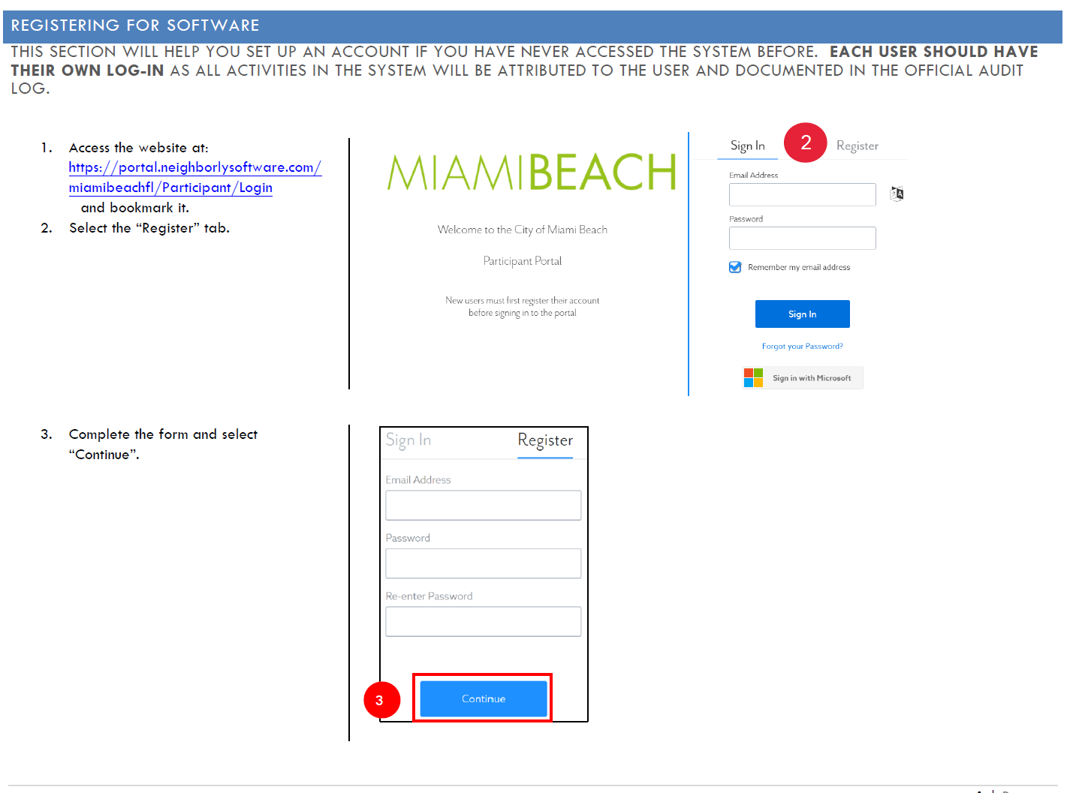
The Application
Notes:
First, log in to the Neighborly portal, you will need to register for an account if you do not have one.

Slide 34
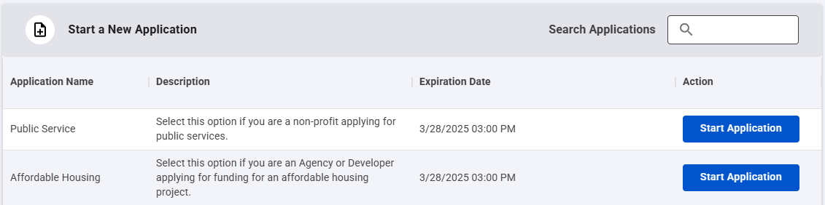
The Application
Applications for CDBG public services are submitted under the “Public Service” application.
Applications for CDBG and HOME housing projects are submitted under the “Affordable Housing” application.
Applications for CDBG Economic Development Activities are submitted under the “Economic Development” application.
Notes:
Once you’ve accessed the site, locate the application form relevant to your project.

Slide 35

The Application
Once you login, you will be asked to enter your agency name. Click submit and you will be directed to section for General Information.
Completing Each Section
At the bottom of each screen you have the option to Save or Complete & Continue to the next section.
Complete & Continue will allow you to move onto the next section
Staff can reopen a section that was accidentally completed
Answers are not automatically saved. You must click on the Save button at the bottom of each screen.
Notes:
Once you login, you will be asked to enter your agency name. Click submit and you will be directed to section for General Information.
You’ll see the main menu of sections on the left side of your screen. Now let’s go through these sections in order

Slide 36
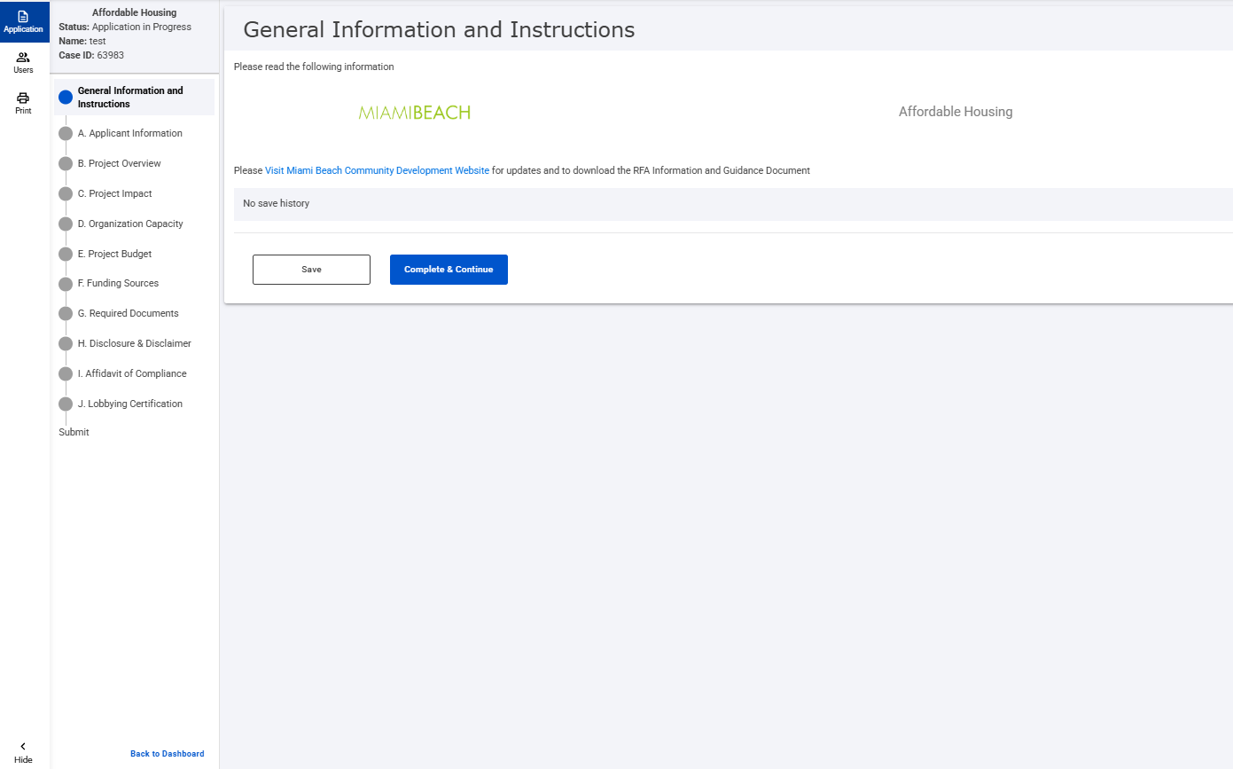
Select ‘Users’ to grant access and collaborate on the application

Slide 37
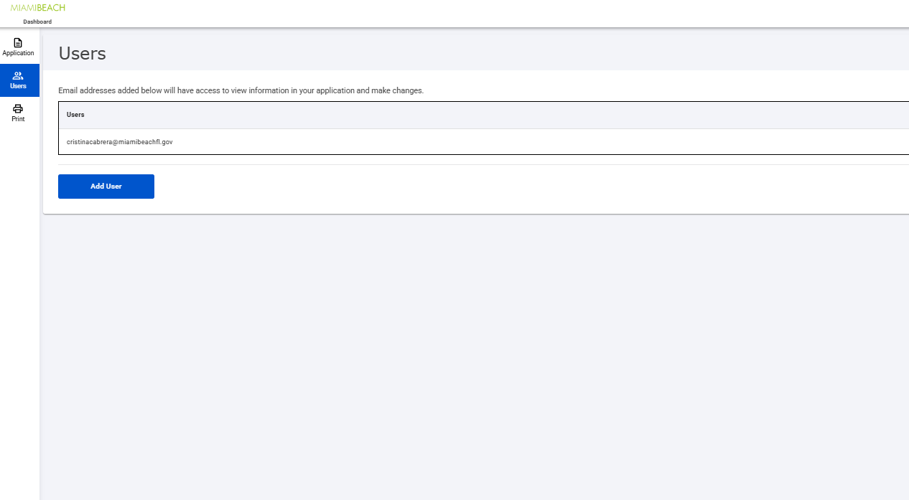

Slide 38
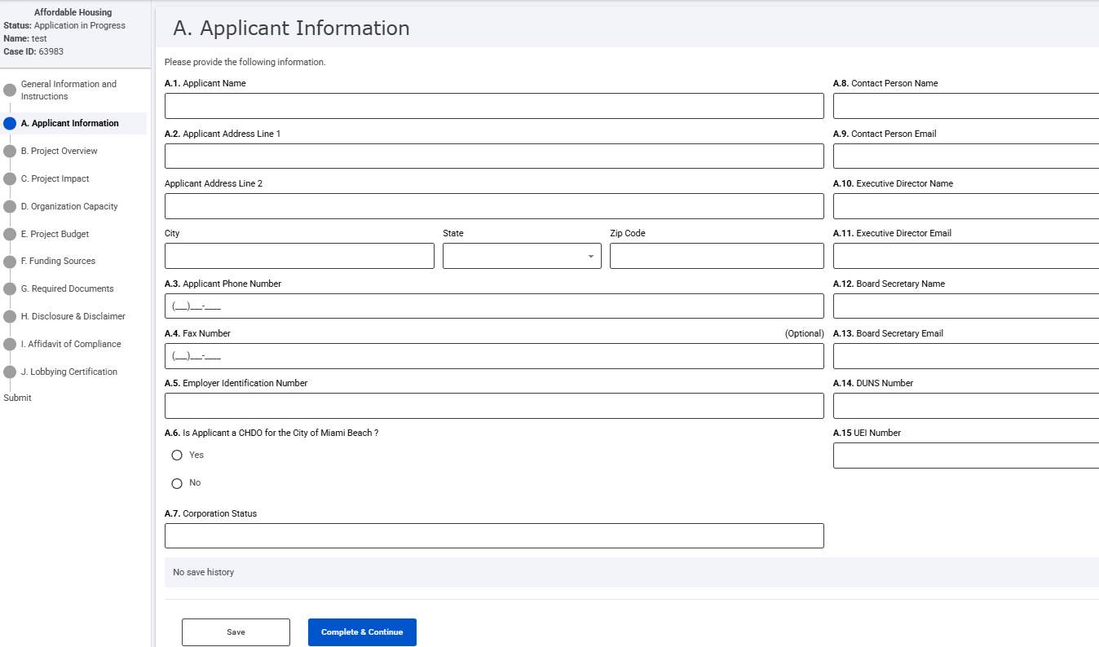
Notes:
“In Section A, you’ll enter your organization’s contact details. Provide your official name, address, phone number, and website. Be sure to include the name and email address of both your CEO (or Executive Director) and your designated point of contact. Double-check the spelling and accuracy of these entries, because this is how the City will communicate with you about your application.”

Slide 39
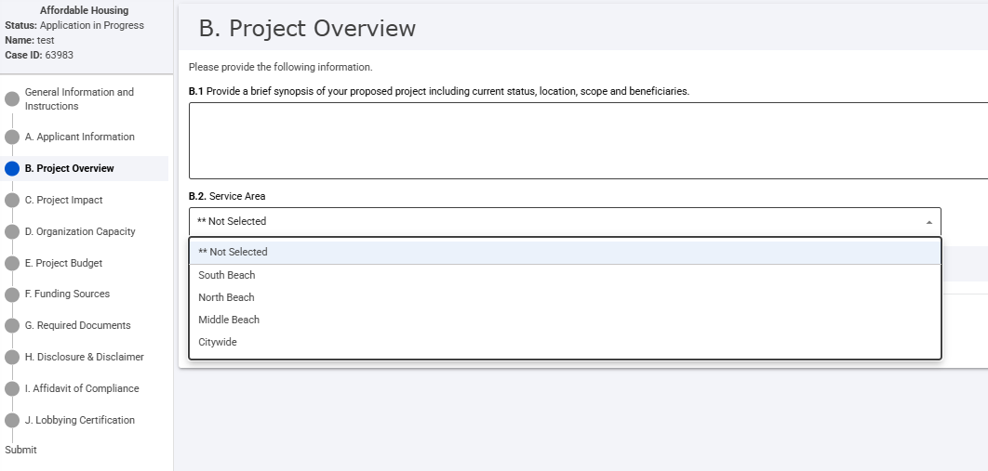
Notes:
Next, Section B focuses on the big picture of your proposed project. Start by typing in your program name. Then, in the brief synopsis, describe the main objectives, location, and who you expect to serve—also known as your beneficiaries. Lastly, define your service area, whether citywide or in a specific neighborhood

Slide 40
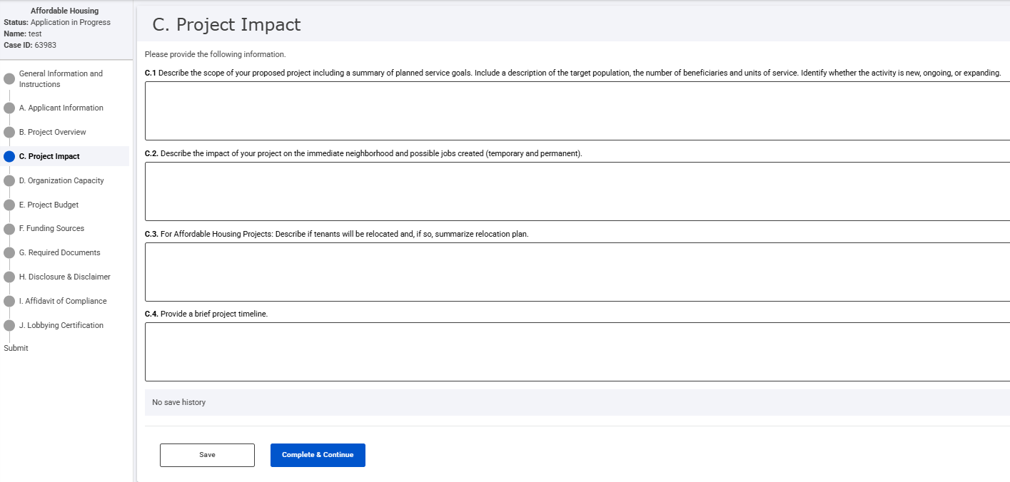
Notes:
In Section C, you’ll go into greater detail about the scope and benefits of your project. Explain how it will address local needs, how many individuals you expect to serve, and the timeline for your activities. If you only serve residents within a certain area indicate that here. You’ll also outline how you plan to measure success, including any tools, data, or client surveys you’ll use to evaluate your impact.

Slide 41
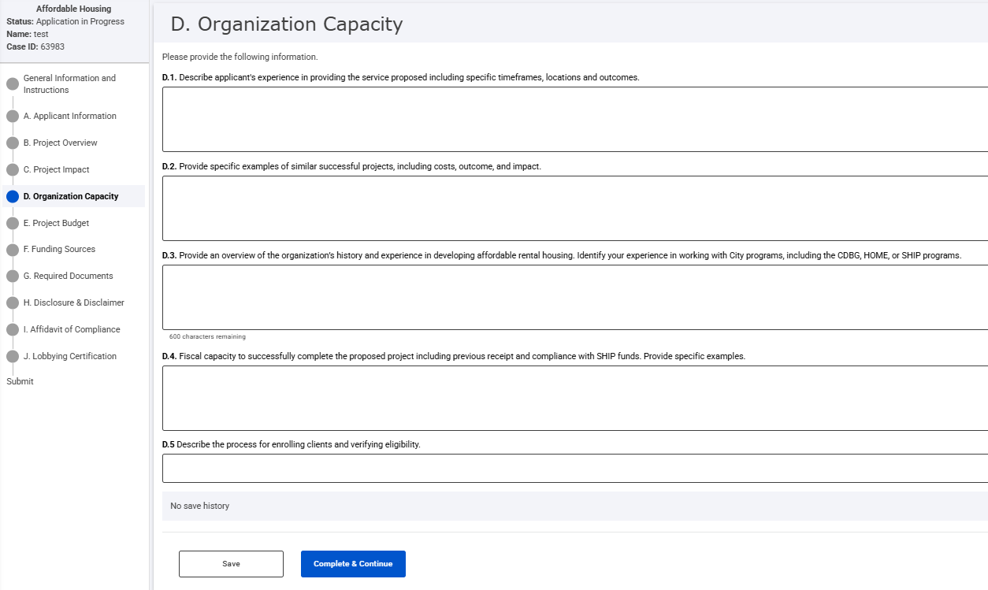
Notes:
“Section D highlights your organization’s background and ability to implement the project. Provide a summary of your mission, history, and any successful outcomes from similar programs. Be specific about any previous experience managing HUD or other federal grants. Next, explain your client intake process, including how you determine eligibility. Finally, list the staff who will oversee the project, noting their titles and years of relevant experience.”

Slide 42
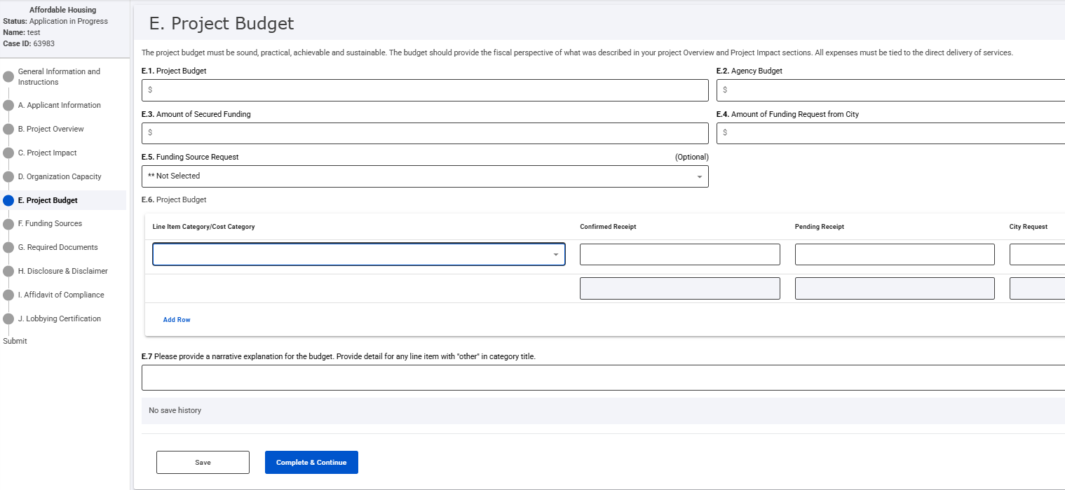
Notes:
In Section E, you’ll detail the financial plan for your project. First, provide your overall project budget, followed by your total agency budget. Indicate any secured funding you already have and the amount of CDBG funding you are requesting. If you have other pending or secured sources, note them here. It’s also important to explain how you would adjust if you receive less funding than requested. Be clear about each line item so reviewers can see exactly how you plan to spend the funds.

Slide 43
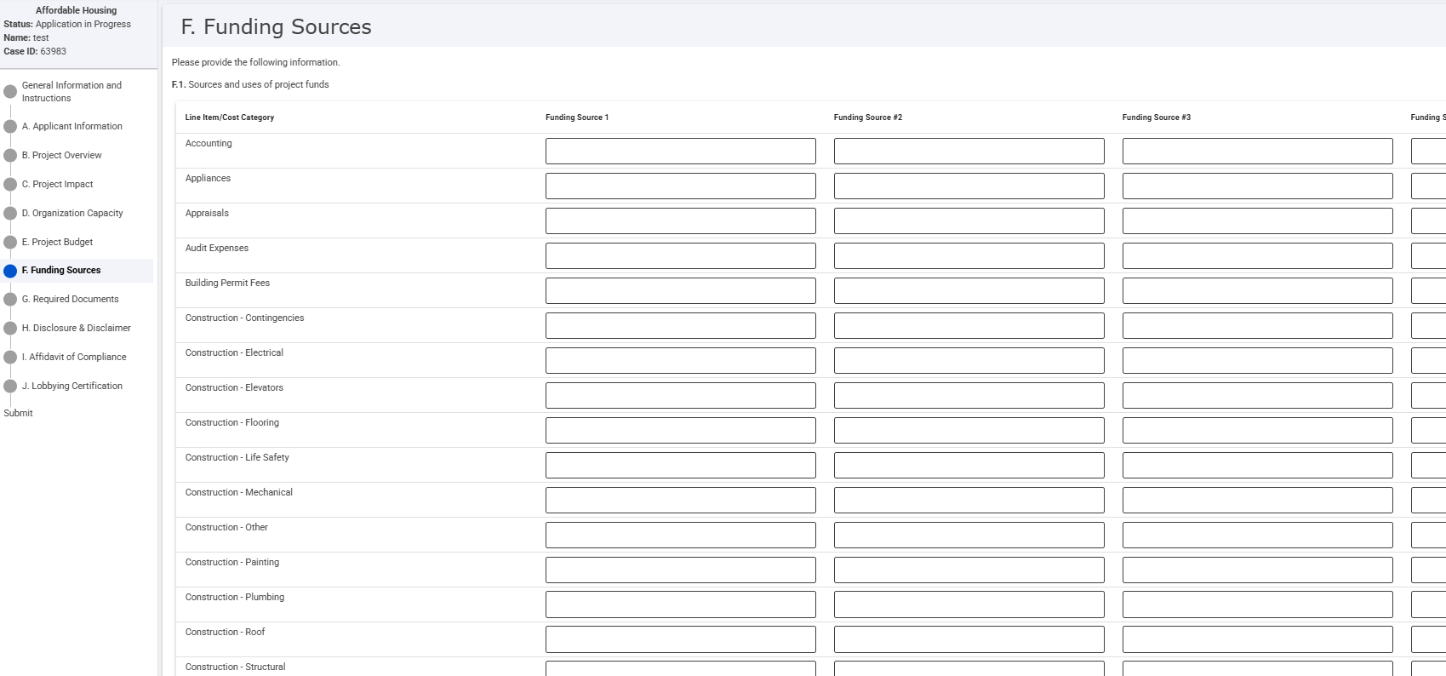
Notes:
In Section F, you’ll break down where all the money is coming from. Enter each source of funding and the specific amount allocated. If you have multiple sources—like private donations or other grants—include them here. This section shows the City you have a well-rounded plan for financial support.

Slide 44
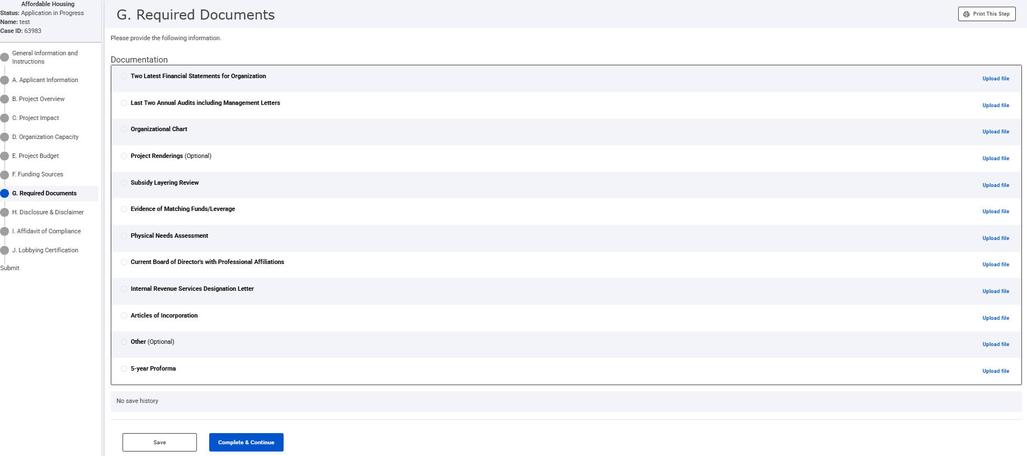
Notes:
In Section G, you’ll upload important documents such as your Articles of Incorporation, IRS nonprofit designation letter, recent financial statements, and evidence of insurance. Make sure each file is labeled clearly and meets the requirements stated in the application guidelines. Double-check that you have uploaded the correct, most up-to-date versions before proceeding

Slide 45
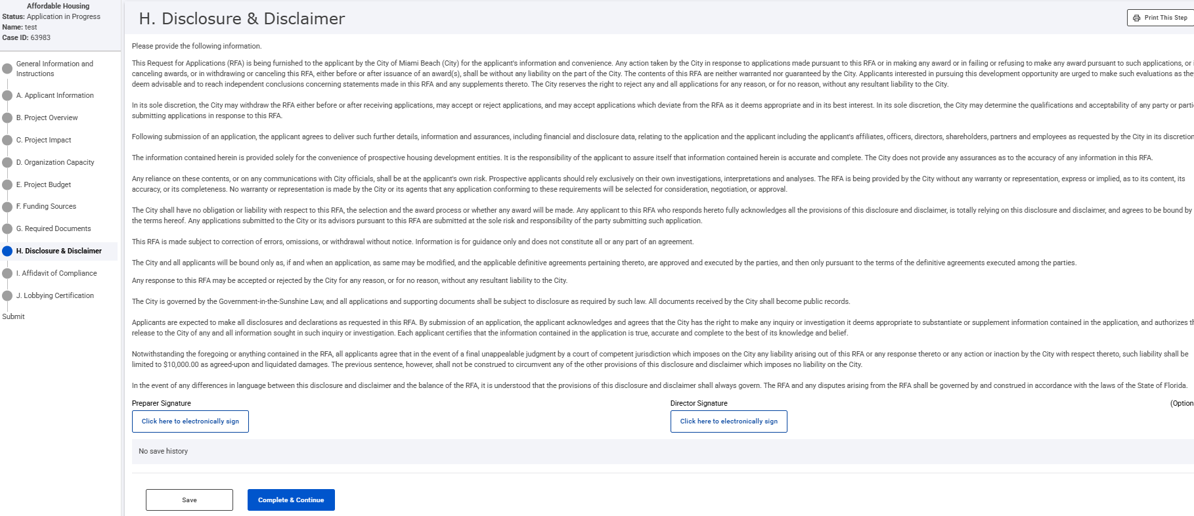
Notes:
“Sections H, I, J, contain critical legal statements. You must carefully review the City’s ‘Disclosure & Disclaimer’ in Section H, the ‘Affidavit of Compliance’ in Section I, and the ‘Lobbying Certification’ in Section J. Please read each one thoroughly and check the appropriate acknowledgment boxes. Signatures are required, ensure the correct individual from your organization signs in the designated fields.

Slide 46
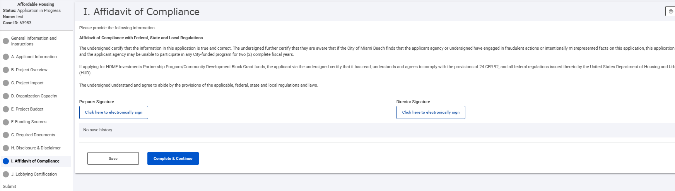

Slide 47
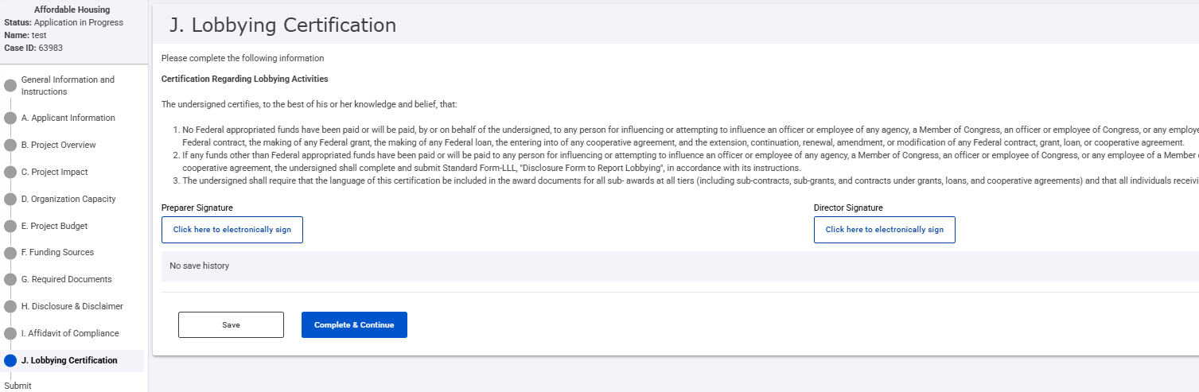

Slide 48
Questions & Answers
The Take Away: We are here to ensure your successful application.

