Slide 1

Methodize
An SAT® & ACT® Prep Platform
Evan Wessler
Director of Tutoring and Instruction
This presentation ©Method Learning, 2026, all rights reserved. SAT is a registered trademark of the College Board; the ACT Test is a registered trademark of ACT, Inc. These organizations are not affiliated with and do not endorse Method Learning.

Slide 2

About Me
Grew up in NY
Graduate of Bucknell University (2009), BS Biology
Brief foray into graduate studies in biomedical science
Have worked with Method Learning for nearly 17 years
Over 12,000 hours of tutoring and course experience
Evan Wessler ca. 2015, looking younger and much more awake

Slide 3
Be methodical with your SAT/ACT prep
Gain clarity
Reduce stress
Manage expectations

Slide 4
Predictability warrants preparation
These exams are standardized: they must test the same set of skills in the same way on every administration.

Slide 5
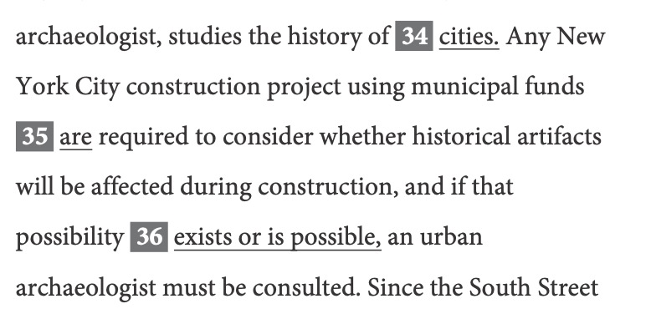
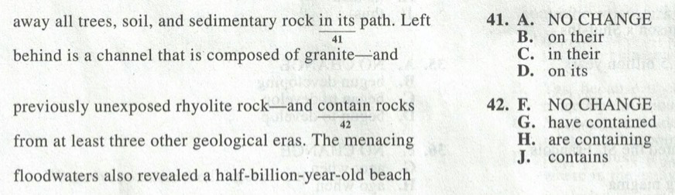
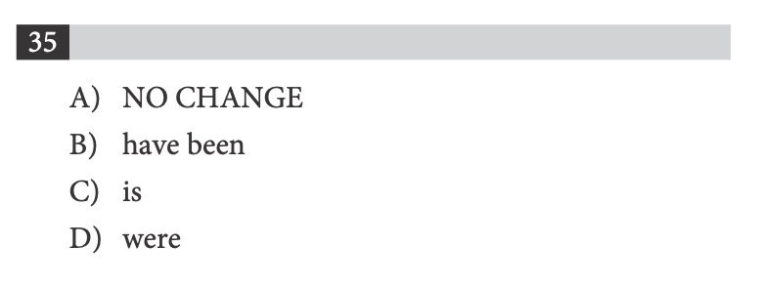
Example Questions
SAT
ACT

Slide 6
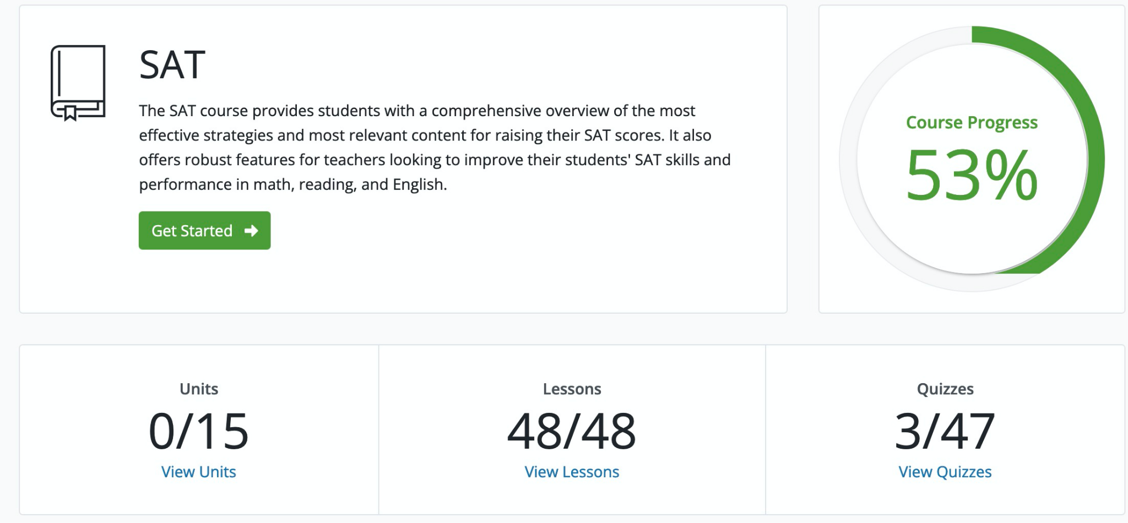
Methodize

Slide 7
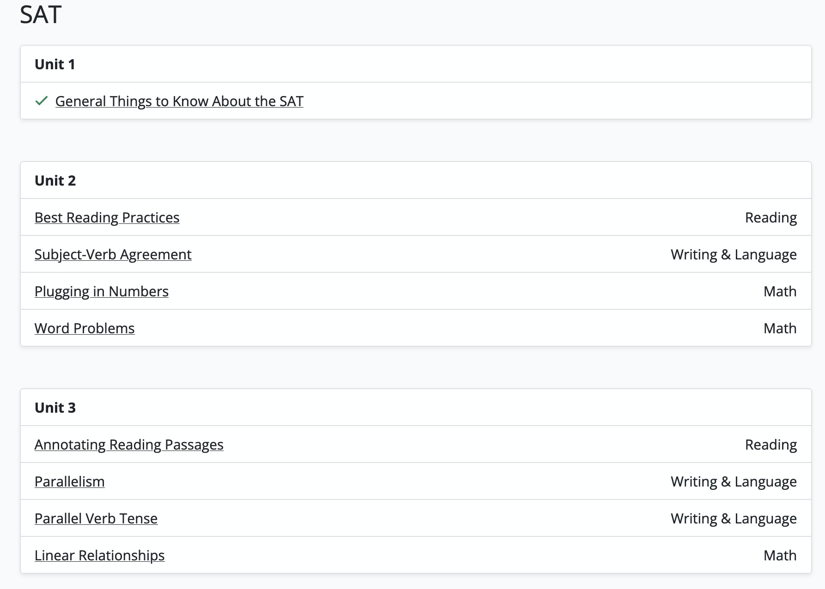
Methodize

Slide 8
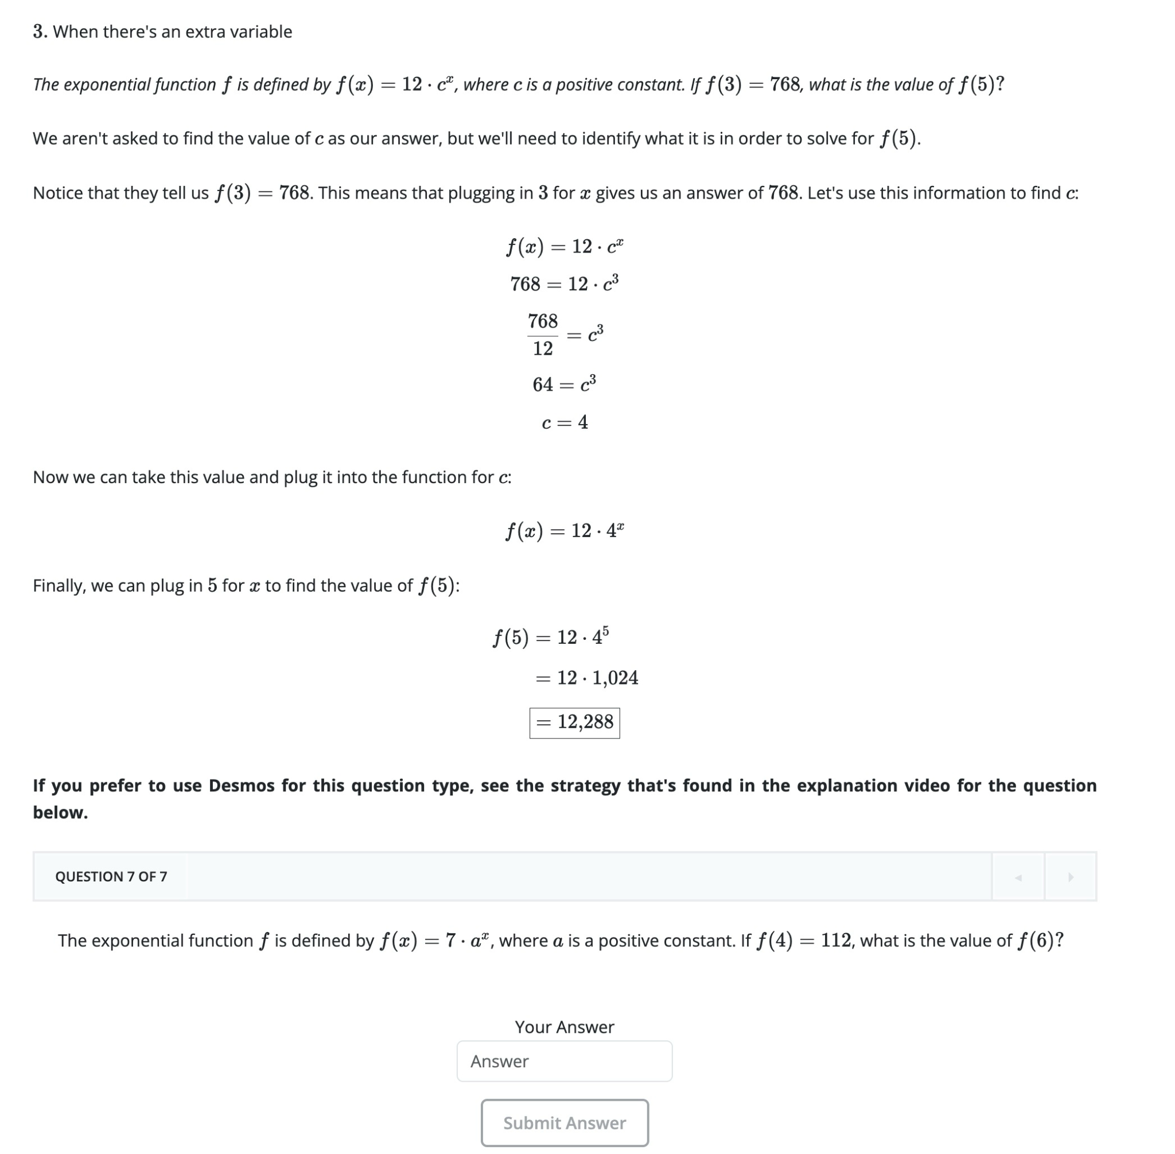
Methodize

Slide 9
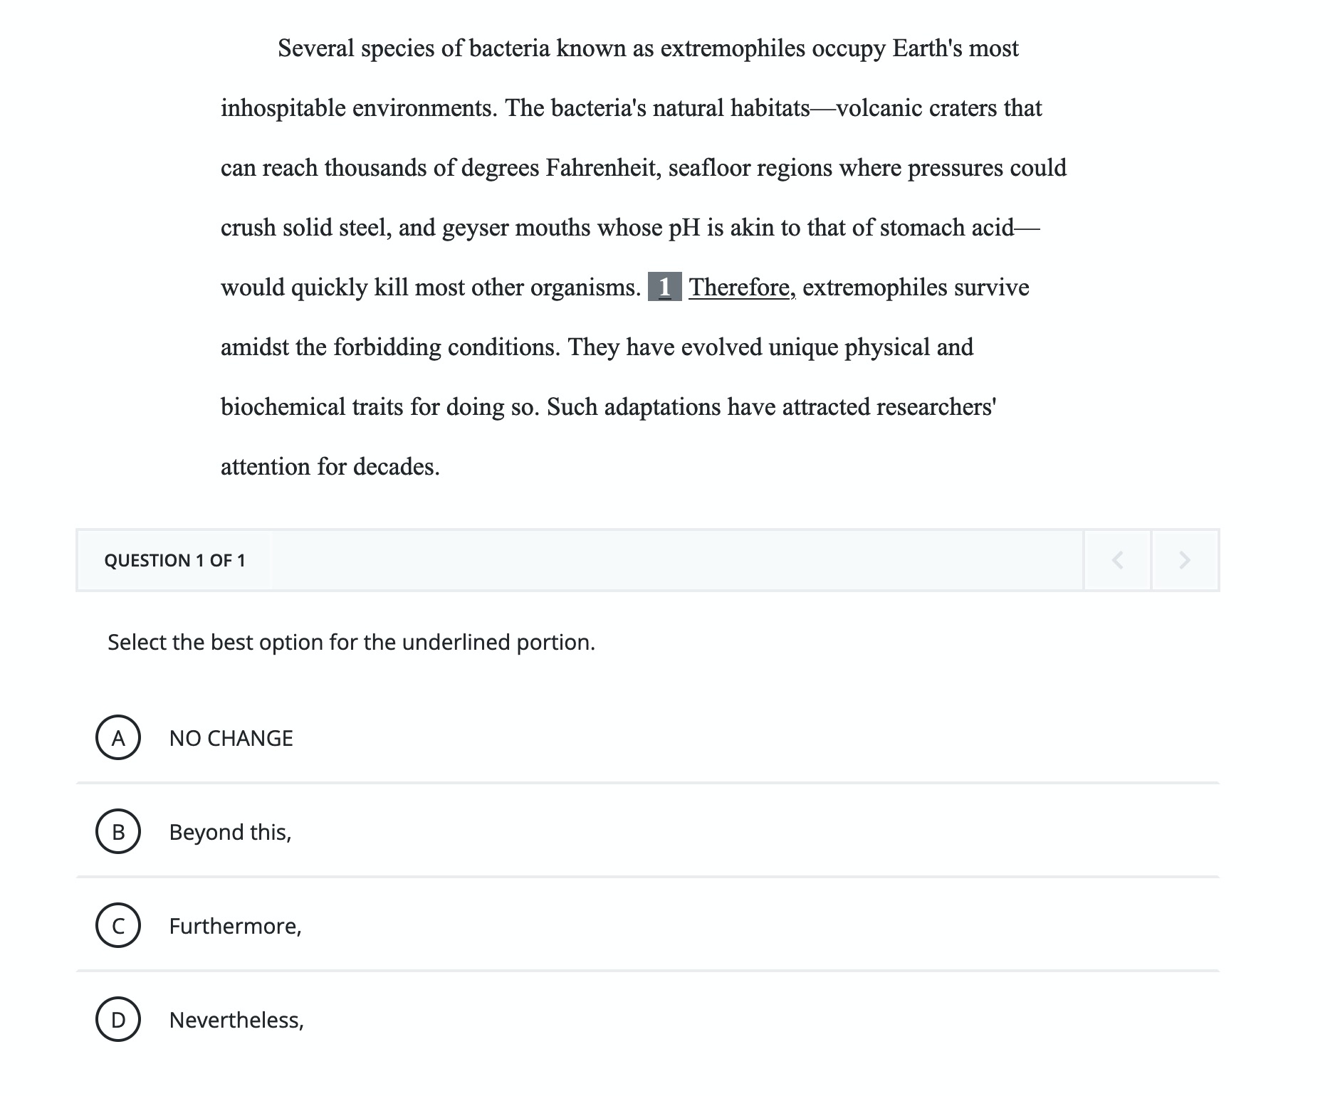
Methodize

Slide 10
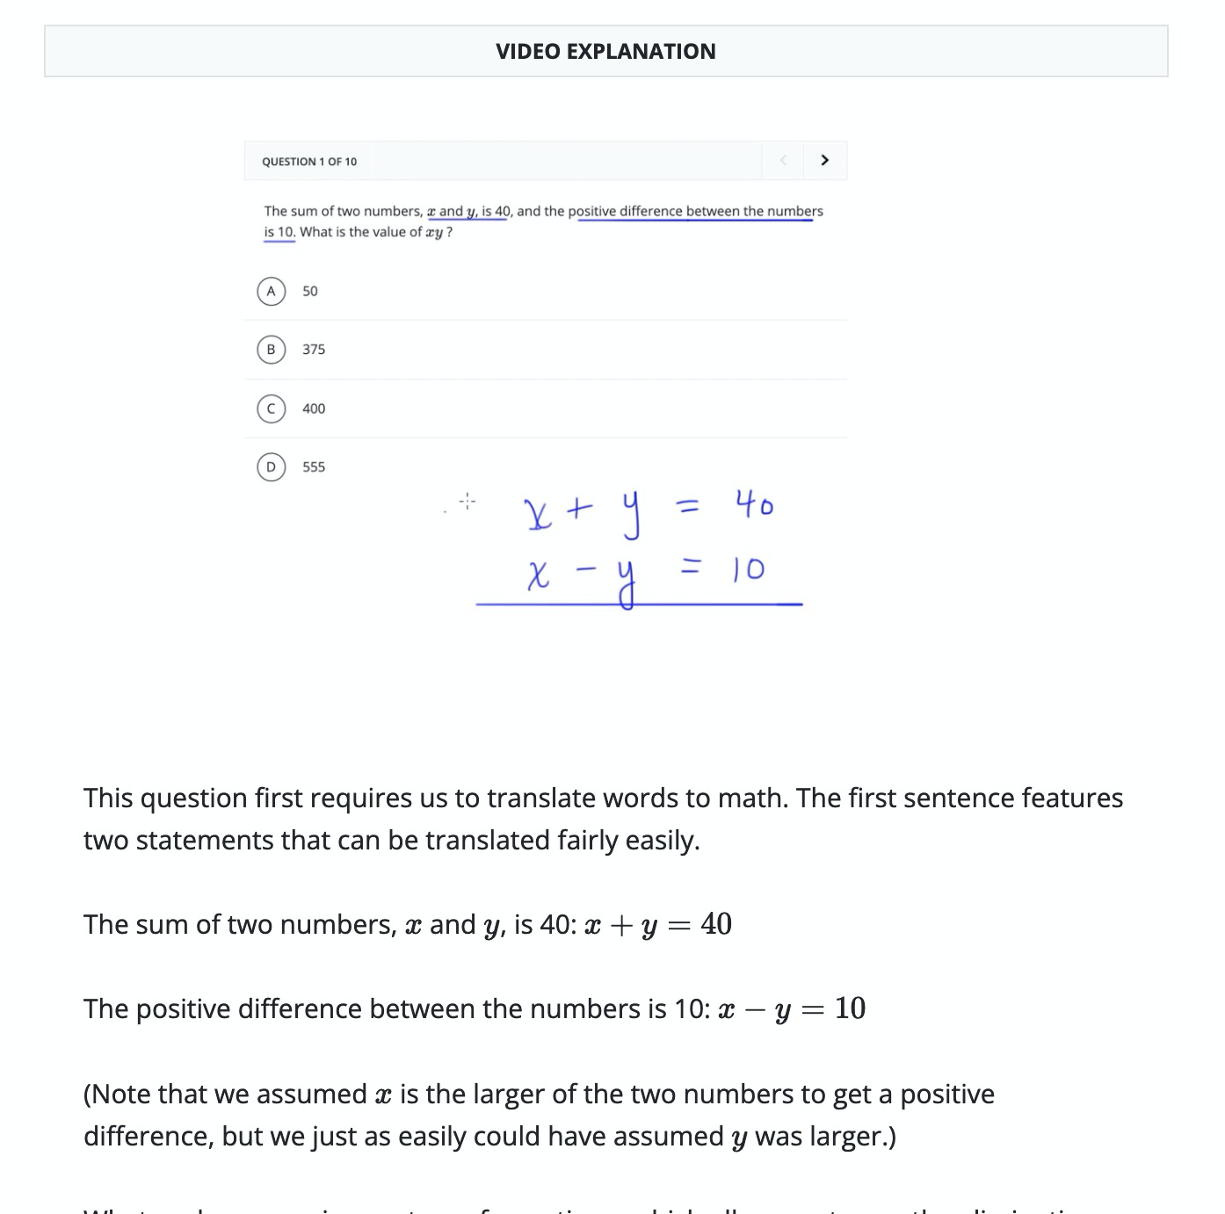
Methodize

Slide 11
Thanks for joining us!
Questions?
evan@methodlearning.com

