Slide 1

Pre-kindergarten Scholarship Program
City of Miami Beach
Family Application
(School Year 2027-2028)
Dr. Leslie Rosenfeld
Chief Education Officer
Education and Performance Initiatives
Maggie Brown
Pre-K Administrator
Education and Performance Initiatives

Slide 2


Slide 3

www.miamibeachfl.gov/prek

Slide 4
Purpose of Informational Session
1. City of Miami Beach Pre-Kindergarten Scholarship Program Overview
2. Family Application and Lottery Process
3. Discuss next steps

Slide 5



Overview of Prekindergarten
Scholarship Program
City funded program will provide a stipend of up to $3000 per school year, to cover up to an additional 450 instructional hours (up to 2.5 hours per day for 180 days)
Can be applied toward educational programming occurring during regular school hours, not after-school hours
Funding will cover 192 Miami Beach resident children, chosen through a lottery of eligible applicants

Slide 6
Miami Beach Child Eligibility for 2027-2028
Families who live in the City of Miami Beach and who have a child(ren) who is 4 years old on or before Sept. 1, 2027
Children born between February 2, 2022 and September 1, 2023 are eligible to participate
Child must be enrolling in PreK for the 2027-2028 academic school year

Slide 7
Proof of City of Miami Beach Residency
One Parent/Guardian must be a resident of the City of Miami Beach upon submission of the application and throughout the 2027-2028 school year
Verification documents will be required when applying
  Valid Photo ID issued by local state (Driver’s license) OR
  Valid Florida vehicle registration, listing the applicants Miami Beach residential address AND
  A monthly bill/statement with the resident's name and address that has been mailed within the last 30 days

Slide 8
Child Proof of Age
One of the following verification documents:
Birth certificate
Certificate of baptism or other religious record of the child’s birth
An insurance policy on the child’s life that has been in force for at least two years
A passport or certificate of the child’s arrival in the United States
An immunization record signed by a physician
A valid military-dependent identification card

Slide 9
Application process
If your preferred PreK Provider is not listed, please reach out to them to apply
Submission deadline is November 30, 2026
Eligible applicants (residency, child age) will be placed in the lottery that takes place on December 4, 2026
Following verification of required documents, enrollment with the selected provider and a signed agreement between the family and provider is required
(Admission by PreK provider is a separate process from the City PreK lottery)

Slide 10
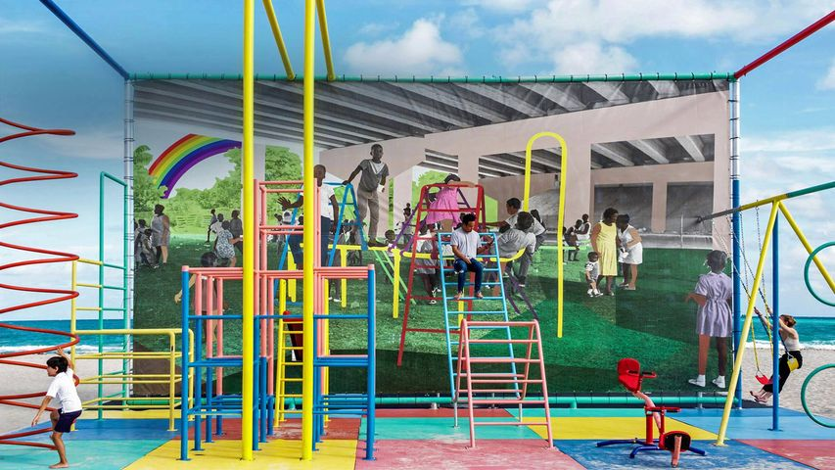
www.miamibeachfl.gov/prek

Slide 12
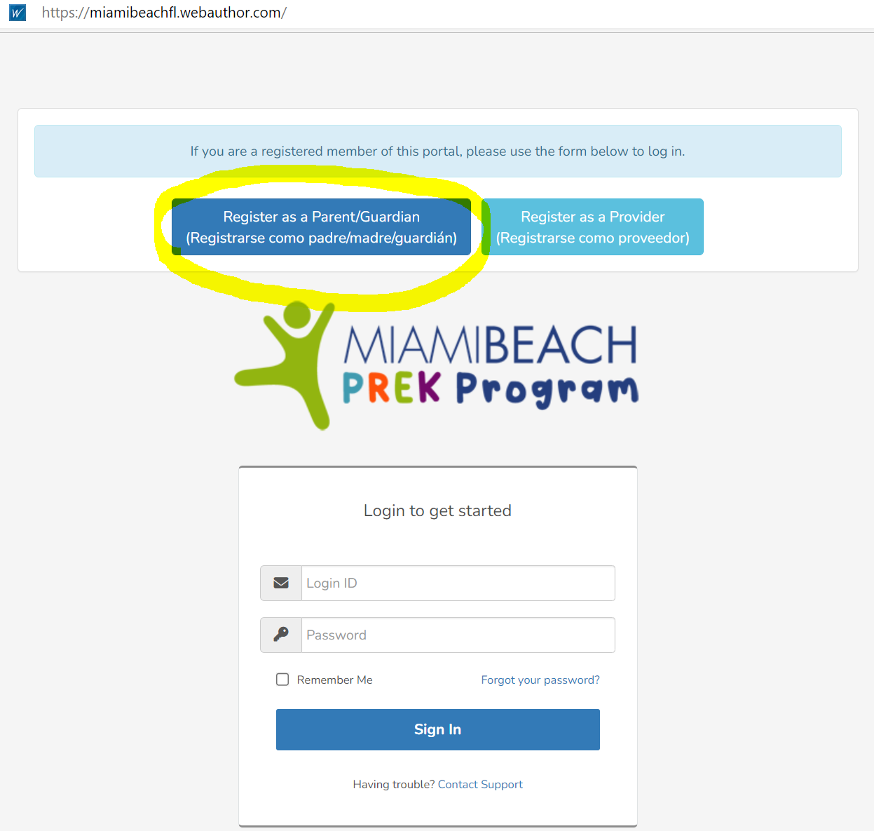

Slide 13
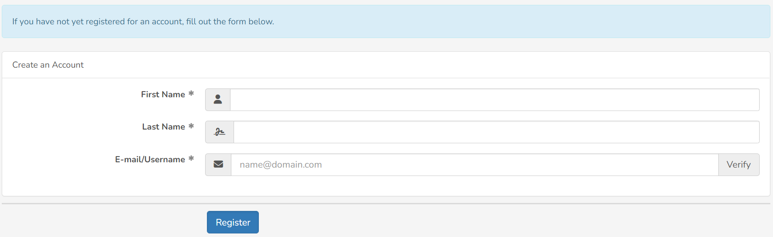


Slide 15
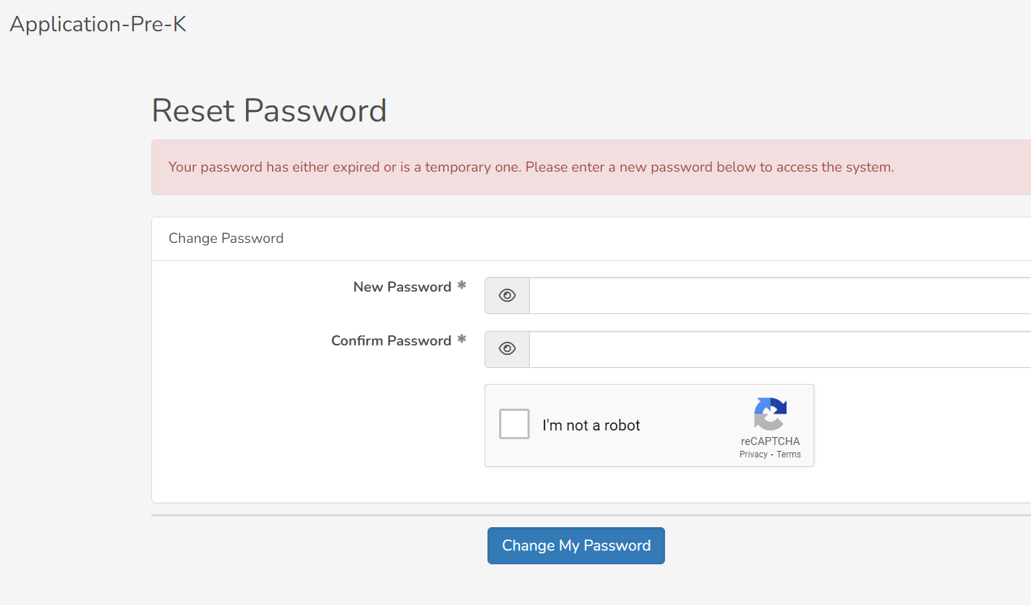
Notes:
Si ha presentado una solicitud en el pasado pero olvidó su contraseña, simplemente haga clic en el botón "olvidé mi contraseña", le enviará un enlace a su correo electrónico y lo dirigirá a esta página donde puede crear una nueva contraseña.

Slide 16
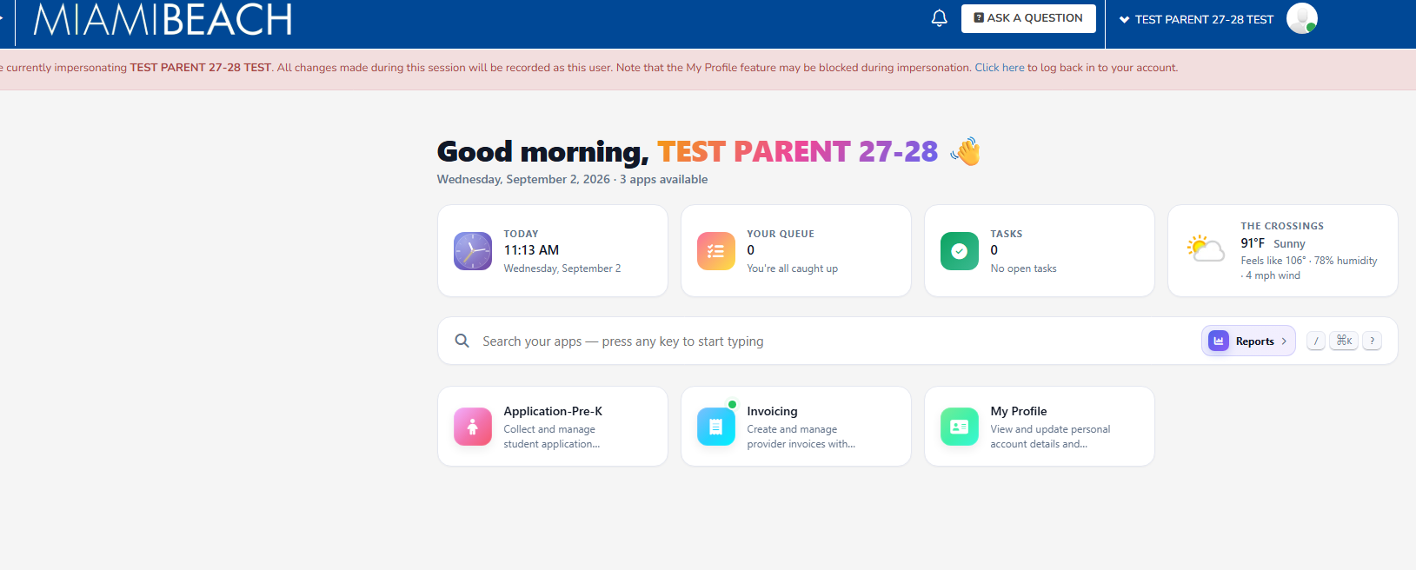

CLICK HERE TO COMPLETE APPLICATION

Slide 17
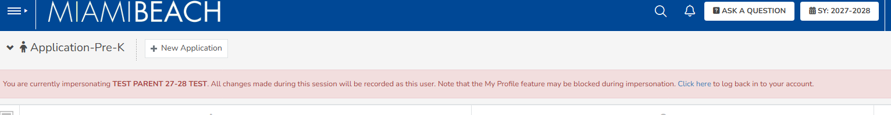
Select SY: 2027 – 2028

Slide 18
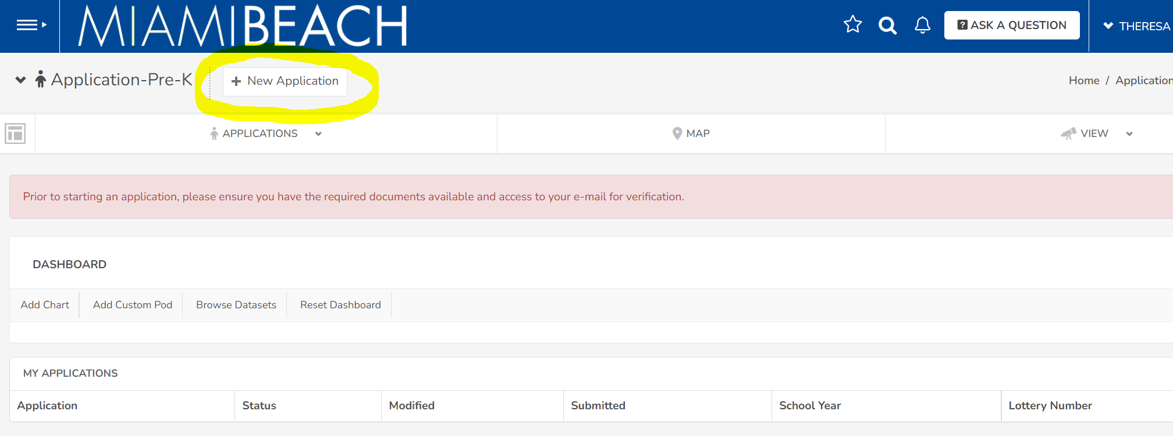

Slide 19
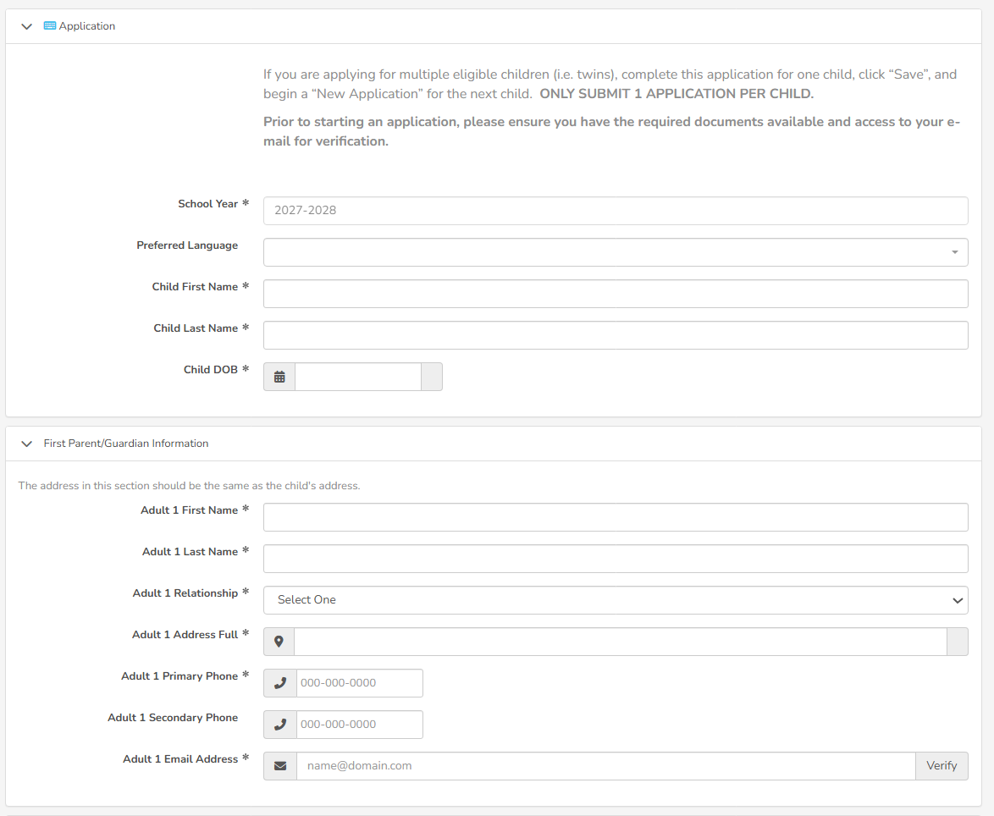

Slide 20
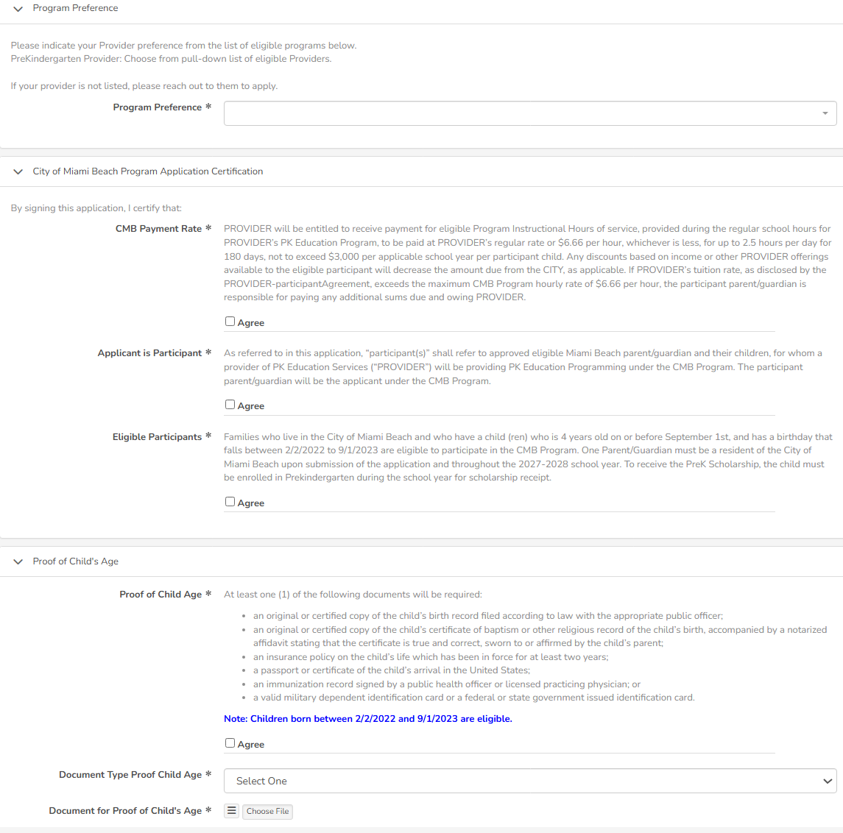

Slide 21
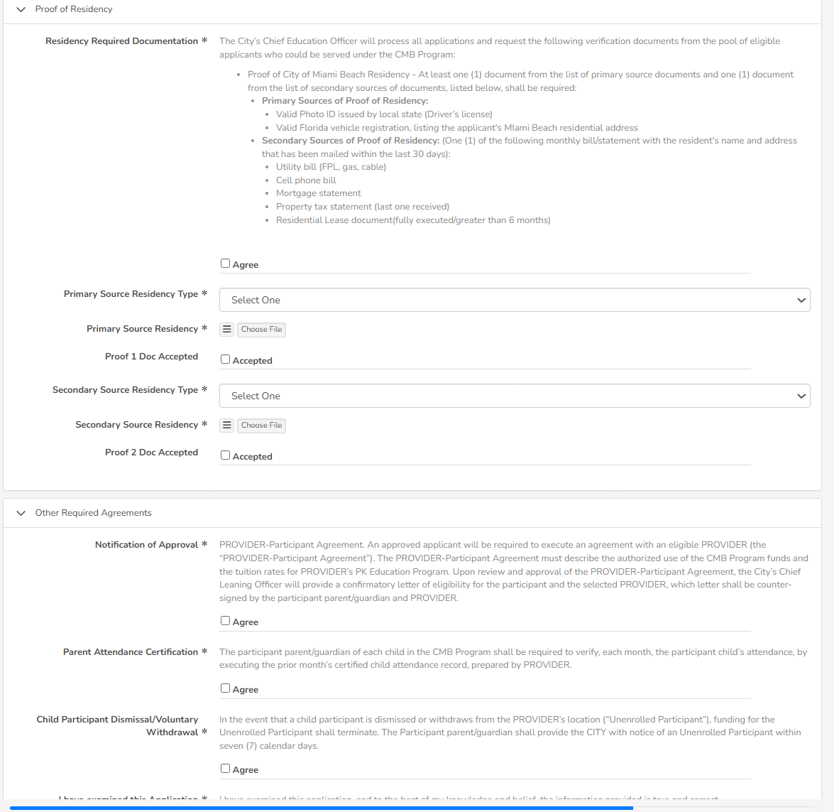

Slide 22
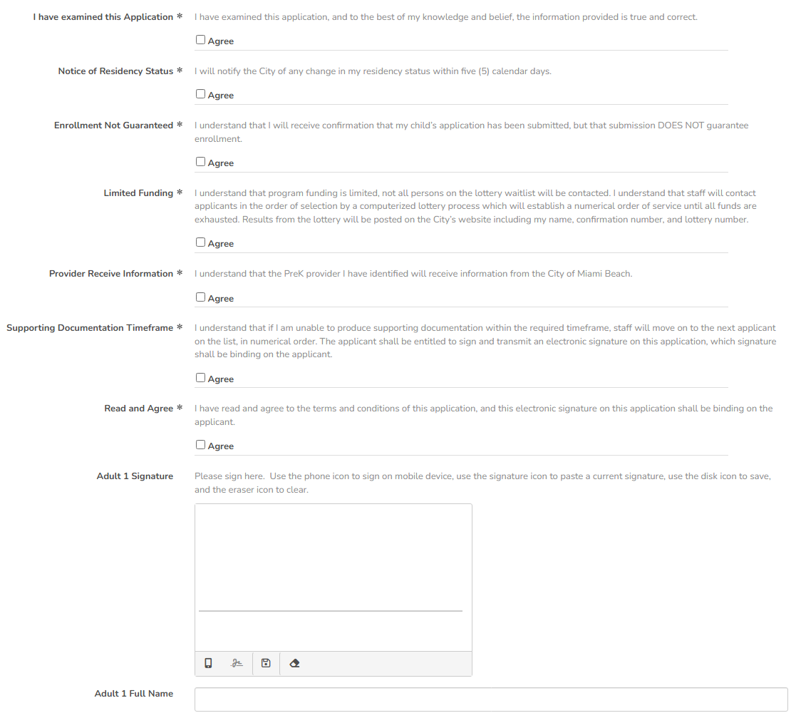

Slide 23
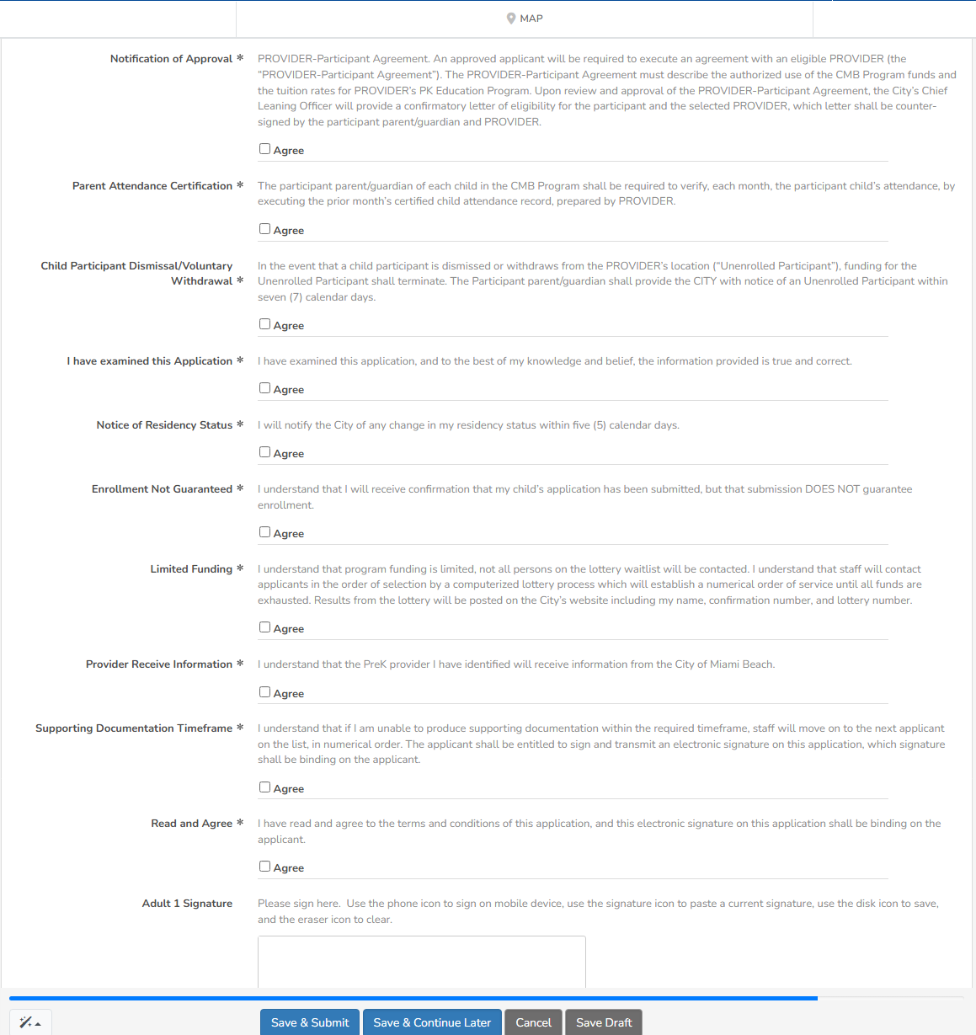
Please note: You must click “Save & Submit” so that your application can be reviewed and added to the lottery. If you select “Save Draft”, your application is NOT submitted and will not be reviewed.

Slide 24
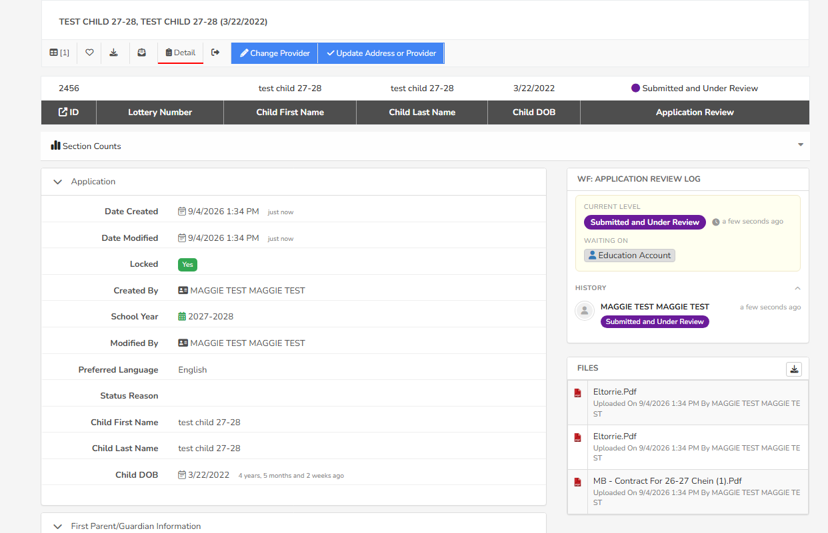


Slide 25
City of Miami Beach PreK Application Email Confirmation

Slide 26
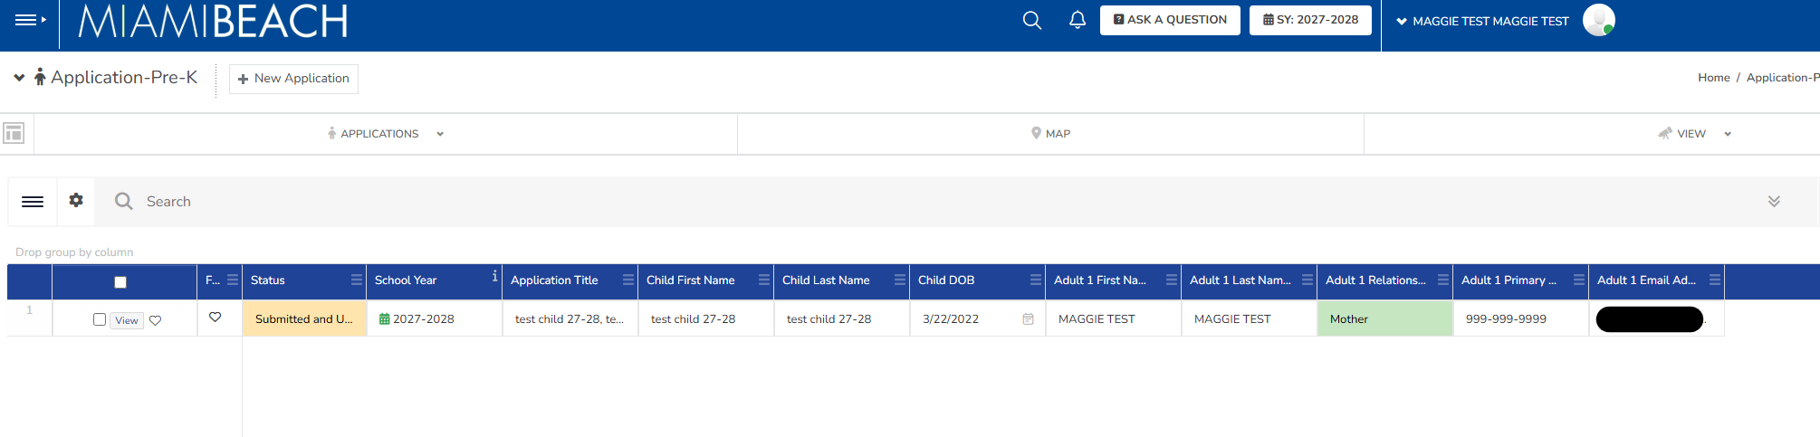
To view your application, click View-Applications

Slide 27
Last day for Family Applications November 30, 2026
www.miamibeachfl.gov/prek
Lottery December 4, 2026
Dec.2026
Aug. 2026
Jan. 2027
Family/ provider executed Confirmatory Letter due to CMB
Prekindergarten Providers informational sessions scheduled
Application for Providers available
www.miamibeachfl.gov/prek
Miami Beach Family
informational sessions scheduled
Provider Invoicing Session Sept 1st Oct 1
Application for Families available on September 10, 2026
www.miamibeachfl.gov/prek
Provider Student Enrollment Info Session
December 11, 2026
Notification to Families and public posting
Notification to Provider of MB family selection

Slide 28
Lottery Process
Program funding is limited, not all persons on the lottery waitlist will be contacted
Staff will contact applicants in the order of selection by a computerized lottery process which will establish a numerical order of service until all funds are exhausted
Results from the lottery will be posted on the City’s website including parent/guardian name, confirmation number, and lottery number

Slide 29
Provider Payment
Providers will be paid at their regular rate or $6.66 per hour, whichever is less, for up to 2.5 hours per day for 180 days, not to exceed $3000 per applicable school year per participant child
Any discounts based on income or other Provider offerings will decrease the amount due from the City
If the amount exceeds the City allowed $6.66/hr, the parent/guardian is responsible for any additional funds owed

Slide 30
Apply: www.miamibeachfl.gov/prek
Email us: education@miamibeachfl.gov

Slide 31
Q & A
Education and Performance Initiative

