Slide 1

City of Miami Beach
PreK Scholarship Program
Provider Information Session
Dr. Leslie Rosenfeld
Chief Education Officer
Education and Performance Initiatives
Maggie Brown
Pre-K Administrator
Education and Performance Initiatives

Slide 2
Purpose of Informational Session
1. City of Miami Beach Pre-Kindergarten Program Overview
2. Provider Application Process (2027-2028)
3. Discuss next steps

Slide 3



Overview of Prekindergarten
Scholarship Program
Funds for the Prekindergarten Scholarship Program are to expand hourly access to prekindergarten for four-year old students by increasing the availability of high-quality prekindergarten placements for Miami Beach children
Builds on the foundation established by the State of Florida’s investment in prekindergarten across the state
State funded program currently provides three (3) hours of VPK services for 180 school days

Slide 4
Overview of Prekindergarten Scholarship Program
Current State funded VPK participants requesting additional 2.5 hours (full-day) pay between $4.80 and $6.00 per hour in public Miami-Dade schools
 | Number of Hours | Hourly Cost | 180 School Days
Florida VPK | 3 | $4.58 | $2,473.20
Public fee-supported pre-K | 2.5 | $6.66 | $3,000.00
Public fee-supported pre-K (free or reduced lunch) | 2.5 | $4.80 | $2,160.00

Slide 5
Payment Rate
City will provide funding to Provider monthly at Provider’s regular rate or $6.66 per hour, whichever is less, for up to 2.5 hours per day for up to180 days, not to exceed $3000.00 in 26-27 school year
Any discounts based on income or other Provider offerings available to the eligible participant will decrease the amount due from the CITY, as applicable

Slide 6
City of Miami Beach Funding
City of Miami Beach funds may fund the expansion of current half-day State funded licensed voluntary pre-kindergarten programs to full-day options for eligible families
Funding may be used to reduce family contribution for hours not currently funded under the State funded VPK and non-State funded pre-kindergarten programs
Providers may NOT bill families in advance or during the school year for the City of Miami Beach PreK Scholarship Program funding
Providers must provide a signed agreement with families reflecting a tuition reduction noting the City of Miami Beach PreK Scholarship awarded

Slide 7
Continuity of Care Model
Children receiving full-day prekindergarten should remain in the same location throughout the day
The child in the program should keep the same caregiver/teacher throughout the day to help foster a secure attachment with their caregiver/teacher

Slide 8

www.miamibeachfl.gov/prek

Slide 9
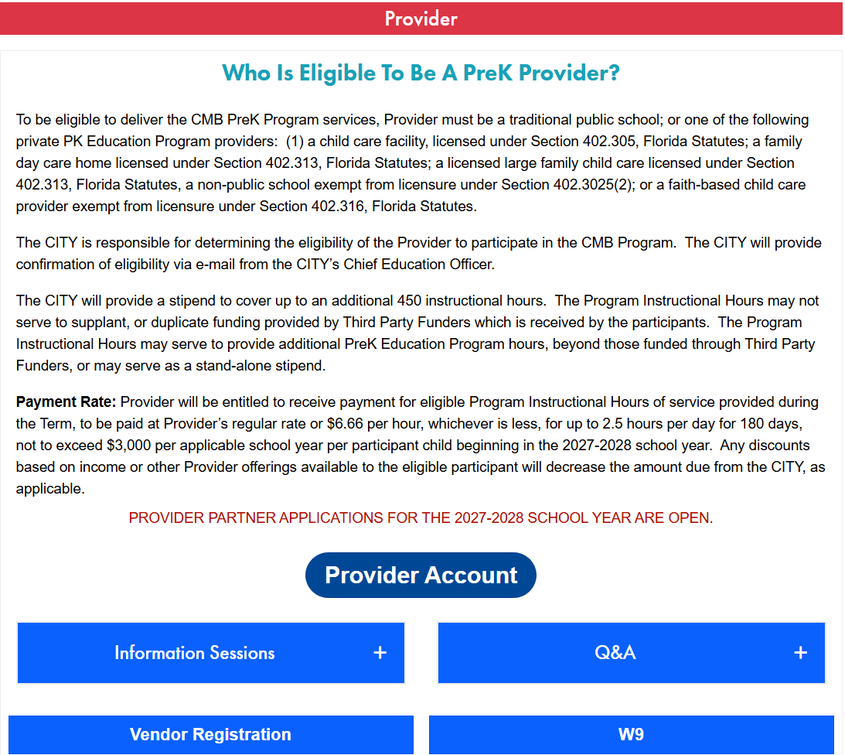

Slide 10
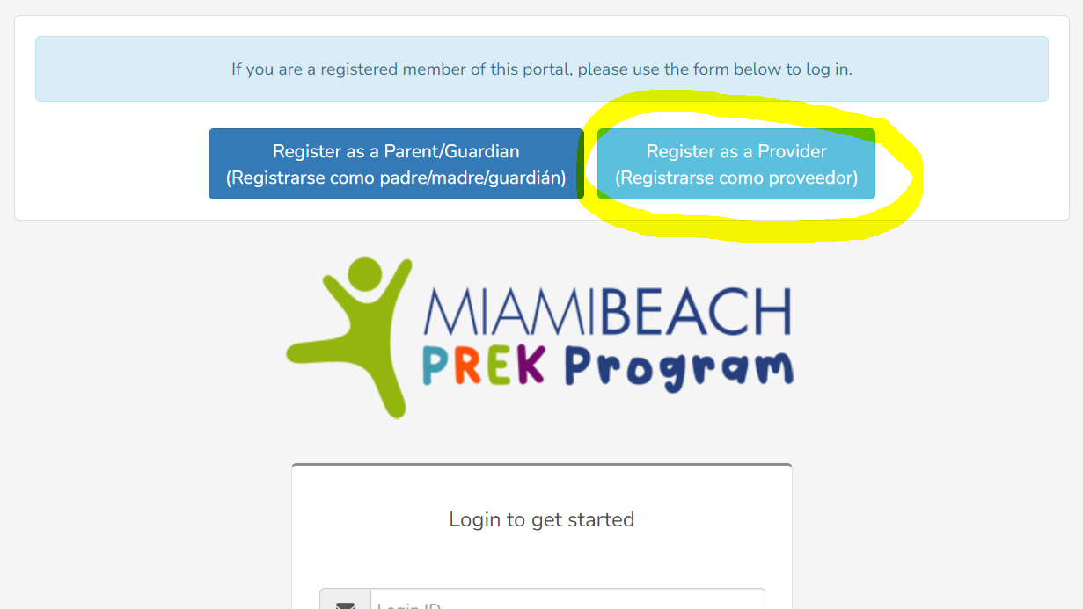

Slide 11
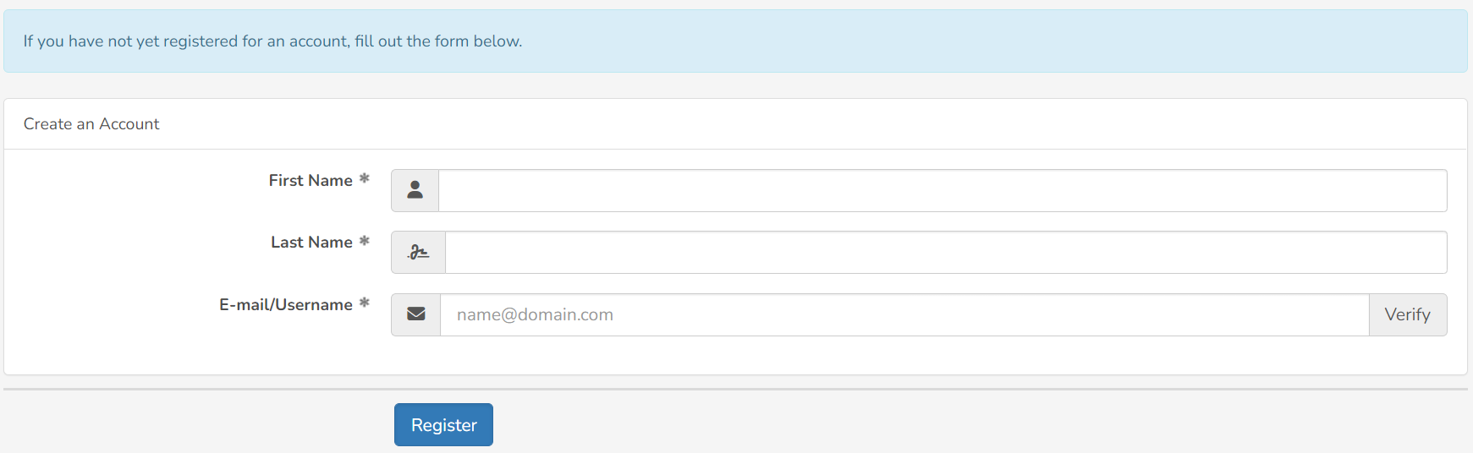


Slide 12
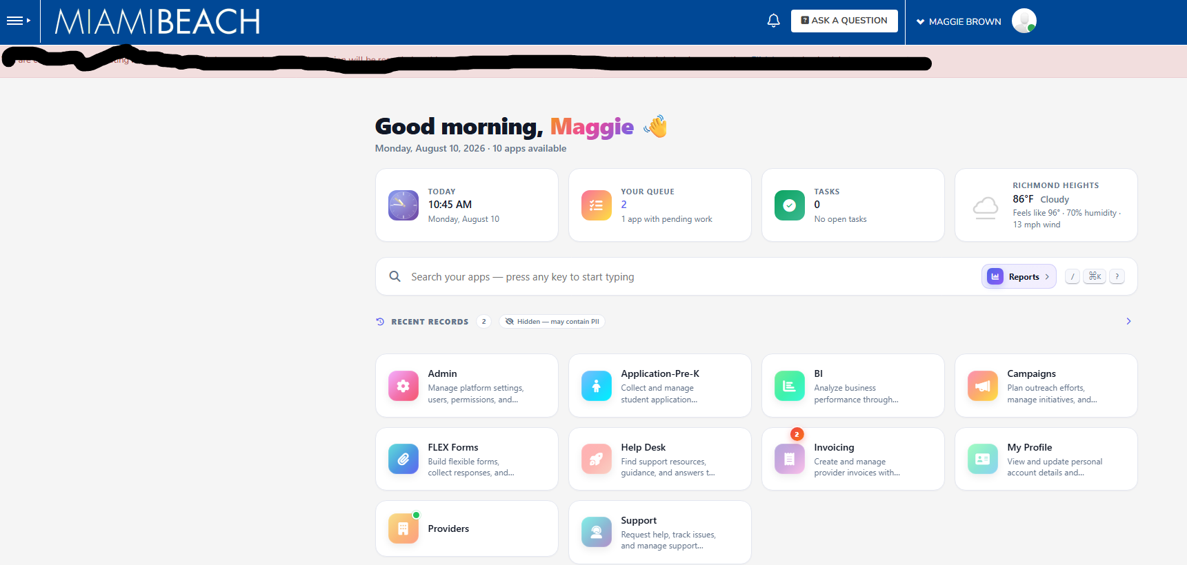
Provider Dashboard
Submit invoices here
Submit provider application here

Slide 13
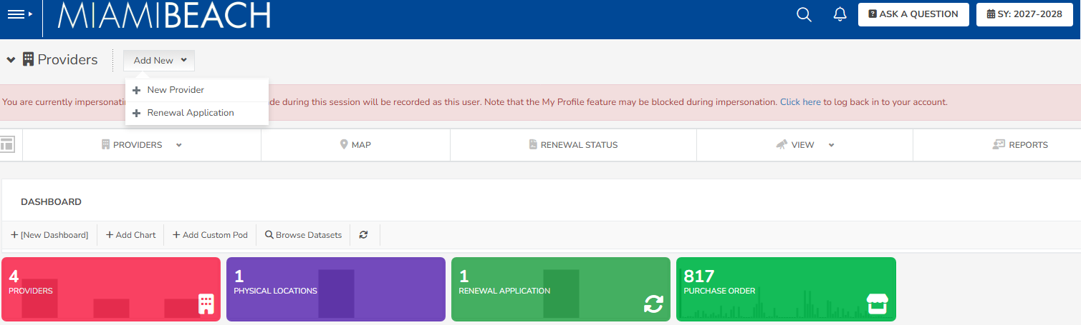
Select Renewal Application
Select School Year 2027-2028

Slide 14
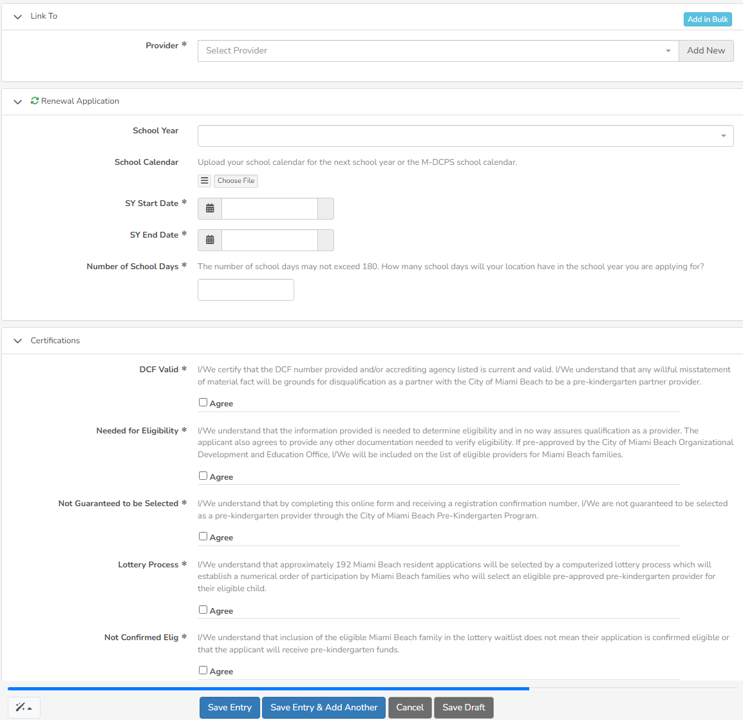
Select Save Entry

Slide 15
Once you’ve applied. . .
We’ll review and process your application. Once approved you’ll receive a link to the PreK Provider contract via DocuSign
Submit a copy of the tuition agreement with the PreK Family being awarded reflecting the City’s PreK scholarship as a line item that reduces parental tuition contribution to be uploaded into the PreK Portal

Slide 16
Last day for Family Applications November 30, 2026
www.miamibeachfl.gov/prek
Lottery December 4, 2026
Dec.2026
Aug. 2026
Jan. 2027
Family/ provider executed Confirmatory Letter due to CMB
Prekindergarten Providers informational sessions scheduled
Application for Providers available
www.miamibeachfl.gov/prek
Miami Beach Family
informational sessions scheduled
Provider Invoicing Session Sept 1st Oct 1
Application for Families available on September 10, 2026
www.miamibeachfl.gov/prek
Provider Student Enrollment Info Session
December 11, 2026
Notification to Families and public posting
Notification to Provider of MB family selection

Slide 17
Apply: www.miamibeachfl.gov/prek
Email us: education@miamibeachfl.gov

Slide 18
Q & A
Education and Performance Initiative

