Slide 1

City of Miami Beach
PreK Scholarship
Provider Invoicing
Dr. Leslie Rosenfeld
Chief Education Officer
Education and Performance Initiatives
Maggie Brown
Pre-K Administrator
Education and Performance Initiatives

Slide 2
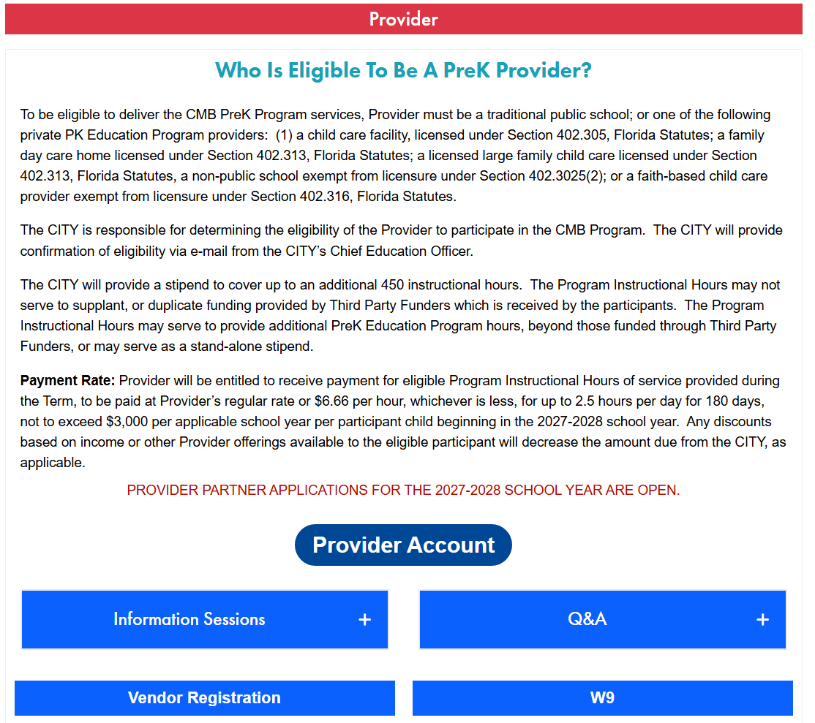

www.miamibeachfl.gov/prek
A copy of this presentation and additional sources can be found here:

Slide 3
How to Create Invoices

Slide 4
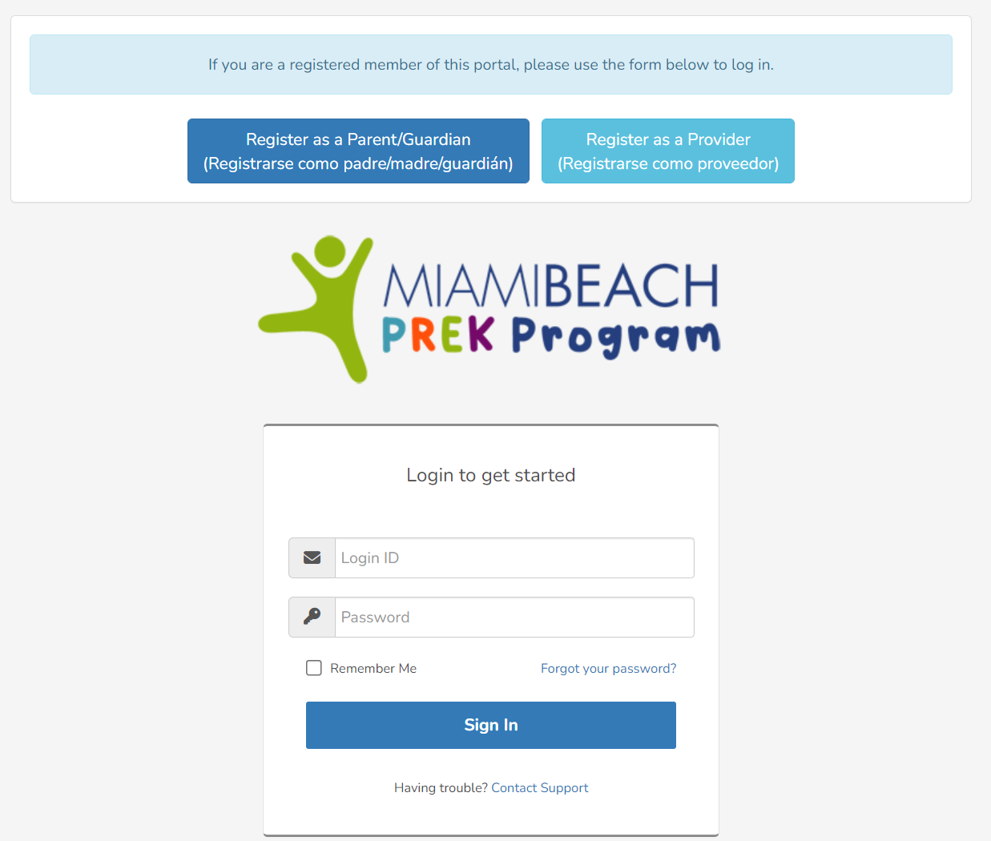
Log Into Your Dashboard
Go to Website https://www.miamibeachfl.gov/prek/
Click “Provider Account”
Enter your Login ID
Enter your Password
Click Sign In

Slide 5
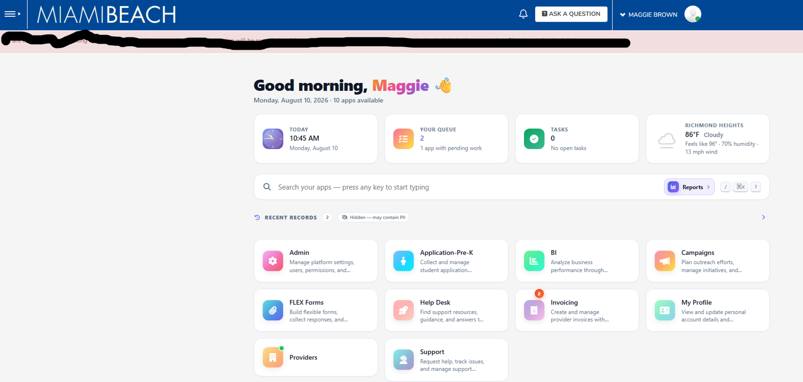
Provider Dashboard
Click Invoicing to generate and submit invoices

Slide 6
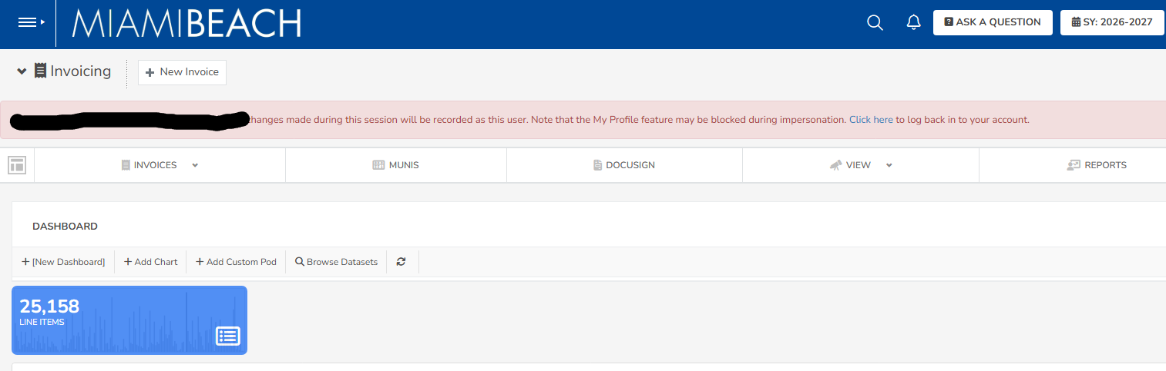
Select the Current School Year
(SY: 2026-2027)

Slide 7
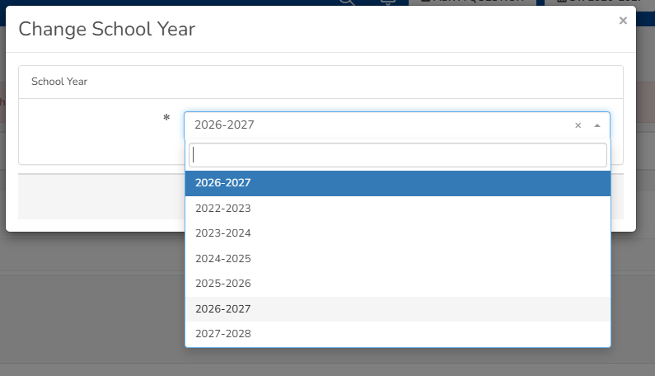

Slide 8
Click “New Invoice”

Slide 9
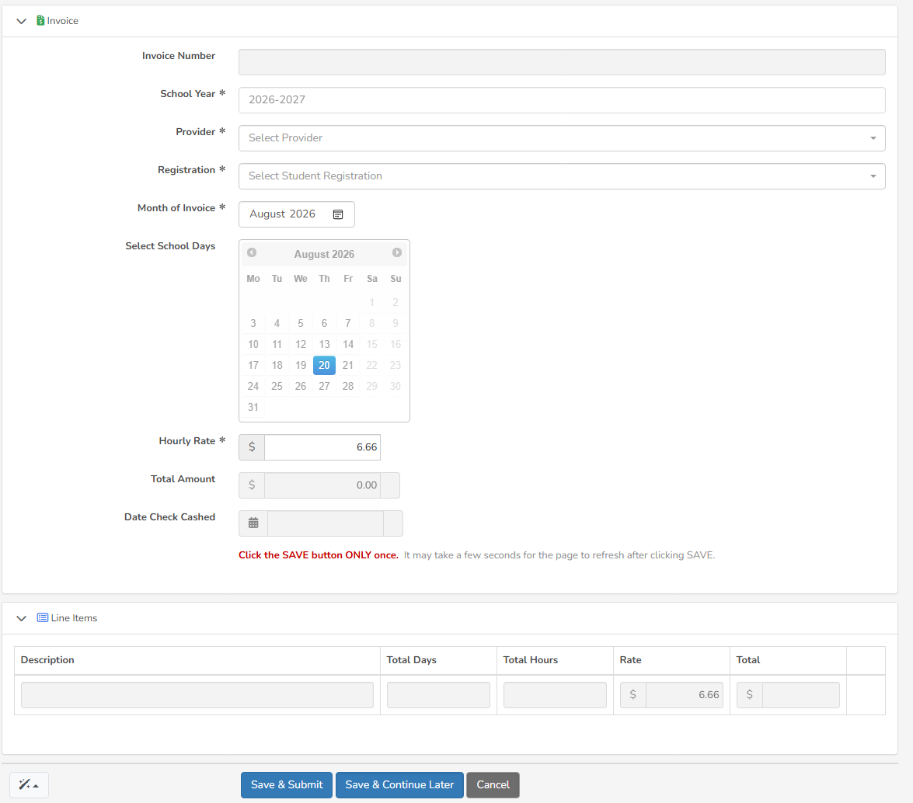
1. Ensure correct school year
2. Select your School as Provider
*Note: You cannot invoice us until the month has concluded
3. Select Student to create invoice for
4. Select the Month of Invoice
5. Select the Dates your school was open to children
6. Enter hourly rate- may not exceed $6.66/hr
*Note: For Hourly Rate you can change to a lower amount but no more than $6.66 per hour
7. Click Save & Submit then can enter other students

Slide 10
What Happens Next!
Once you click Save & Submit the invoice is automatically sent to the parent, provider and program director for signatures via DocuSign.
Providers, please inform parents the invoice will be coming to them in DocuSign for signature.
For any assistance please email education@miamibeachfl.gov

Slide 11
Provider Payment
Providers will be paid at their regular rate or $6.66 per hour, whichever is less, for up to 2.5 hours per day for 180 days, not to exceed $3,000 per applicable school year per participant child
Any discounts based on income or other Provider offerings will decrease the amount due from the City
If the amount exceeds the City allowed $6.66/hr, the parent/guardian is responsible for any additional funds owed
Providers must submit a tuition agreement for each family to begin invoicing. Agreements can be submitted to Education@miamibeachfl.gov
You may submit an invoice each month, once the month has concluded (on the first day of the following month). At the conclusion of the academic school year, you may invoice the final month on the last day of school

Slide 12

www.miamibeachfl.gov/prek

